Slide 1
SHINGLES

Slide 2
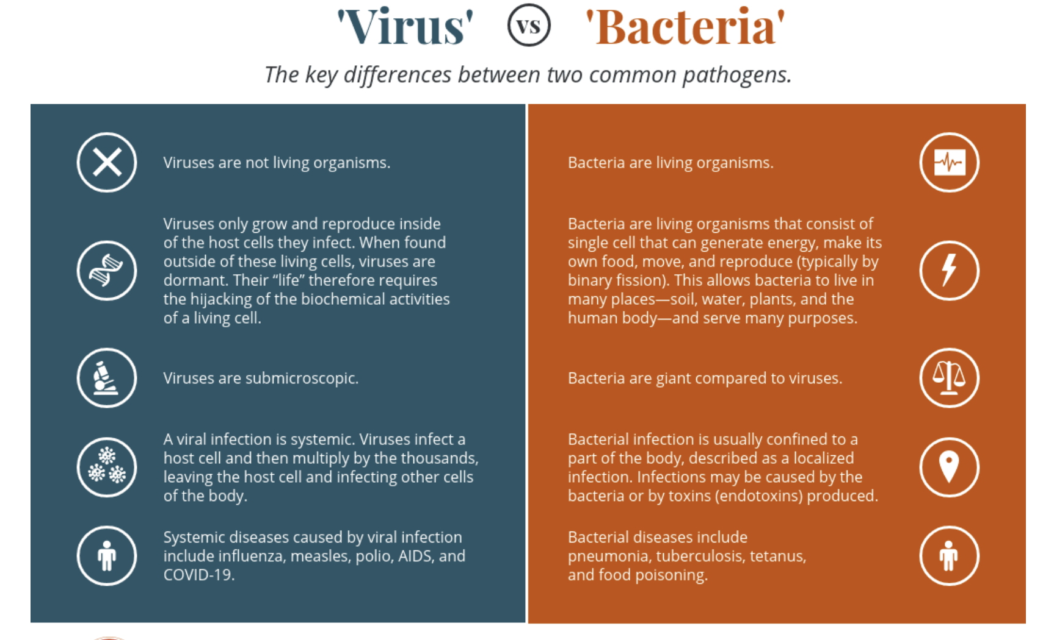

Slide 3
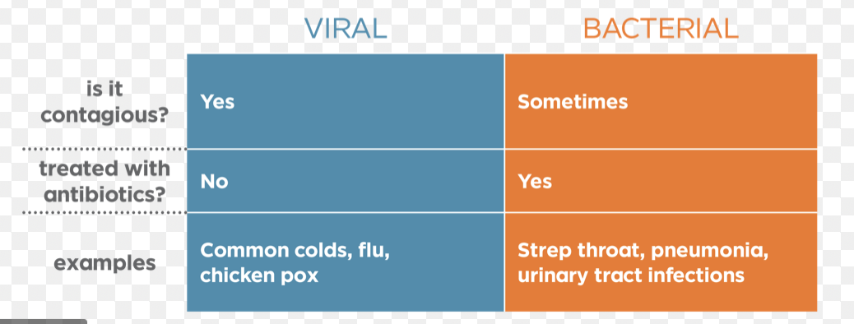

Slide 4
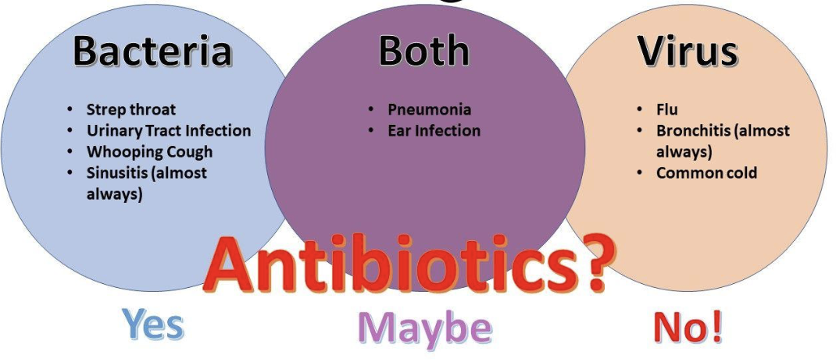

Slide 5
The Varicella-zoster virus (VZV) or human herpes virus 3 is the causative agent for both chickenpox/varicella and shingles/Herpes zoster (HZ).
HZ represents a reactivation of VZV in the host
variable clinical presentations,
HZ complications are potentially life-threatening.
HZ reactivation has been reported as a possible adverse event after COVID-19 vaccination.
Treatment options and prevention by vaccination are of clinical importance.

Slide 6
a person with the VZV may develop chickenpox, highly contagious.
after these symptoms go away, the virus stays latent in the body in nerves
later, it can reactivate as herpes zoster, which is the medical name for shingles.

Slide 7
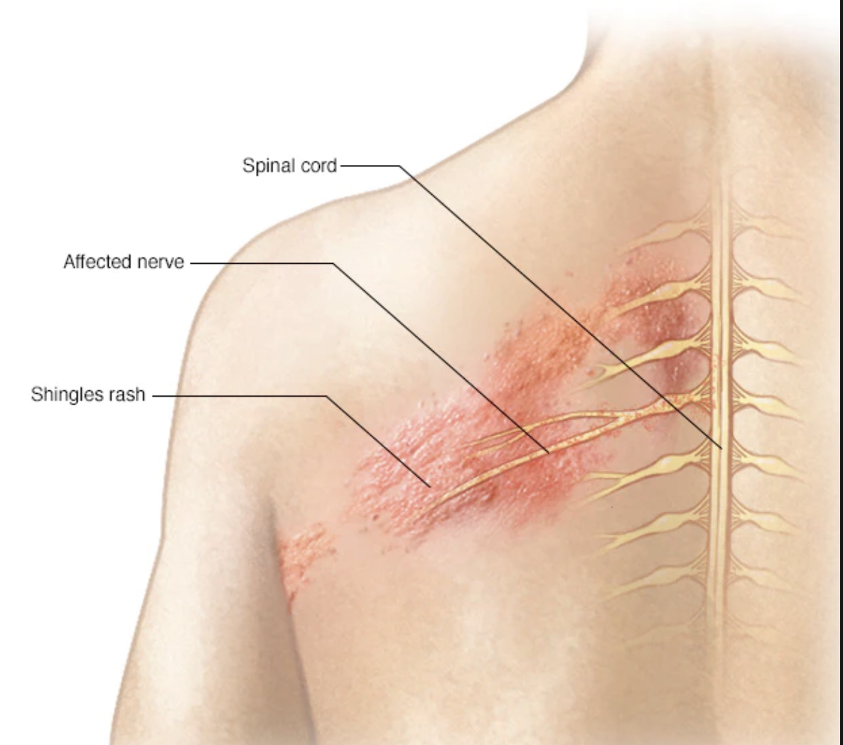

Slide 8
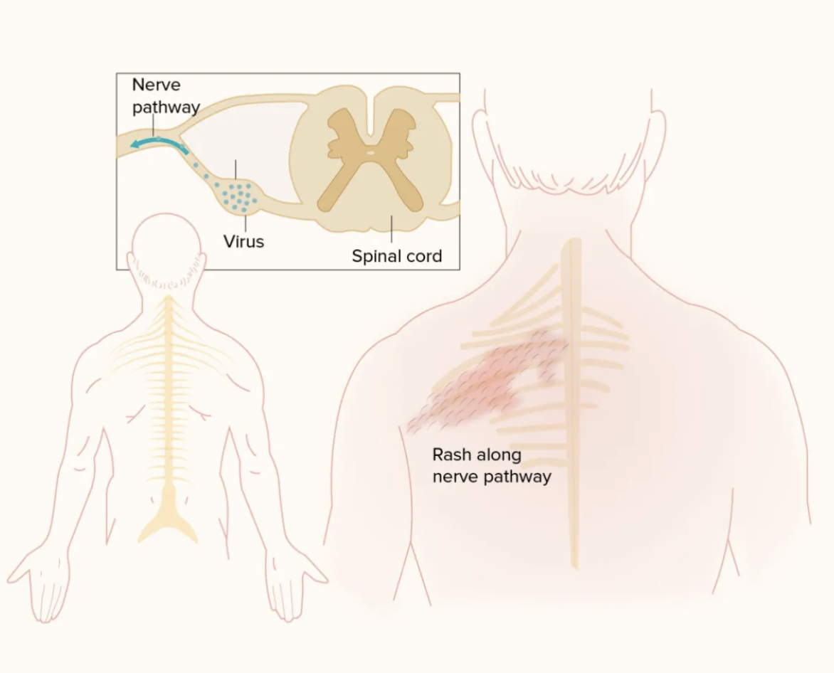

Slide 9
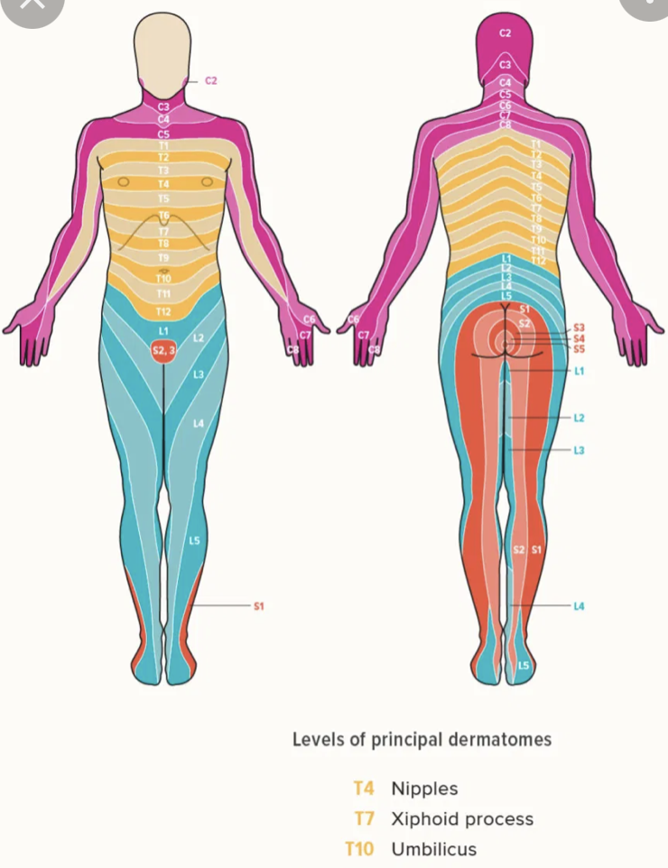
Dermatomes
A dermatome is an area of skin that is mainly supplied by a single spinal nerve

Slide 10
Triggers to reactivation of Varicelle-Zoster
Emotional stress
Use of medications (immunosuppressants)
Acute or chronic illness
Exposure to the virus
Presence of a malignancy

Slide 11
Can it spread ?
the VZV in a person with shingles spreads via contact with the fluid or pus from the blisters.
people who comes into contact with this, may develop chickenpox if they have never had it, and may later develop shingles
VZV in a person with shingles can transmit via coughing and sneezing only if blisters have developed in the person’s oral cavity.

Slide 12
Risk Factors
age > 50 years,
immunosuppression
infections
mental stress
female gender
diabetes

Slide 13
Stage 1: Pre-eruptive
burning pain in a specific dermatome x 2 days pre-rash
+/- headaches, malaise, photophobia (intolerance of light)

Slide 14
Stage 2: Eruptive (Rash)
Multiple painful vesicles
May appear in 1-3 crops overt 3-5 days
Vesicles may burst, ulcerate and dry out
This is the most contagious phase
Eruptive phase may last 2-4 weeks
Pain may last longer
Most commonly develops as a stripe of blisters that wraps around either the left or right side of the torso, in a single dermatome
Sometimes occurs around one eye or on one side of the neck or face.

Slide 15
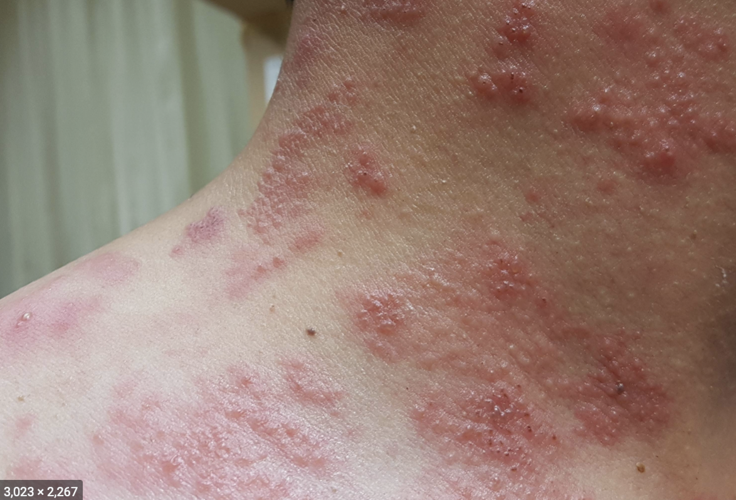

Slide 16
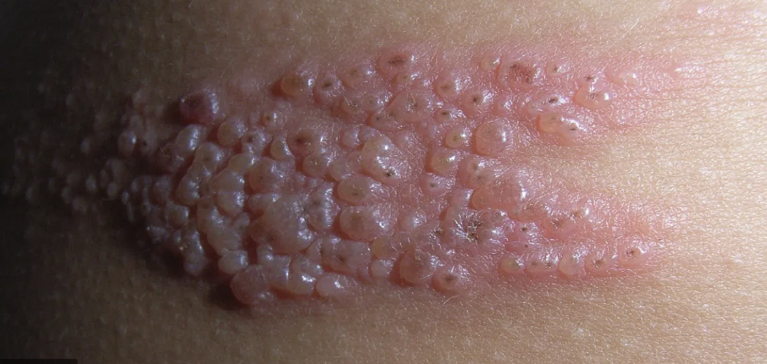

Slide 17
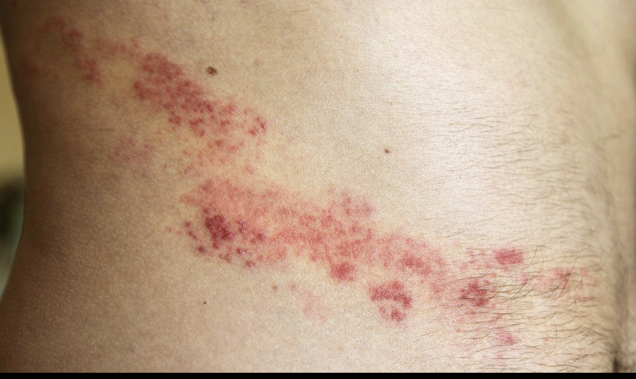

Slide 18
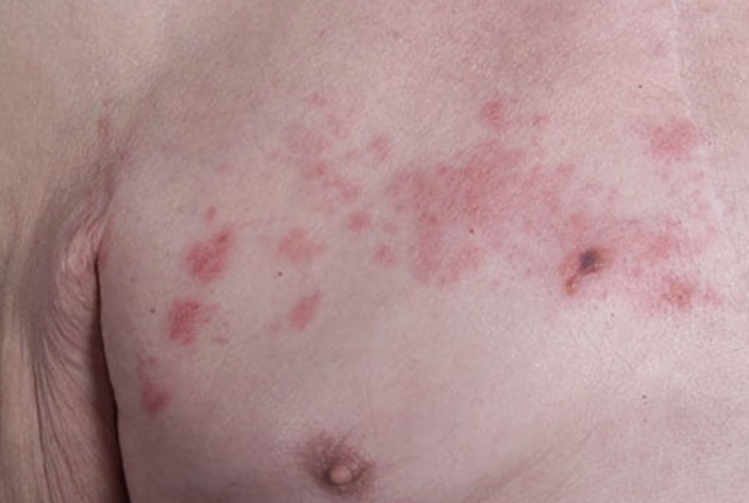

Slide 19
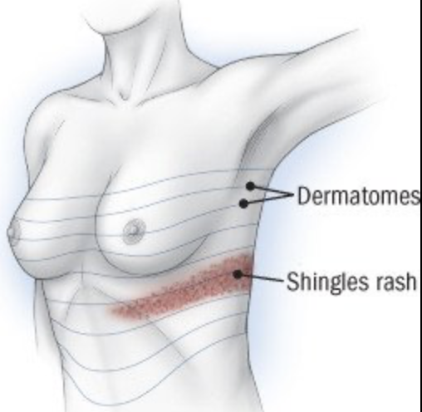

Slide 20
Stage 3: Chronic HZ Infection
severe pain that lasts > 4 weeks.
altered sensation (pins and needles / shock-like sensations)
pain may be disabling
pain may last several months

Slide 21
symptoms
pain, burning or tingling
sensitivity to touch
red rash that begins a few days after the pain
fluid-filled blisters that break open and crust over
itching
Less common
fever
headache
sensitivity to light
fatigue

Slide 22
Herpes Zoster Ophthalmicus (HZO)
the affected nerve is a branch of the trigeminal nerve which supplies sensation to part of the face and eye
50-85% of cases of HZO get eye complications (inflammation / infection / necrosis of various parts of the eye)
there is a risk of blindness
increased risk of getting HZO with
  age >50 years
  Immunosuppression
Patients with HZO have up to x 4 increased risk of stroke

Slide 23
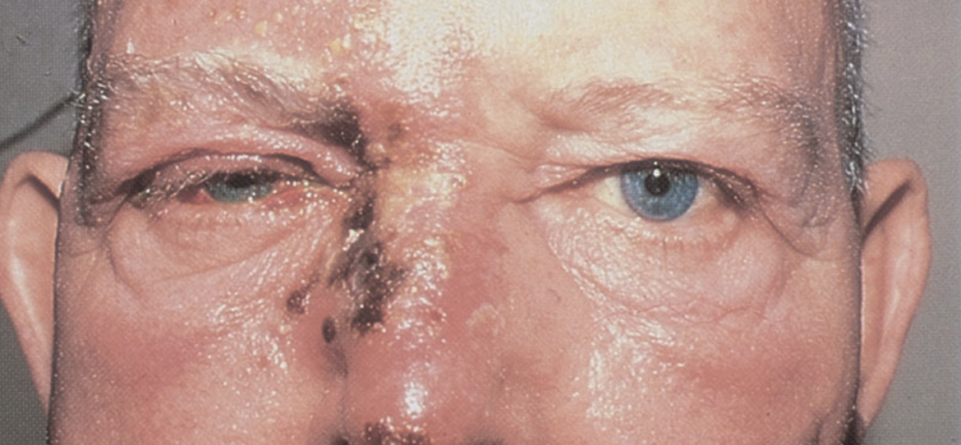

Slide 24
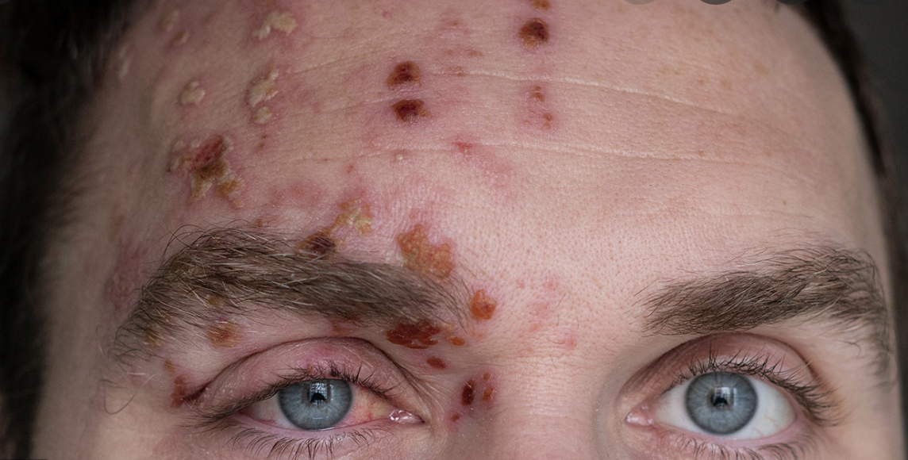

Slide 25
Ramsay Hunt Syndrome
involves a different nerve (the facial nerve)
<1% of all HZ cases
facial palsy
post-herpetic neuralgia common
other nearby nerves may be involved, causing
  dizziness
  altered hearing / tinnitus
  difficulty swallowing
  hoarseness

Slide 26
Facial (Bell’s ) Palsy
weakness or paralysis on one side of face
facial droop
difficulty making facial expressions, (closing eye / smiling)
drooling
pain around the jaw or in or behind your ear
increased sensitivity to sound on that side
headache
loss of taste
changes in amount of tears and saliva

Slide 27
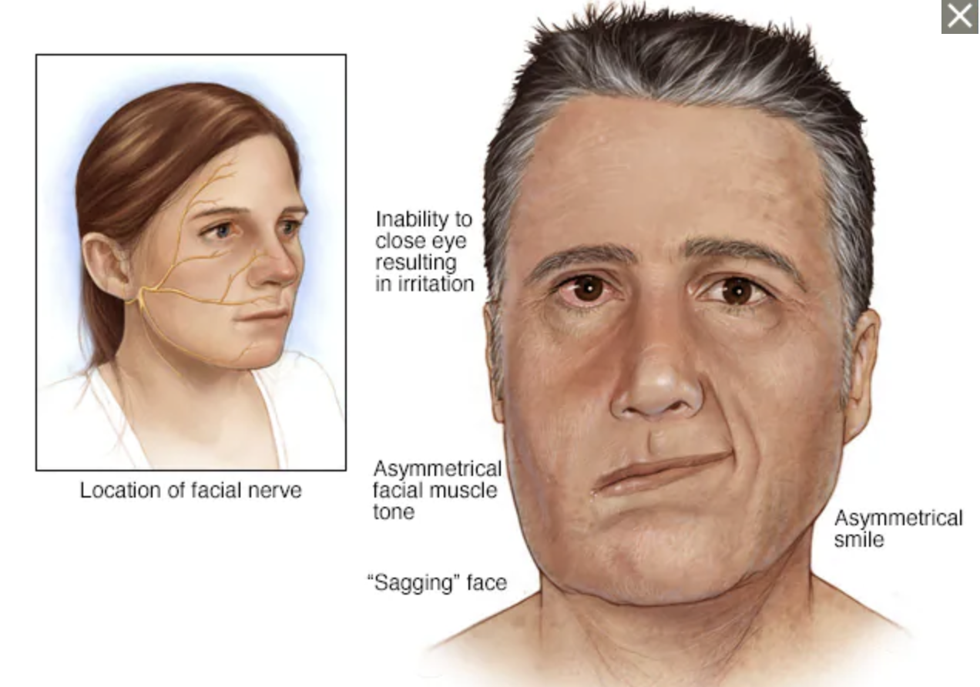

Slide 28
Complications
post herpetic neuralgia (pain)
  frequent complication
  severe pain, lasting several weeks weeks
acute urinary retention
acute colonic pseudo-obstruction
keloids (benign connective tissue tumours in healing HZ skin lesions
recurrence

Slide 29
HZ and Cancer
HZ is linked with an increased risk of getting cancer, esp blood cancers and lung cancer
Separately, patients with cancer (if immunocompromised) may have increased risk of developing HZ

Slide 30
Covid Vaccines
all Covid vaccines are linked with increased risk of HZV reactivation

Slide 31
Treatment
antiviral medication (acyclovir ACV)
small risk of renal toxicity
can also be used to reduce risk of reactivation in immunocompromised patients

Slide 32
Vaccination
Reduces risk of HZV reactivation
Reduces the risk of getting PHN
Gabapentin and pregabalin used to reduce risk of PHN

Slide 33
When to see a doctor
the pain and rash occur near an eye.
ge 50 or older (increased your risk of complications).
weakened immune system (cancer, medications or chronic illness).
rash is widespread and painful.

