Slide 1
Gallstones

Slide 2
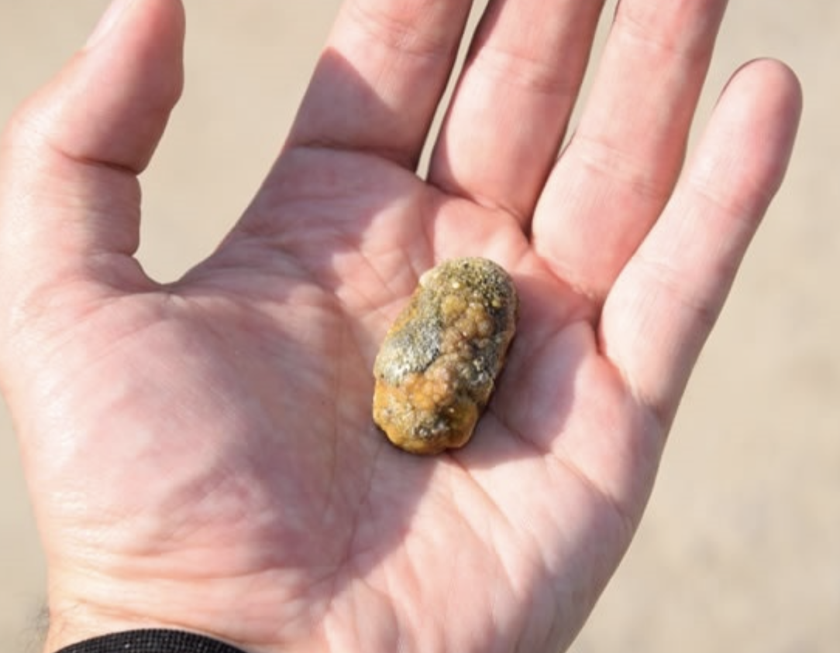

Slide 3
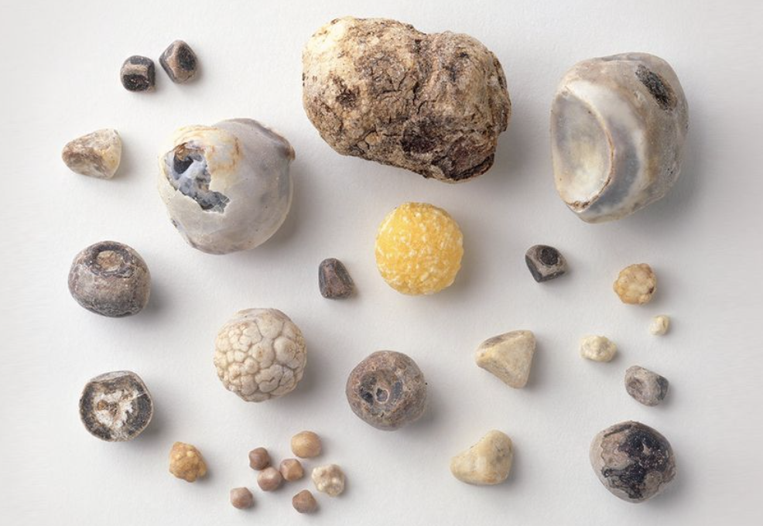

Slide 4
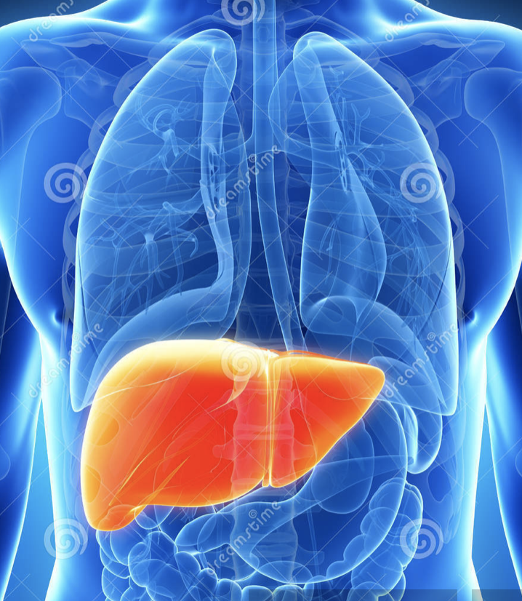

Slide 5
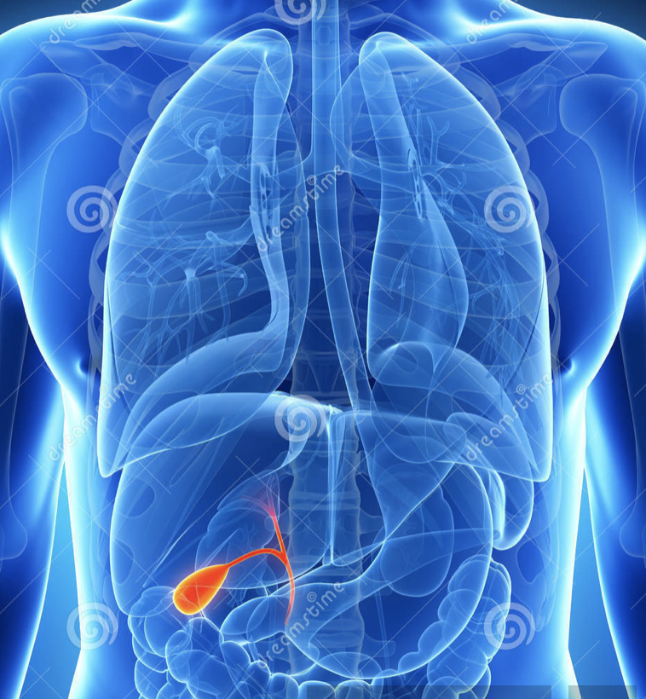

Slide 6
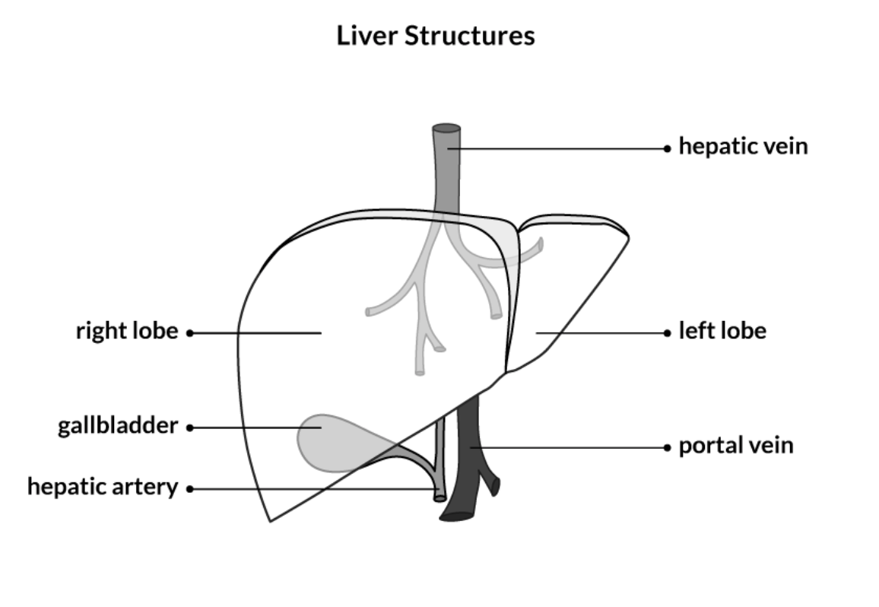

Slide 7
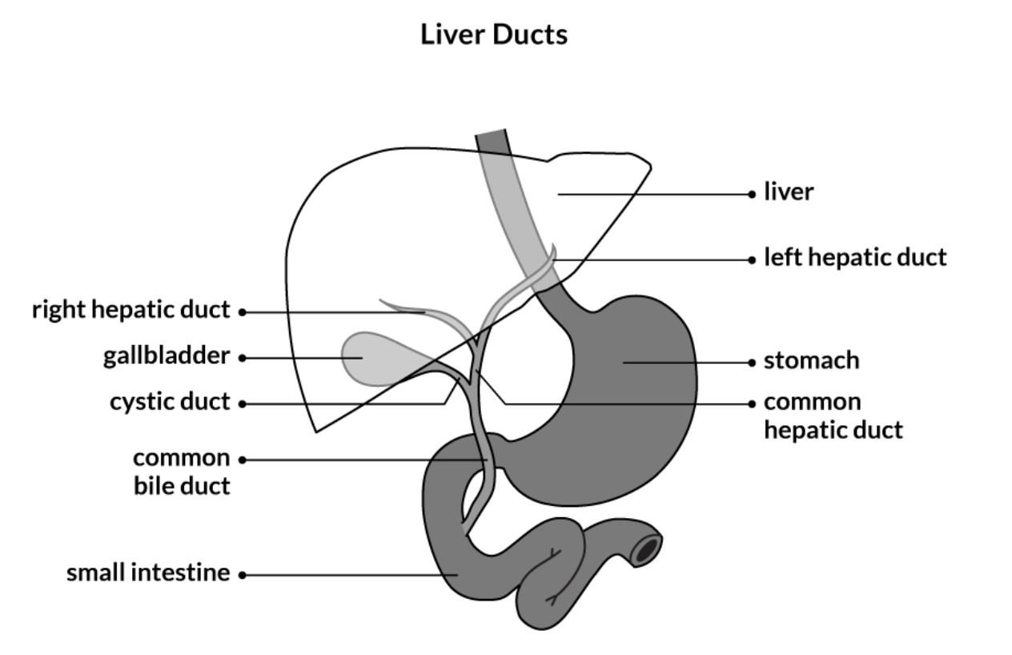

Slide 8
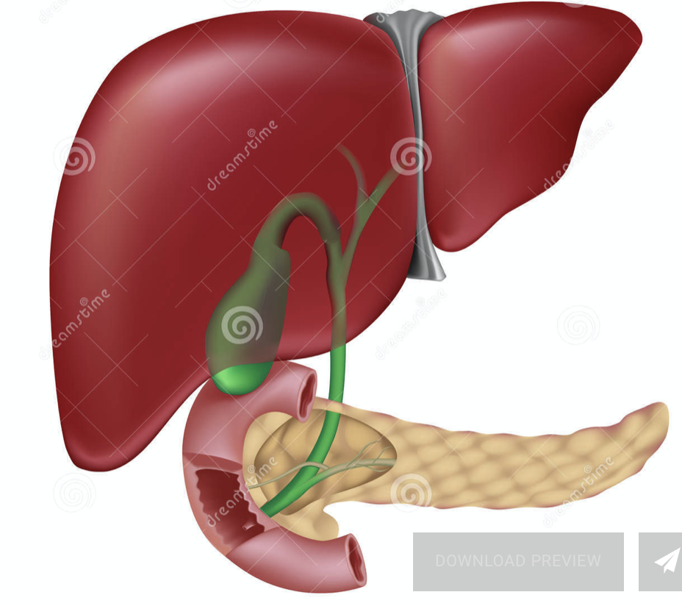

Slide 9
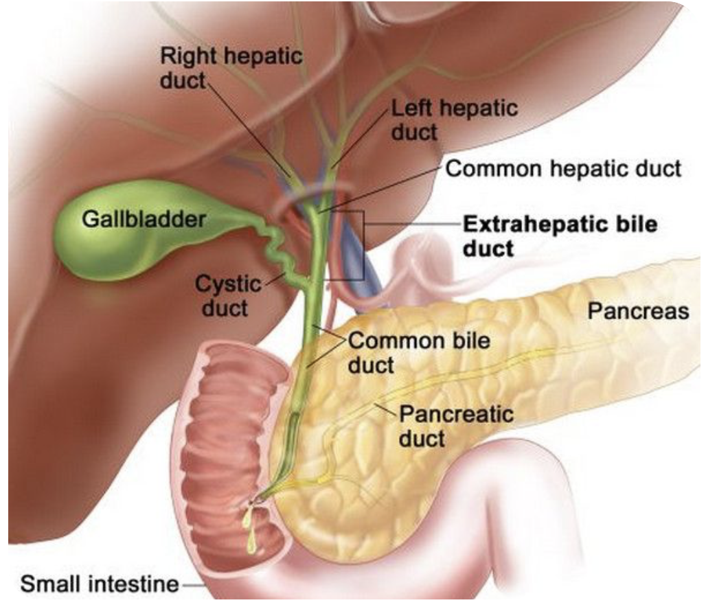

Slide 10
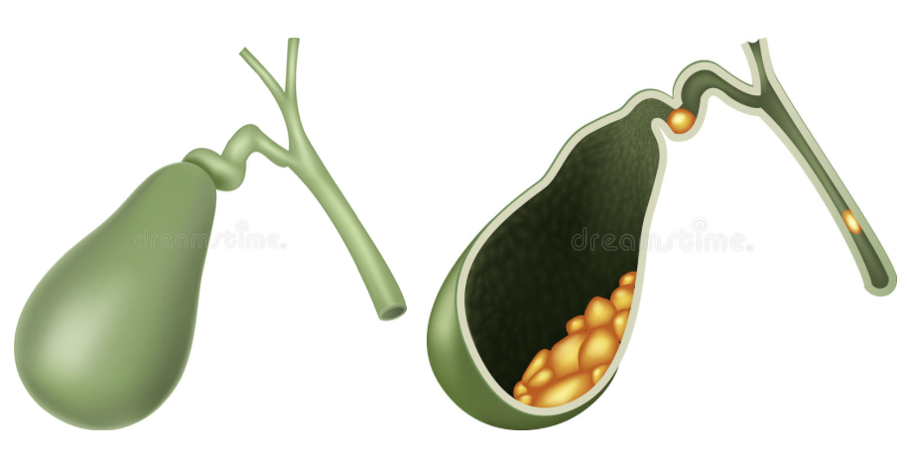

Slide 11
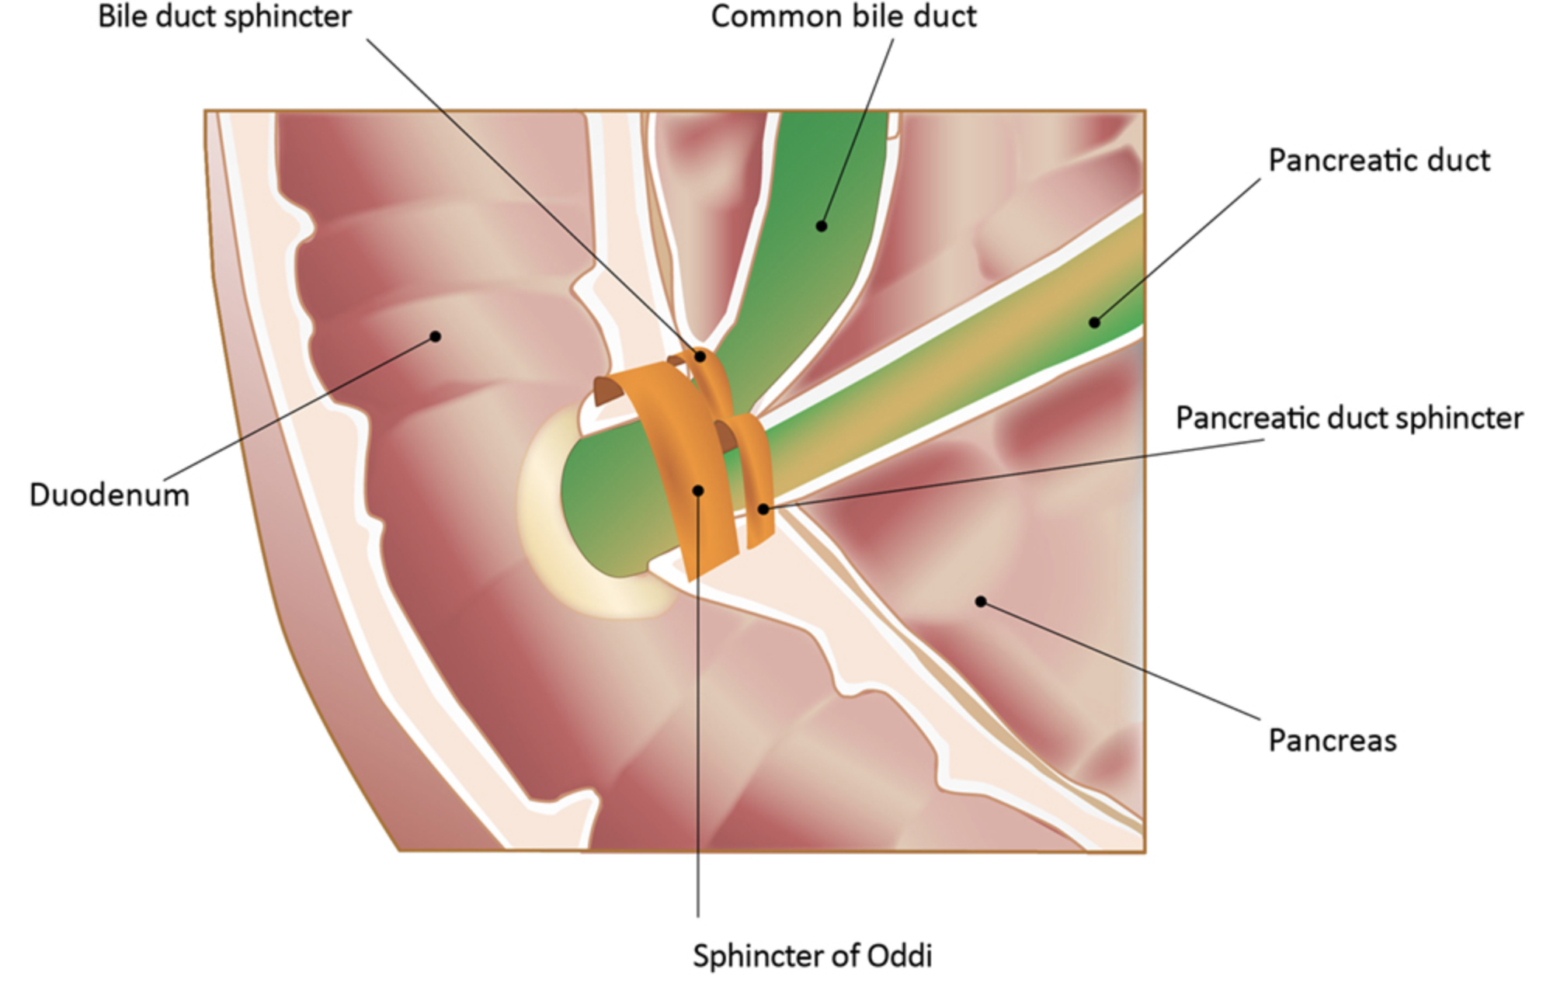

Slide 12
approx 9% of the population develop gallstones or another gallbladder disease at some time in their lives.
gallstones are lumps of solid material that form in the gallbladder
usually resemble small stones or gravel
can be as large as pebbles. Most are the size of a pea and may take many years to grow.
anyone can get gallstones
middle aged, overweight women have the highest risk - fair, fat and forty traditionally describes a typical patient!

Slide 13
Gallstone formation
like hard pebbles
preceding sludge phase (proteins, calcium + cholesterol crystals)
excess cholesterol in the bile (hypersaturation)
pooling / stasis of bile due to reduced GB motility
Reduced contraction of GB wall
Spasm at the Sphincter of Oddi
pigment stones. Excess bilirubin (from red cell breakdown)

Slide 14
Main causes
Your bile contains too much cholesterol. .
Your bile contains too much bilirubin. .
Your gallbladder doesn't empty correctly.

Slide 15
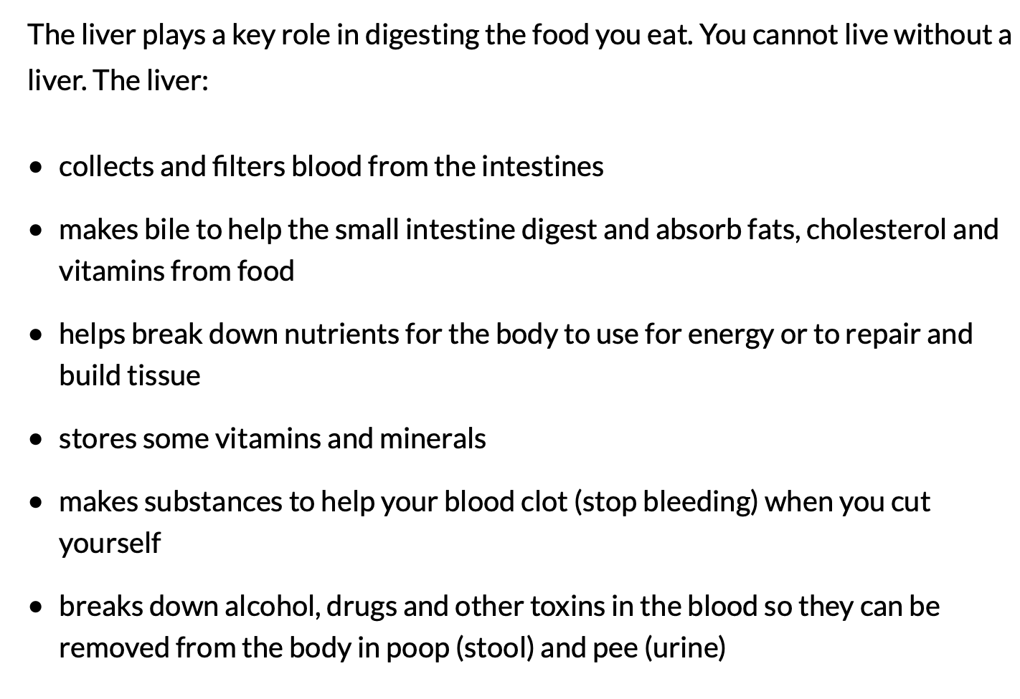

Slide 16
Symptoms
Sometimes
Sudden and rapidly intensifying pain in the upper right portion of your abdomen
Sudden and rapidly intensifying pain in the center of your abdomen, just below your breastbone
Back pain between your shoulder blades
Pain in your right shoulder
Nausea or vomiting
Gallstone pain may last several minutes to a few hours.

Slide 17
Risk factors
high-cholesterol diet
low-fiber diet
family history of gallstones
diabetes
certain blood disorders, such as sickle cell anemia or leukemia
losing weight very quickly
medications that contain estrogen, such as oral contraceptives or hormone therapy drugs
liver disease
female
age 40 or older
Native American
Hispanic / Mexican origin
overweight or obese
sedentary
pregnant
eating a high-fat diet

Slide 18
Complications
Inflammation of the gallbladder. Cholecystitis, whichcan cause severe pain and fever.
Blockage of the common bile duct. . Severe pain, jaundice and bile duct infection can result.
Blockage of the pancreatic duct. A gallstone can cause a blockage in the pancreatic duct, which can lead to inflammation of the pancreas (pancreatitis).
Gallbladder cancer. People with a history of gallstones have an increased risk of gallbladder cancer. But gallbladder cancer is very rare,

Slide 19
Investigations / Diagnosis
Abdominal ultrasound.
Endoscopic ultrasound (EUS). .
Other imaging tests. .
Blood tests.

Slide 20
Treatment
Surgery to remove the gallbladder (cholecystectomy). You don't need your gallbladder to live, and gallbladder removal doesn't affect your ability to digest food, but it can cause diarrhea, which is usually temporary.
Medications to dissolve gallstones. Medications you take by mouth may help dissolve gallstones. But it may take months or years of treatment to dissolve your gallstones in this way, and gallstones will likely form again if treatment is stopped.
Sometimes medications don't work. Medications for gallstones aren’. commonly used and are reserved for people who can't undergo surgery.

Slide 21
