Slide 1
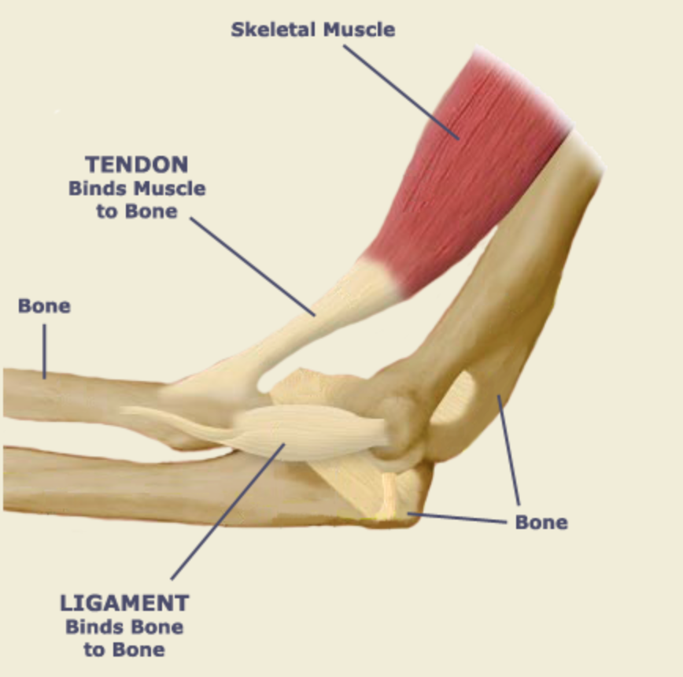

Slide 2
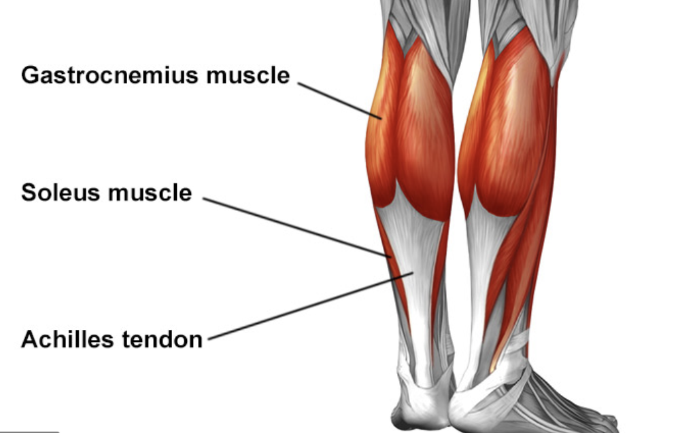

Slide 3
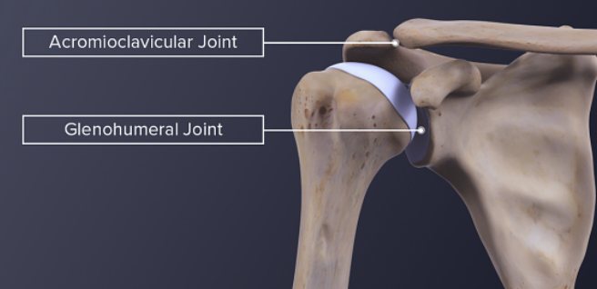

Slide 4
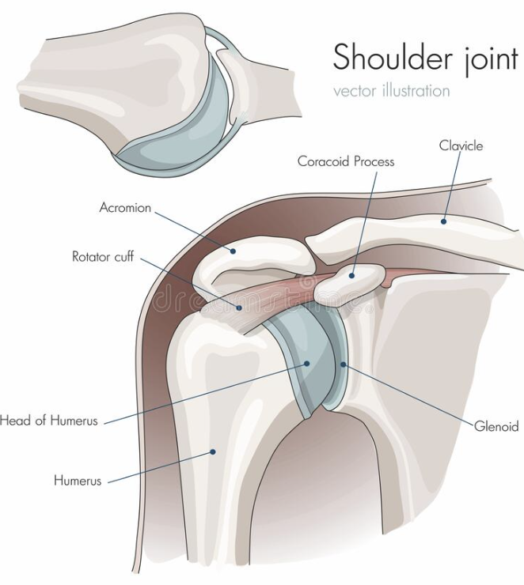

Slide 5
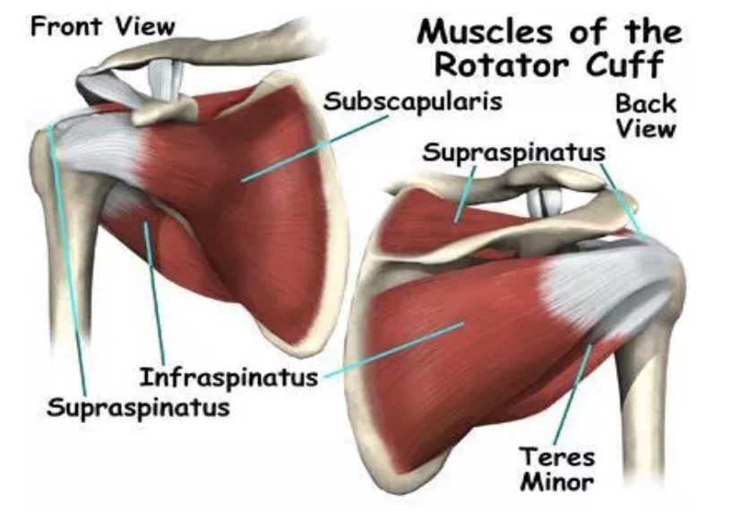

Slide 6
Shoulder Inpingement
Shoulder impingement occurs when the top outer edge of your shoulder blade, called the acromion, rubs against (“impinges on”) or pinches the structures lying between it and the head of the humerus, causing pain and irritation.
The structures that get pinched are
The rotator cuff and
The subacromial bursa causing.

Slide 7
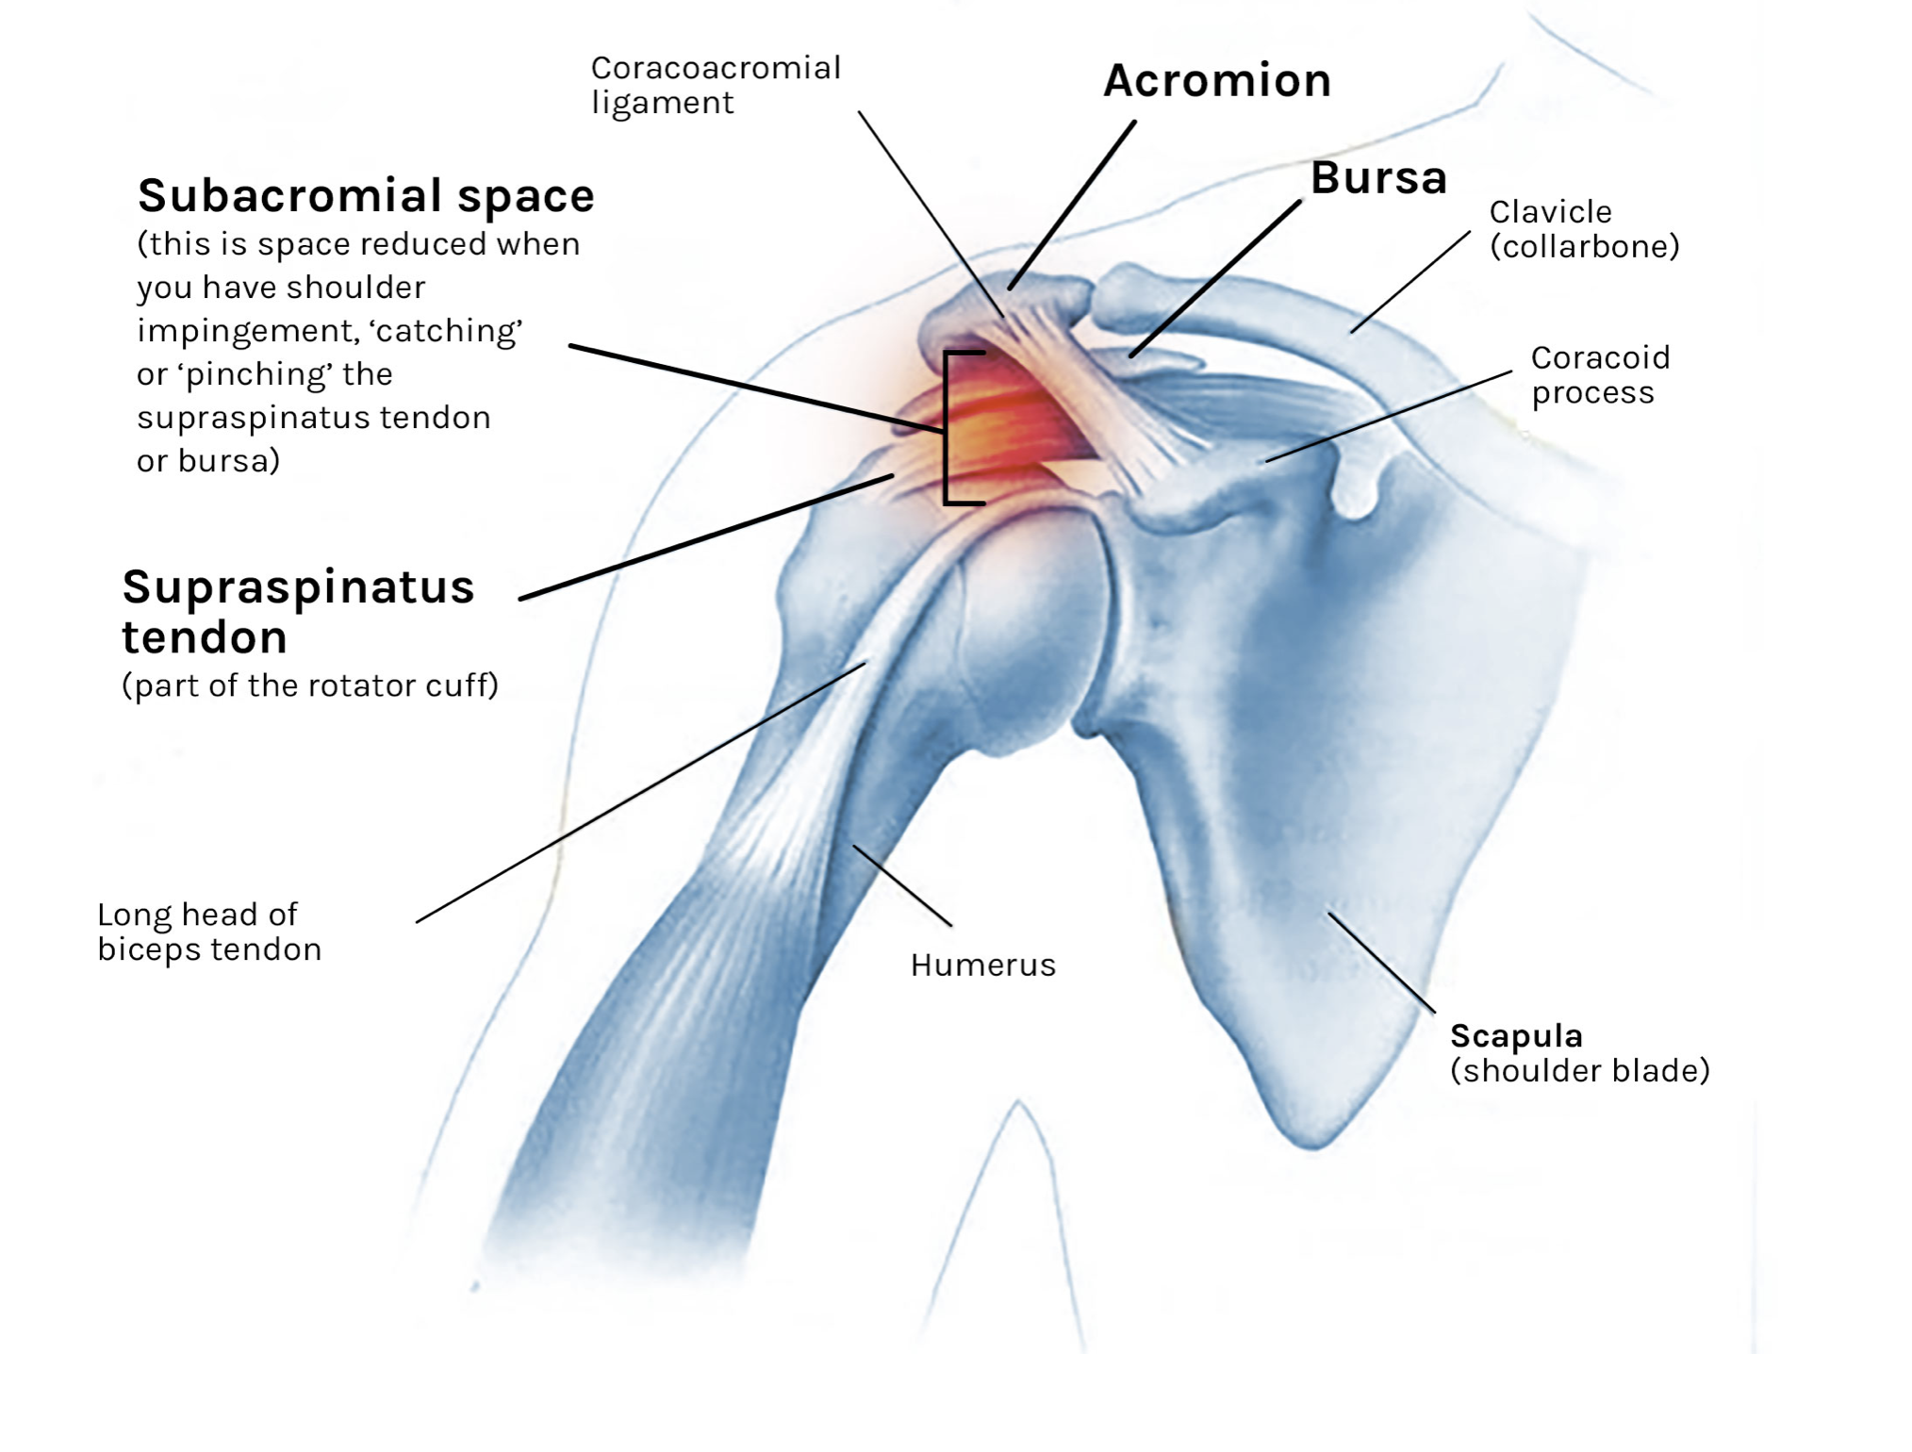

Slide 8
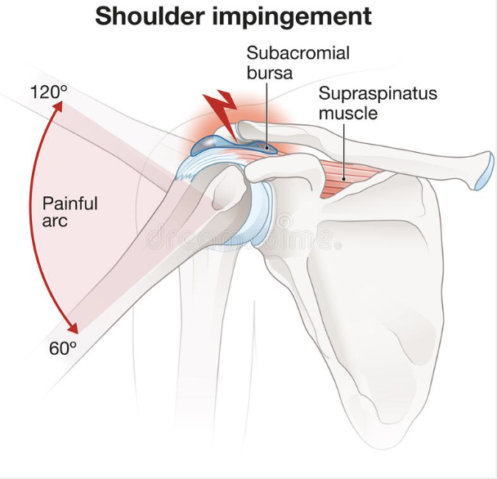

Slide 9
Causes
The rotator cuff tendon is swollen due to inflammation (tendonitis) or a tear. This can be due to overuse from repetitive activity of the shoulder, injury or from age-related wear and tear.
The subacromial bursa is irritated and inflamed (and swollen) . Your bursa is the fluid-filled sac between your tendon and the acromion. Your bursa helps your muscles and tendons glide over your bones. Your bursa can become inflamed due to overuse of the shoulder or injury.
Abnormal acromial shape Your acromion is not flat (you were born this way) or you have developed age-related bony spurs on the undersurface of your acromion which make the subacromial space smaller.

Slide 10
Pain with shoulder impingement occurs…
when the arm is raised overhead.
while lifting the arm or lowering your from a raised position
lying on the affected side
In bed at night, often causing disturbed sleep
reaching behind your back, like reaching into a back pocket
dressing / undressing
lifting a weight
NB Painful Arc

Slide 11
symtoms
Usually gradual onset
Pain is located in the shoulder and may radiate down the side of the arm
Usually no pain at rest
Shoulder / arm may feel weak

Slide 12
Diagnosis
History
Clinical tests
imaging

Slide 13
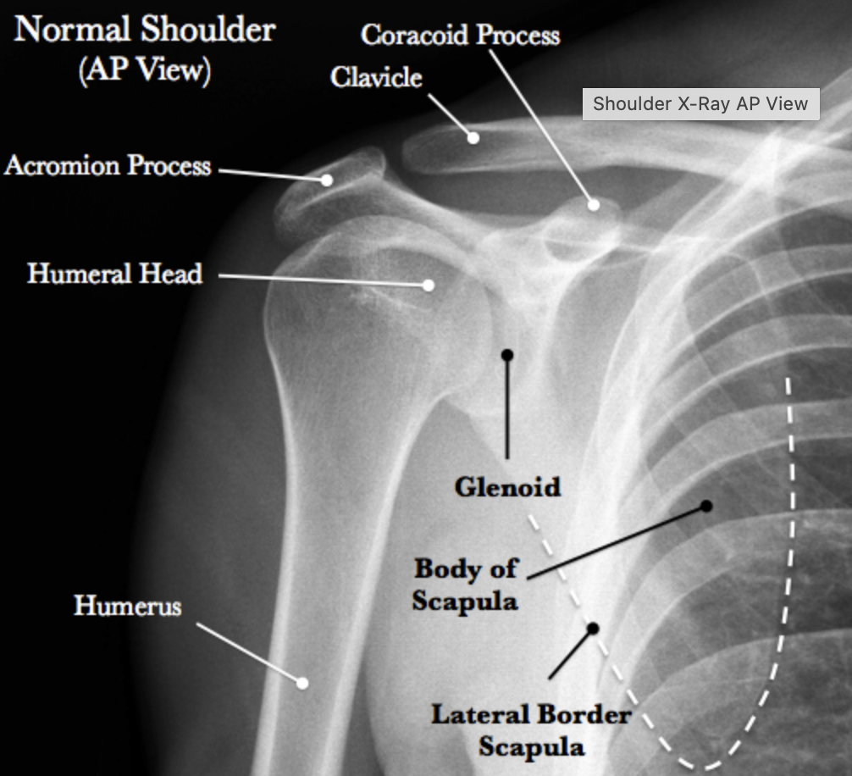

Slide 14
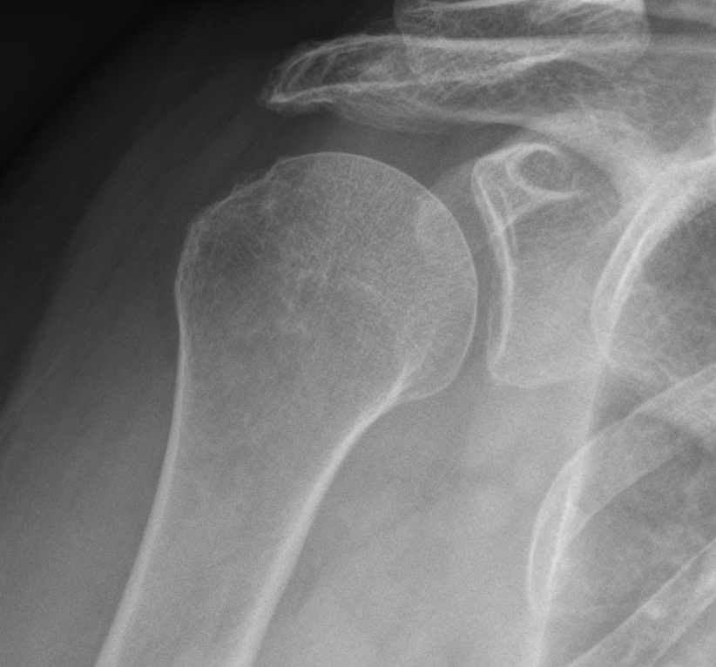
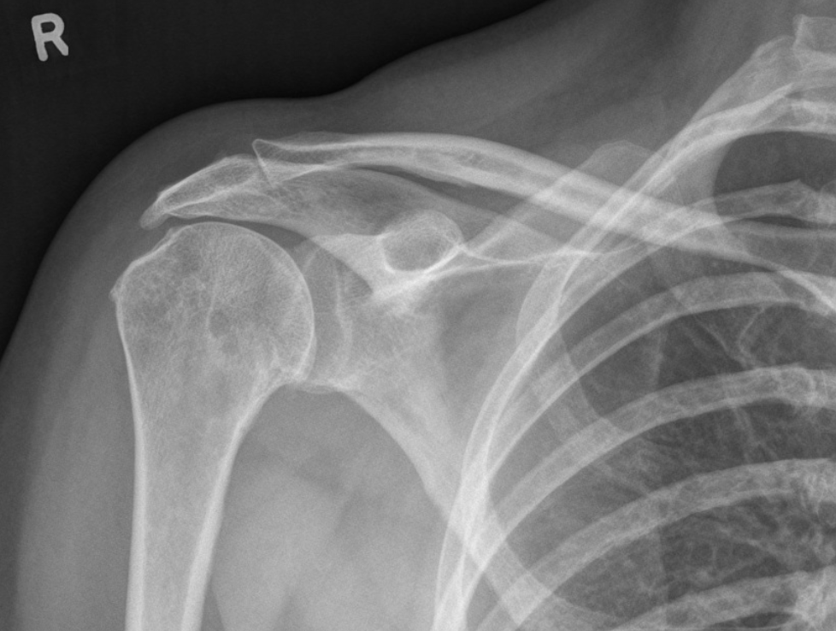

Slide 15
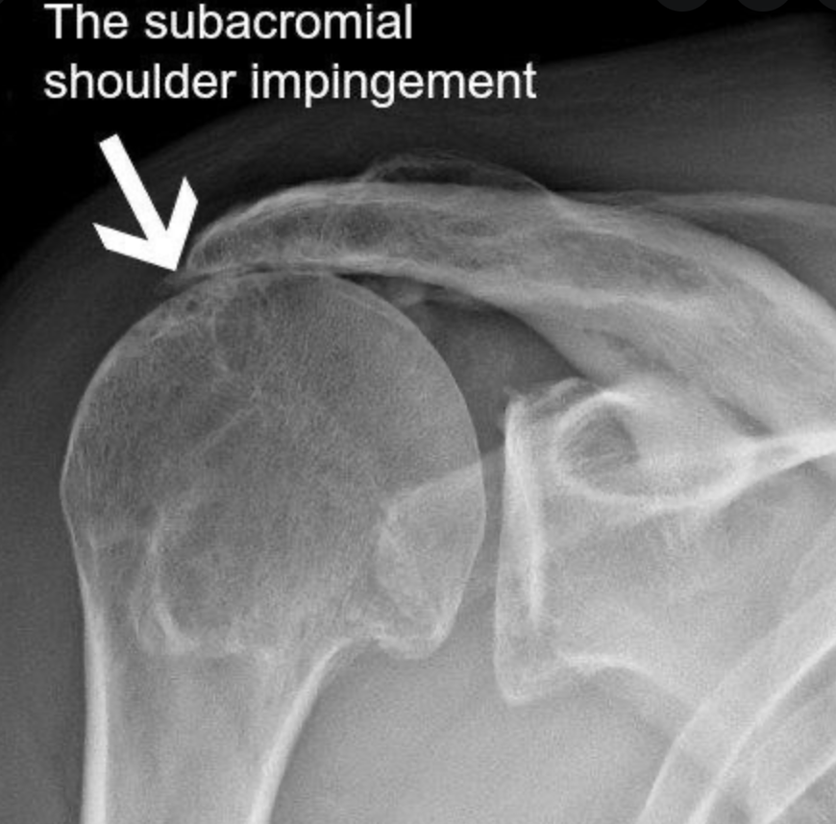

Slide 16
Rotator cuff tendonitis: the strength tests are painful
Bursitis: the strength tests are pain free

Slide 17
Treatment
Physiotherapy: ROM exercises, strength work, posture correction
Medication
Injections
surgery

