Slide 1
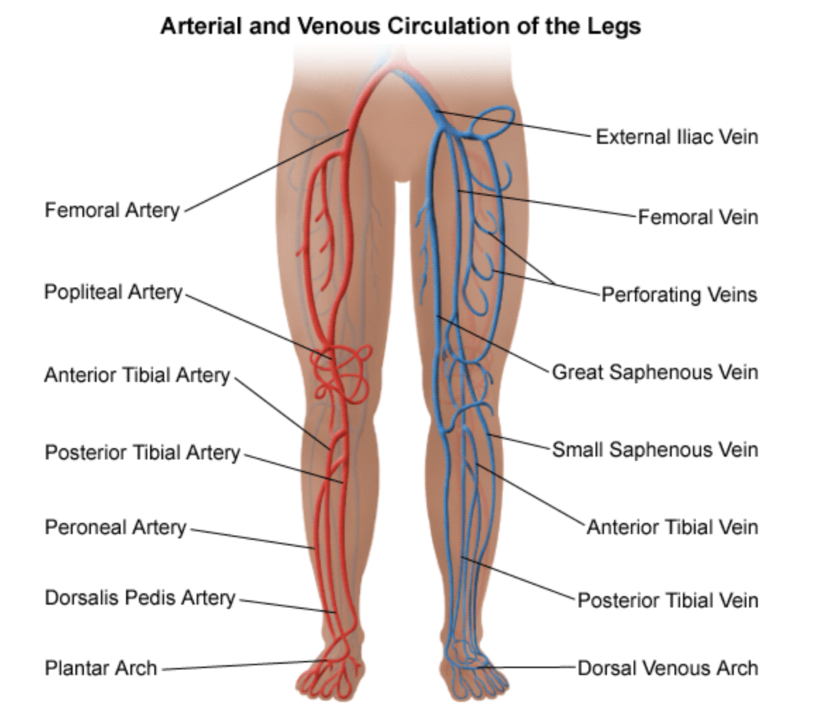

Slide 2
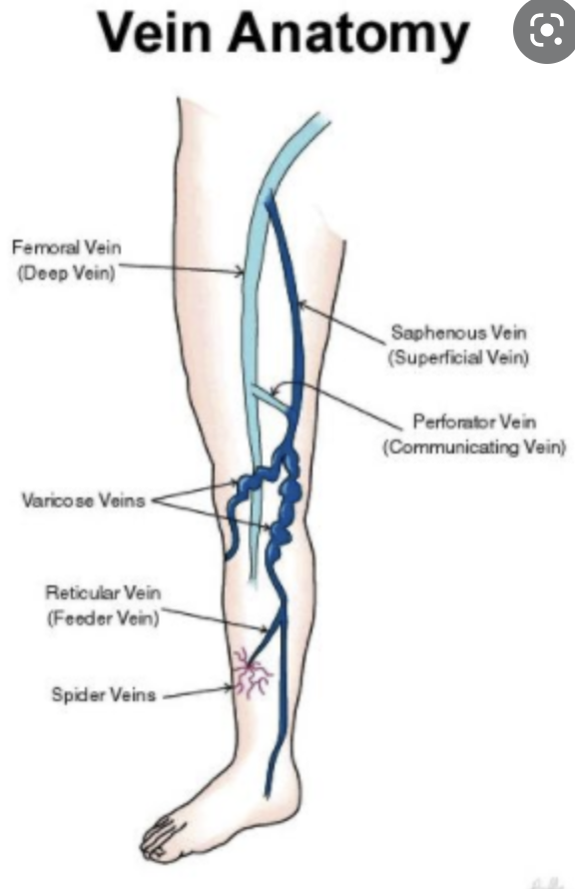

Slide 3
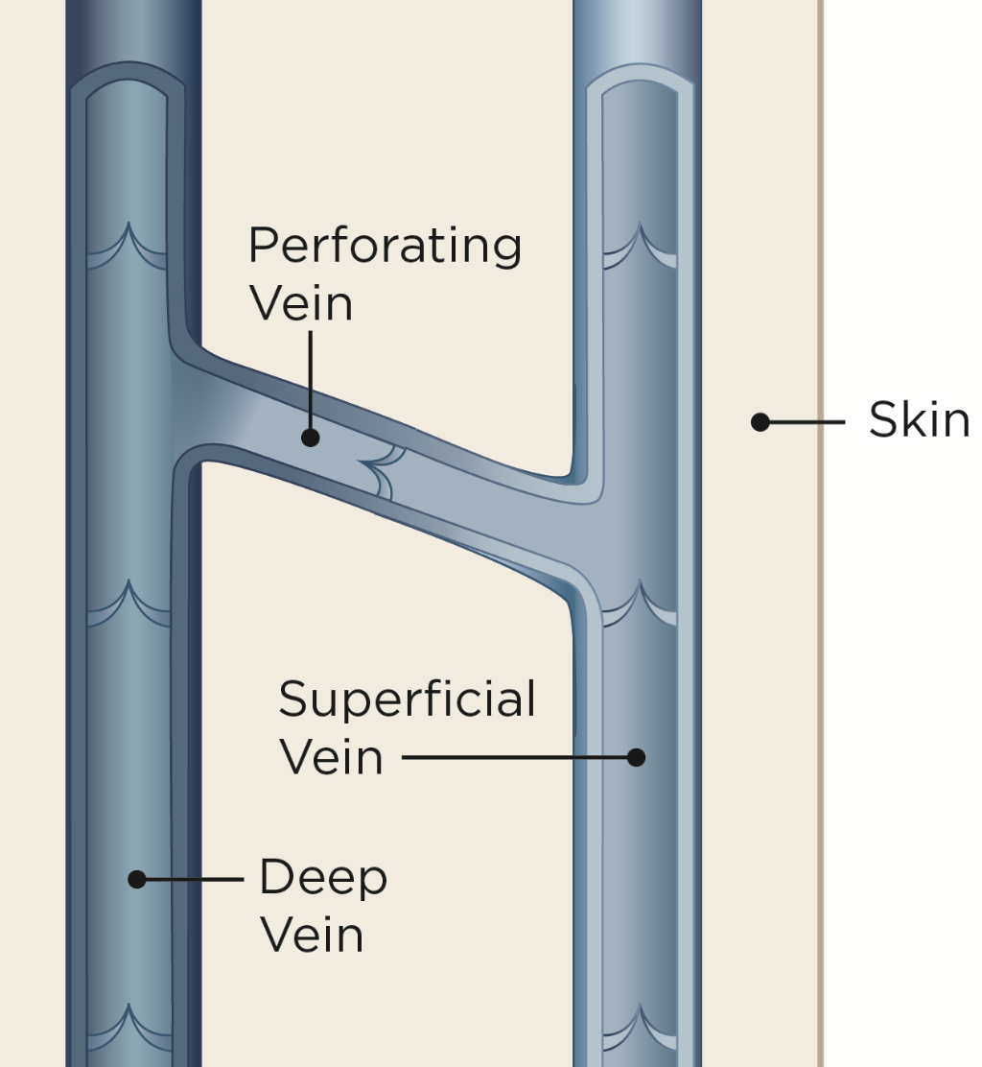

Slide 4
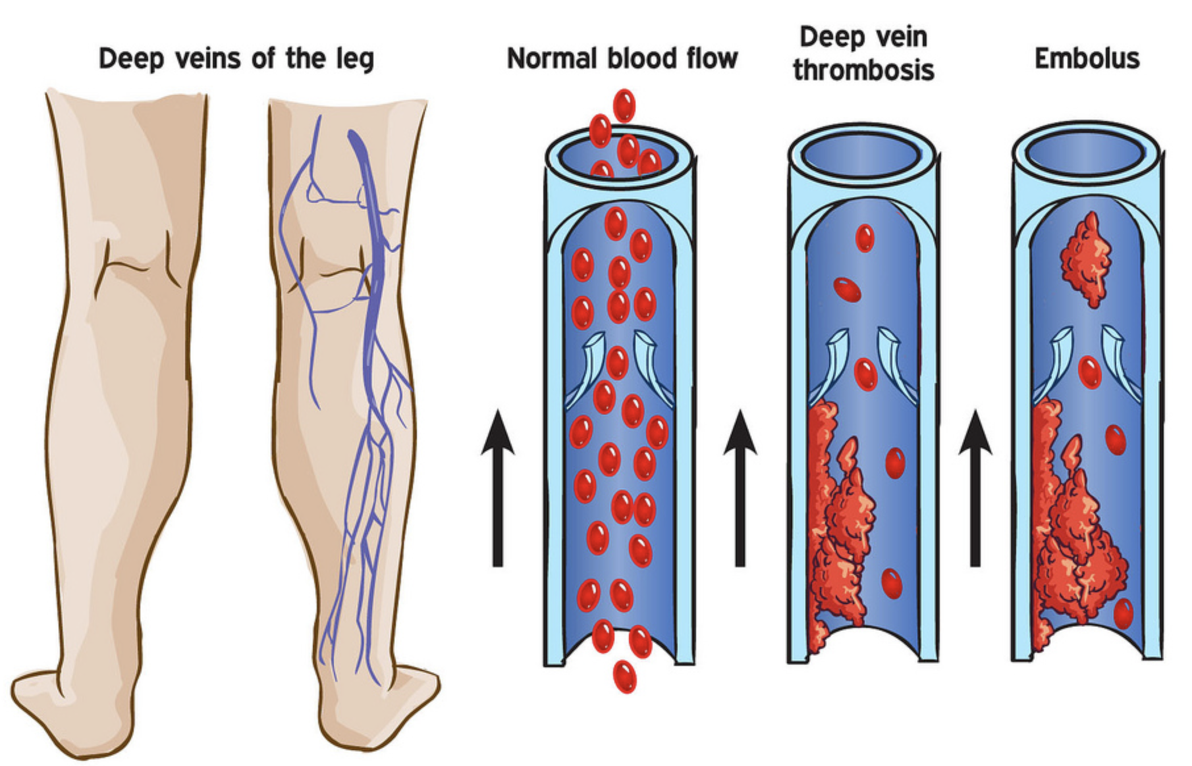

Slide 5
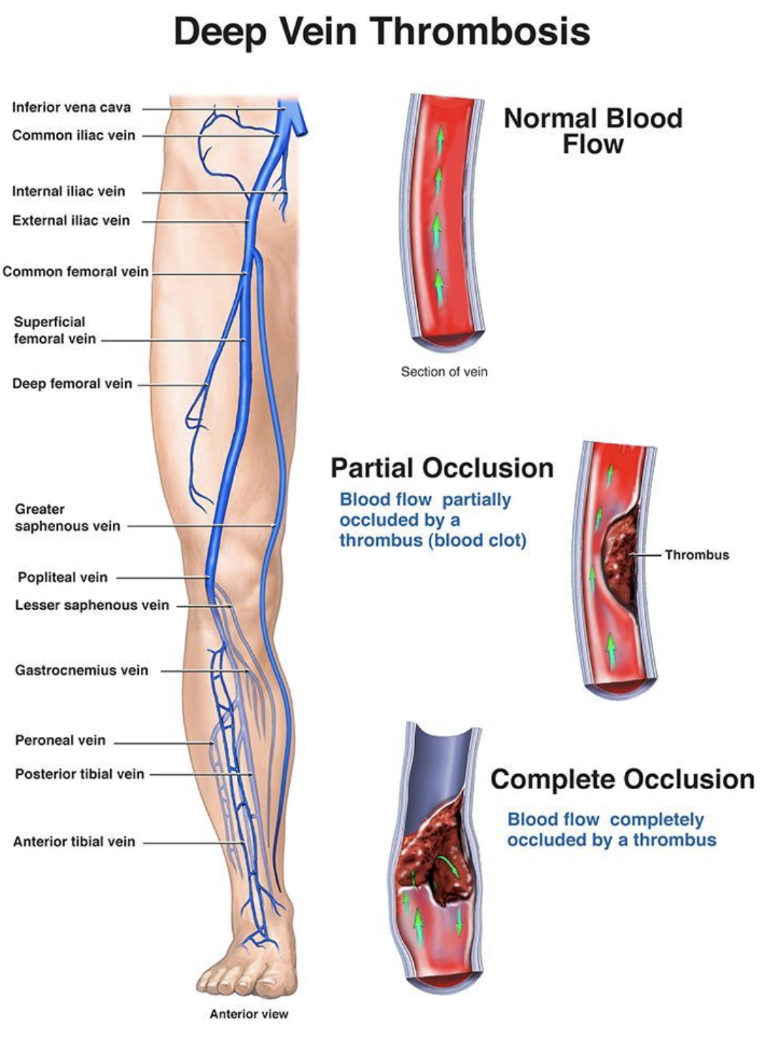

Slide 6
Risk factors
Overweight or obesity
Blood clotting disorder
Age over 60 years
Surgery
A long period of not moving, for example, when in the hospital or sitting on a long journey
Birth control pills or hormone replacement therapy
Certain diseases and conditions, such as:
Previous blood clot
Varicose veins
Heart problems, such as heart failure, or heart attack
Inflammatory bowel disease
Lupus, a disease of the immune system
Cancer and some cancer treatments
Paralysis
Pregnancy
Having a central venous catheter, for example, in a large vein in the chest

Slide 7
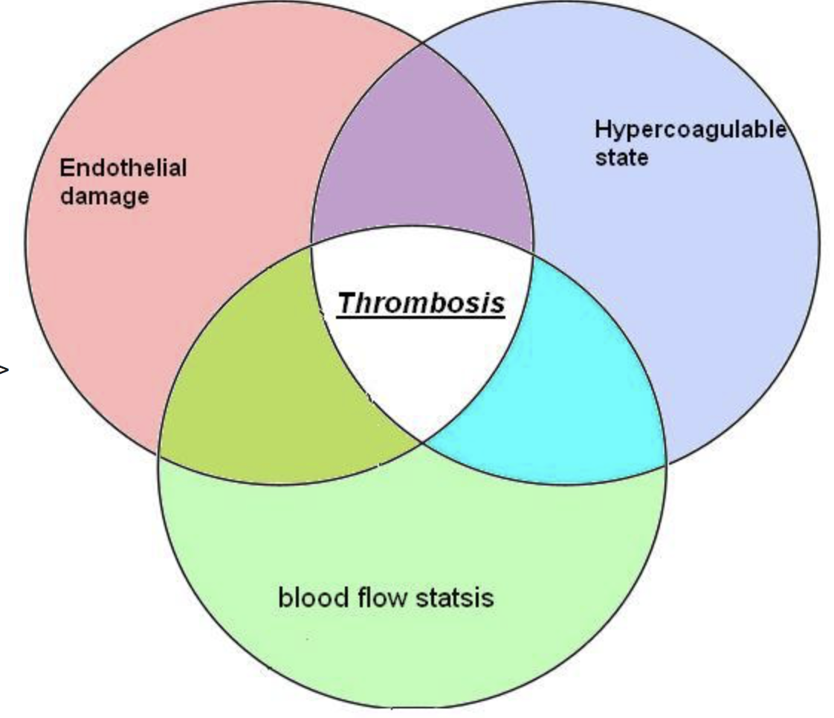

Slide 8
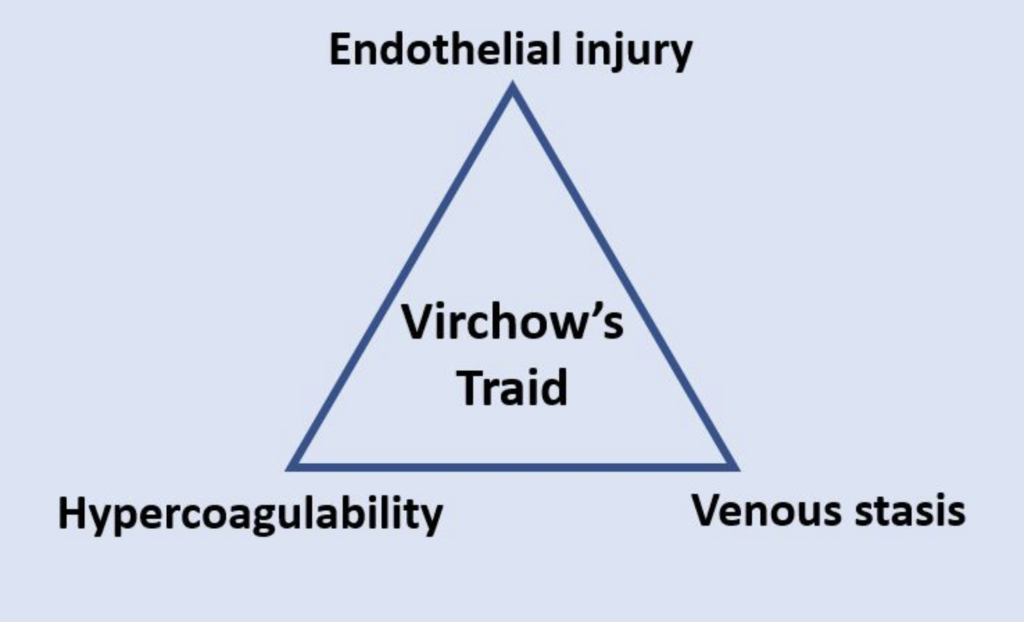

Slide 9
symptoms
Pain
Swelling
Redness
Severe breathlessness or collapse (if a pulmonary embolus occurs)

Slide 10
Diagnosis
Ultrasound
Blood test for elevate levels of D Dimers

Slide 11
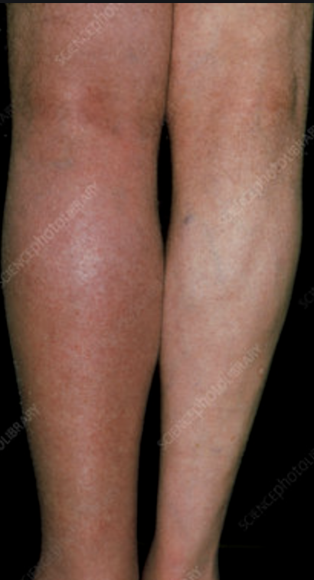

Slide 12
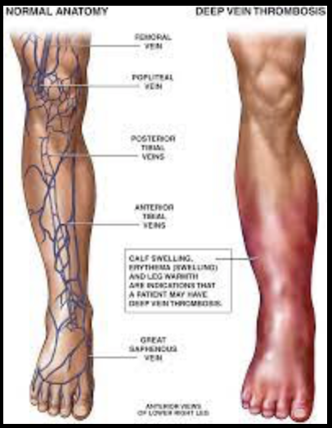
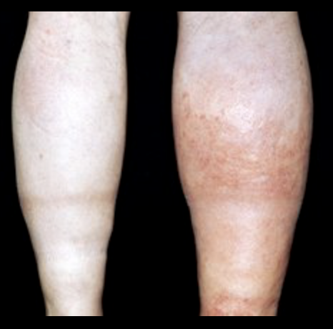

Slide 13
Factors influencing choice of treatment
How old you are
Your overall health and medical history
How sick you are
The location of the clot
How well you can handle specific medicines, procedures, or therapies
How long the condition is expected to last
Your opinion or preference

Slide 14
complications
Pulmonary embolus
Chronic venous insufficiency
Post-thrombotic syndrome

Slide 15
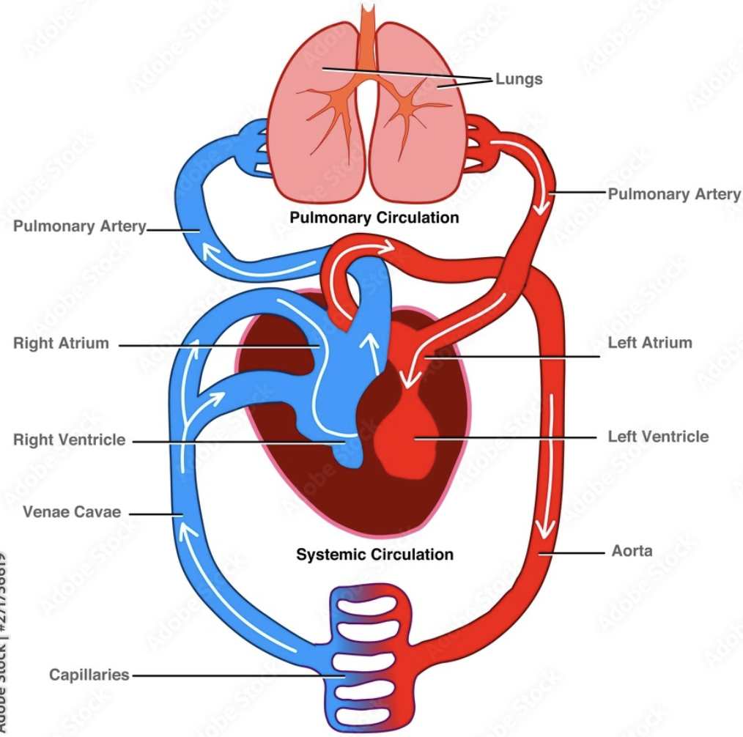

Slide 16
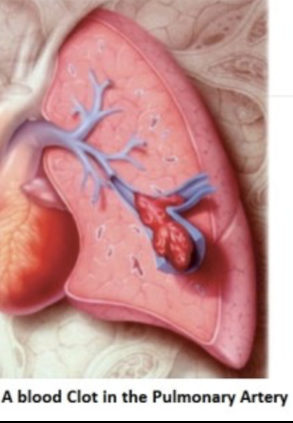
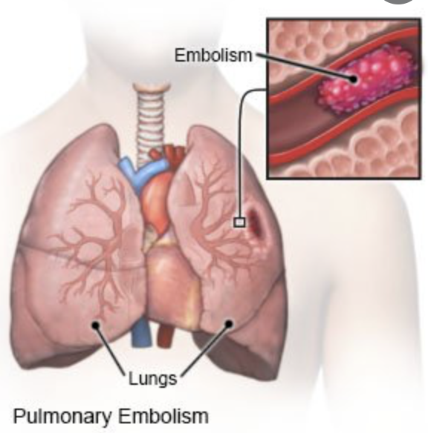

Slide 17
Treatment
Blood thinners (anticoagulant medicines). These medicines decrease the ability of the blood to clot. Examples of anticoagulants include warfarin and heparin. Other anticoagulants may also be used, including rivaroxaban, apixaban, dabigatran and enoxaparin.
Clot busters (fibrinolytics or thrombolytics). These medicines are used to break up clots.
Inferior vena cava filter. In some cases, a filter is placed in the vena cava (the large vein which returns blood from the body to the heart). This filter prevents clots from reaching the heart and lungs.

Slide 18
Prevention
Anticoagulant medicines are given to certain patients having surgery to prevent blood clots.
Wiggling the toes and moving the ankles helps to prevent blood clots caused by long periods of sitting or lying down.
When you travel :
Walk up and down the aisles (if traveling by plane or bus)
Stop about every hour and walk a little (if traveling by car)
While sitting, move your legs, ankles, and toes
Wear loose clothing
Limit the amount of alcohol you drink
Drink a lot of water and other healthy drinks
Compression stockings

