Slide 1
Frozen Shoulder Adhesive Capsulitis

Slide 2
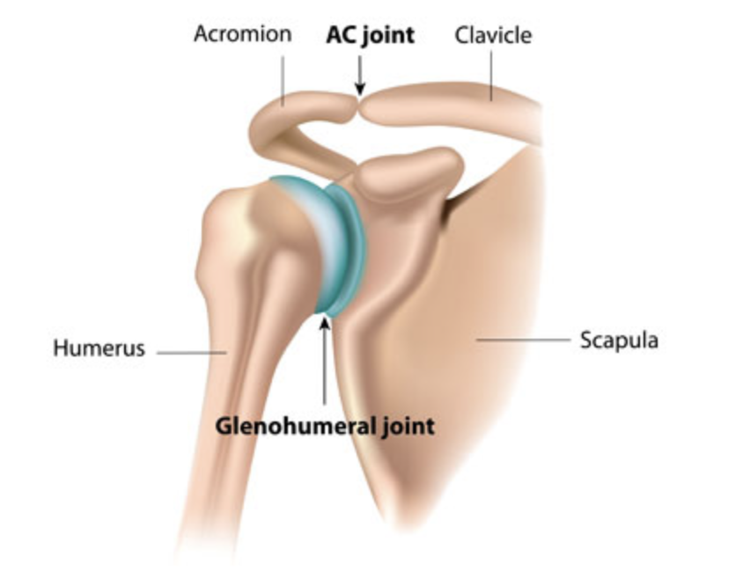

Slide 3
What is it?
The shoulder joint is enclosed in a capsule of connective tissue.
Frozen shoulder occurs when this capsule becomes inflamed (capsulitis). This has 2 effects:
Pain (red, raw angry capsule)
Reduced movement caused by thickening and tightening of the capsule around the shoulder joint, restricting its movement.

Slide 4
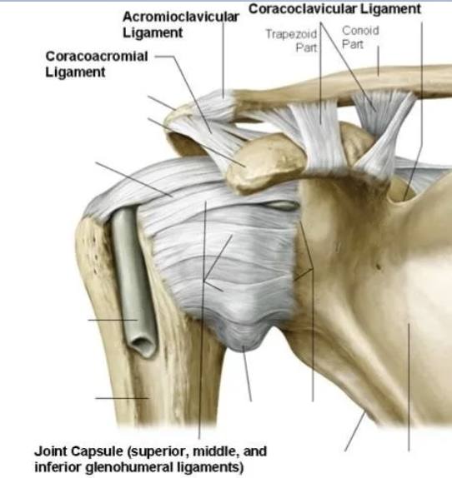

Slide 5
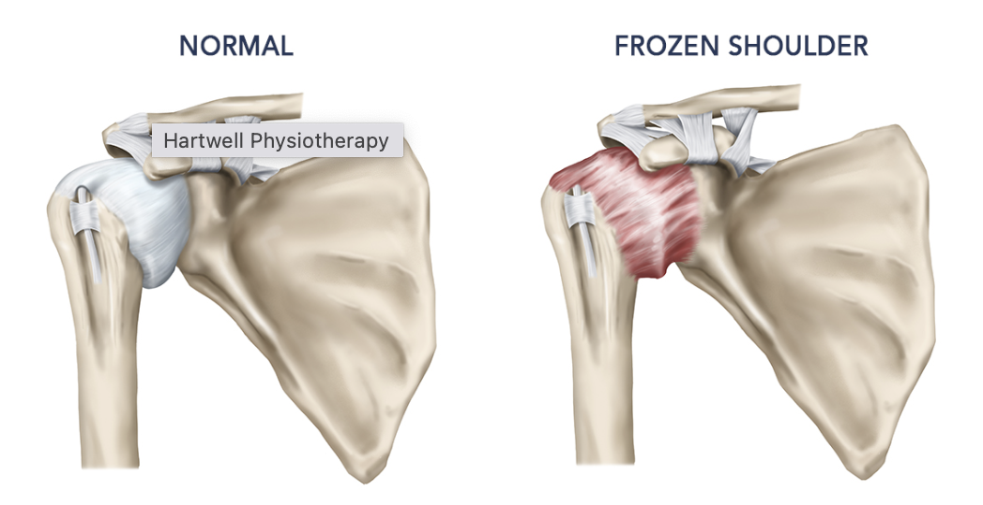

Slide 7
Natural history
Gets bad: freezing phase
Stays bad: frozen phase
Gets better: thawing phase

Slide 8
The pain
Sudden movements
Lying on that side in bed (often waj=kened by pain, difficuklty getting asleep)
Reaching behind head
Reaching behind back
Great difficulty dressing / undressingh

Slide 9
The stiffness
Reduced ability to reach behind (head or back)
Reduced external rotation

Slide 10
Freezing stage. Any movement of the shoulder causes pain, and the shoulder's ability to move becomes limited. This stage lasts from 2 to 9 months.
Frozen stage. Pain might lessen during this stage. However, the shoulder becomes stiffer. Using it becomes more difficult. This stage lasts from 4 to 12 months.
Thawing stage. The shoulder's ability to move begins to improve. This stage lasts from 5 to 24 months.

Slide 11
Risk Factors
Age
Female gender
Prolonged immobility
Shoulder surgery (e.g. rotator cuff repair)
Fracture
Stroke
Systemic disease
Diabetes
Thyroid disease (overactive or underactive)
Cardiovascular do9zsease
Parkinson’s Disease

Slide 12
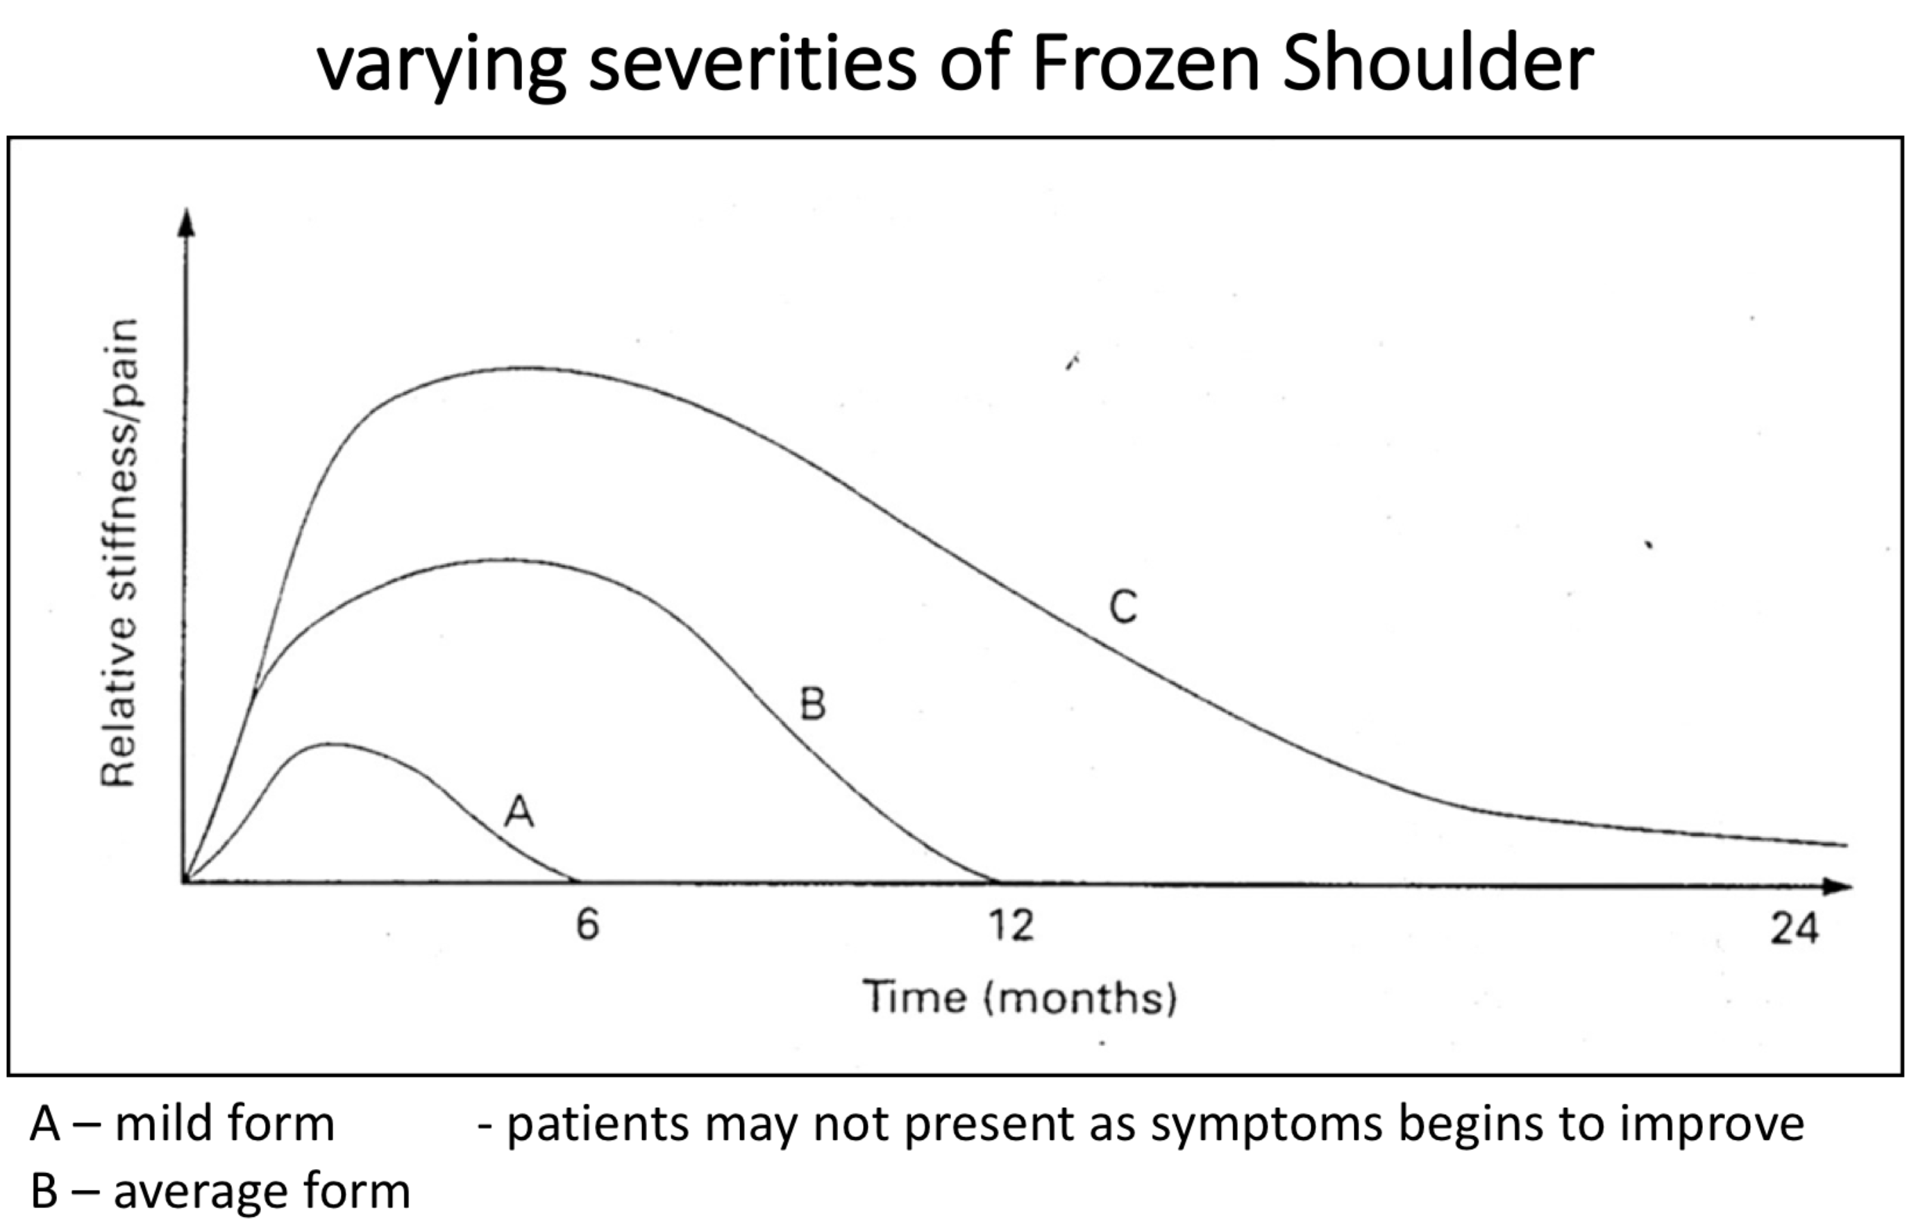

Slide 13
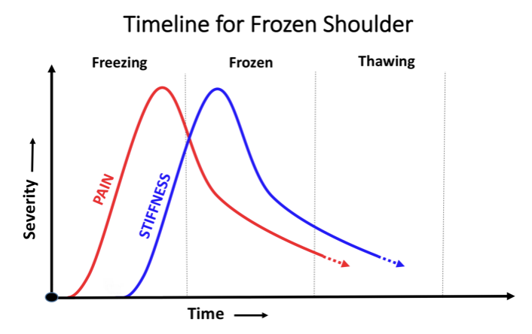

Slide 14
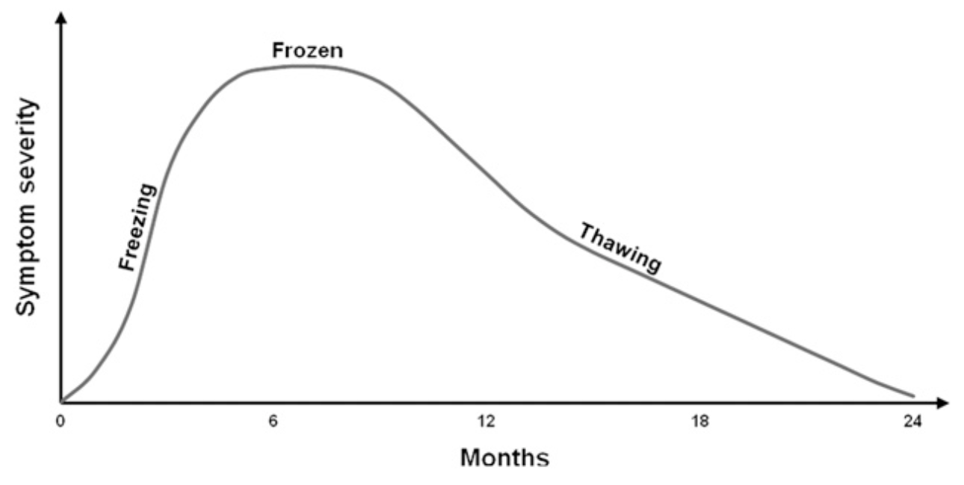

Slide 15
Diagnosis
History
Clinical examination
Restricted active and passive movement
Resisted movements relatively pain free
Imaging usually not necessary except too exzclude other p[roblems

Slide 16
Treatment
Wait and see
Medication for pain
Physiotherapy
Gently mobilization
Exercises at home for range of movement

Slide 17
Freezing Phase:
pain relief/management is the primary goal in this stage i.e. heat, TENS, dry needling, soft tissue massage, gentle ROM
advice and education for prevention of further loss in global range of motion of shoulder joint through gentle ROM

Slide 18
Frozen Phase:
encouraging ADLs within functional limits
safe exercise program->not aggressive
maintaining current range in all directions of shoulder and other upper limb joints

Slide 19
Thawing Phase:
exercise progressions, strengthening exercises to control and maintain increased range of movement. Physiotherapy is most effective during this thawing phase.

Slide 20
More aggressive treatment
Steroid injections.
Hydrodilatation. Injecting sterile water into the joint capsule can help stretch the tissue and make it easier to move the joint.
Shoulder manipulation.
Surgery.

