Slide 1
Knee osteoarthritis

Slide 2
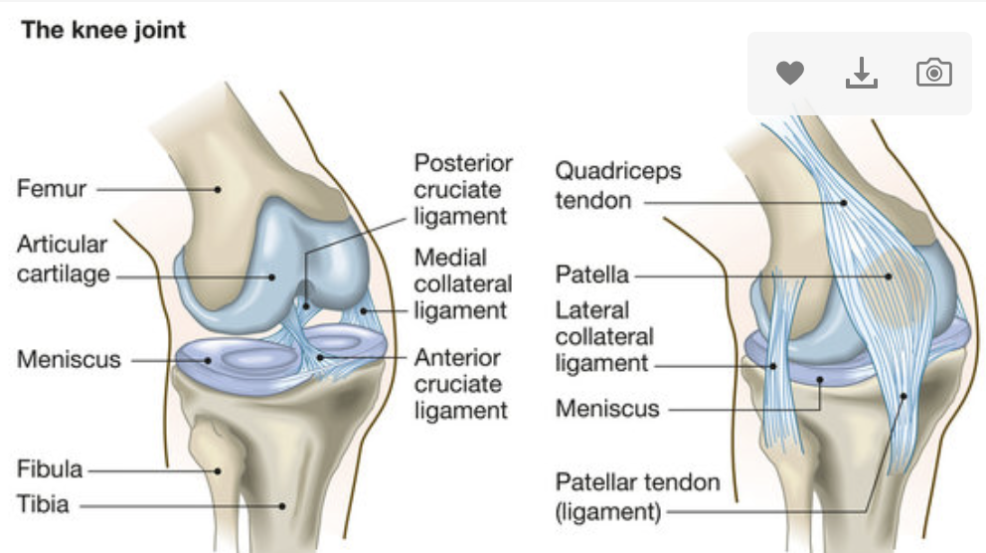

Slide 3
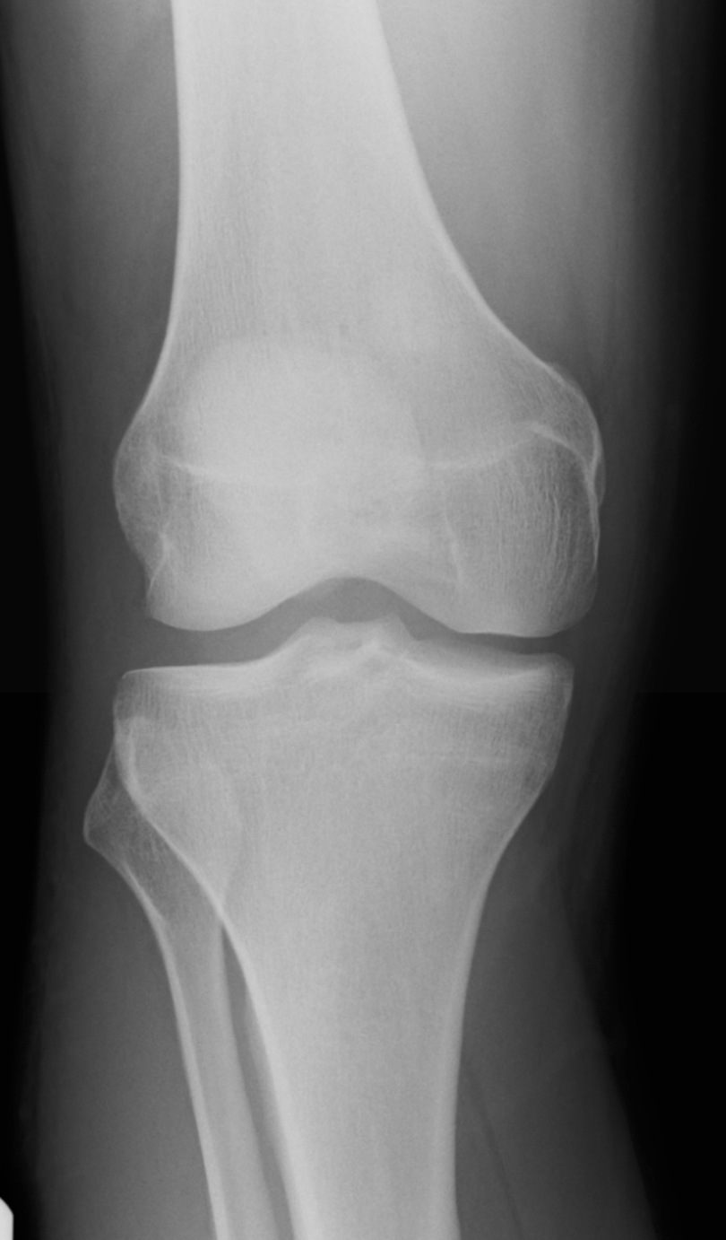

Slide 4
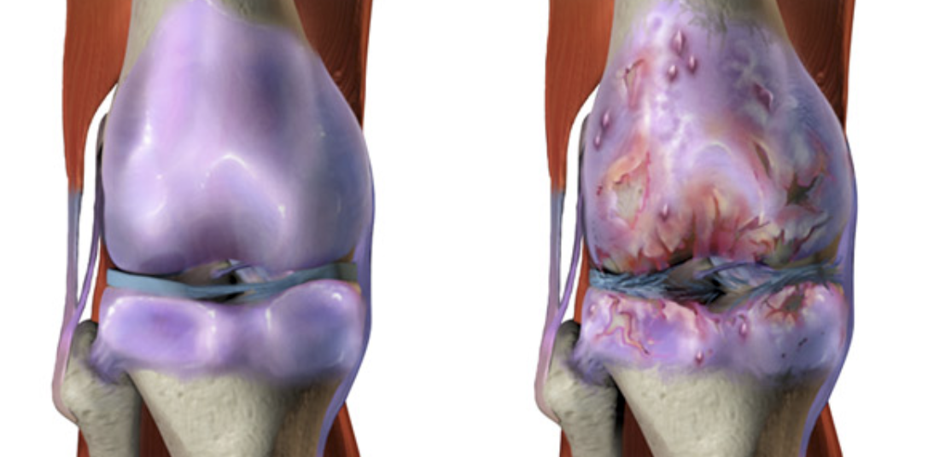

Slide 5
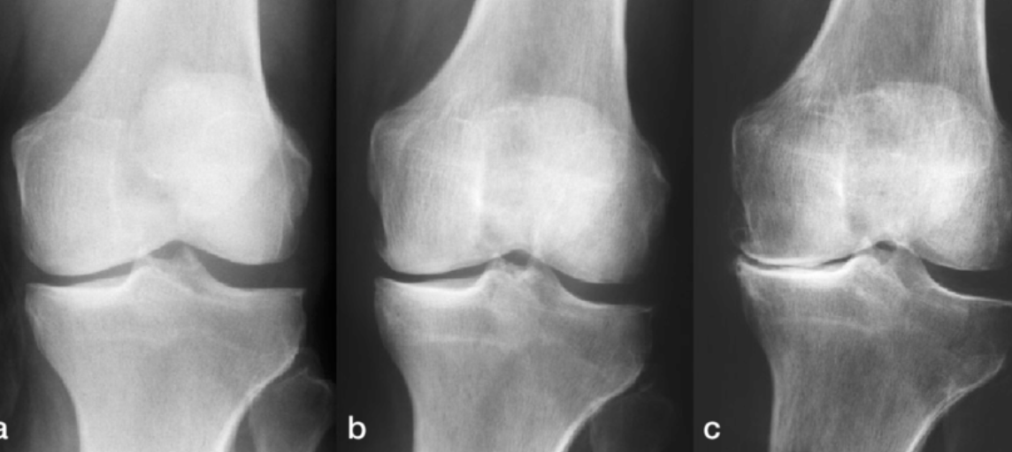

Slide 6
symptoms
Pain swelling
Stiffness
Limping
Heat and redness
Noise / creaking

Slide 7
Risk factors
Age
Previous injury
Family history
Some other medical conditions (e.g rheumatoid arthritis)
Sepsis / infection
BMI

Slide 8
Exam findings
Reduced ROM
Swelling
Palpable crepitus
Tenderness over joint lines

Slide 9
treatment
Medication
Physio
Weight loss
Surgery
Washout
Knee replacement

