Slide 1
Hoarseness
Hoarseness generally refers to an abnormal vocal quality that may be manifested as a voice that sounds breathy, strained, rough, raspy, tremorous, strangled, or weak, or a voice that has a higher or lower pitch.
It may be the presenting symptom, but more commonly it is one of many other symptoms, such as cough, difficulty breathing or swallowing, sore throat, or fever.

Slide 2
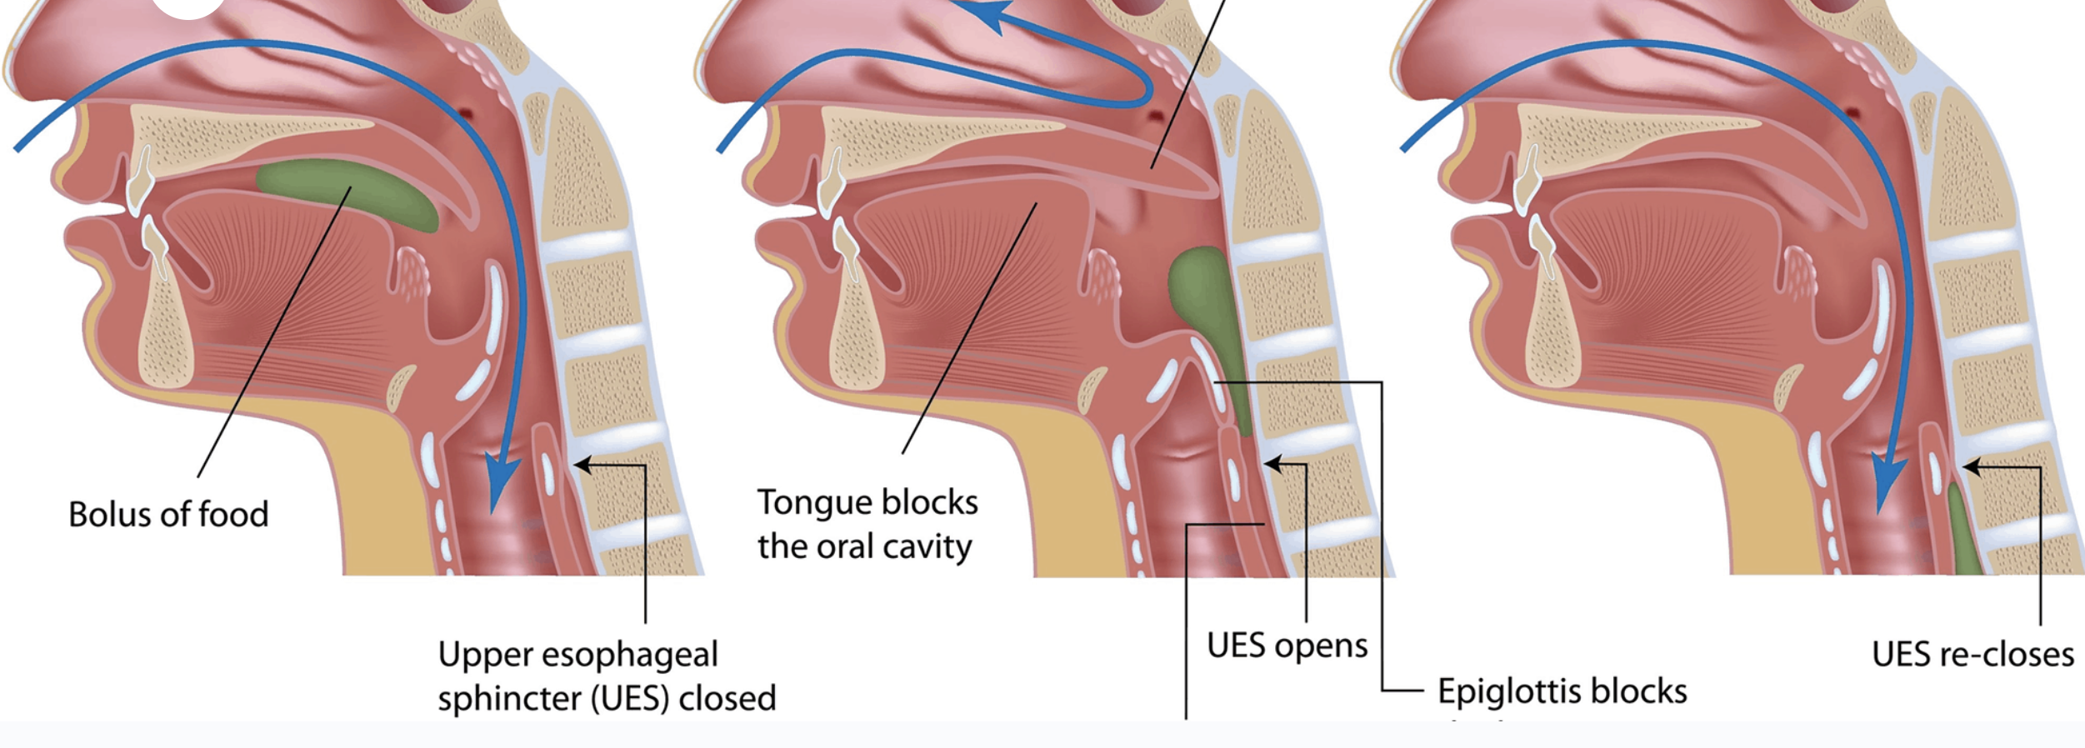

Slide 3
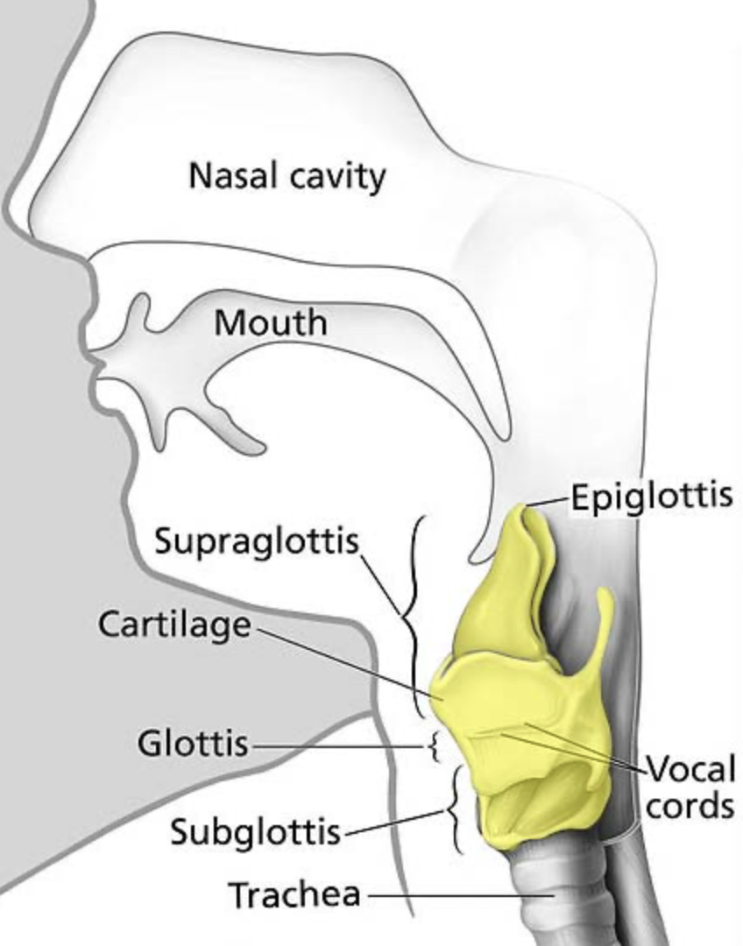

Slide 4
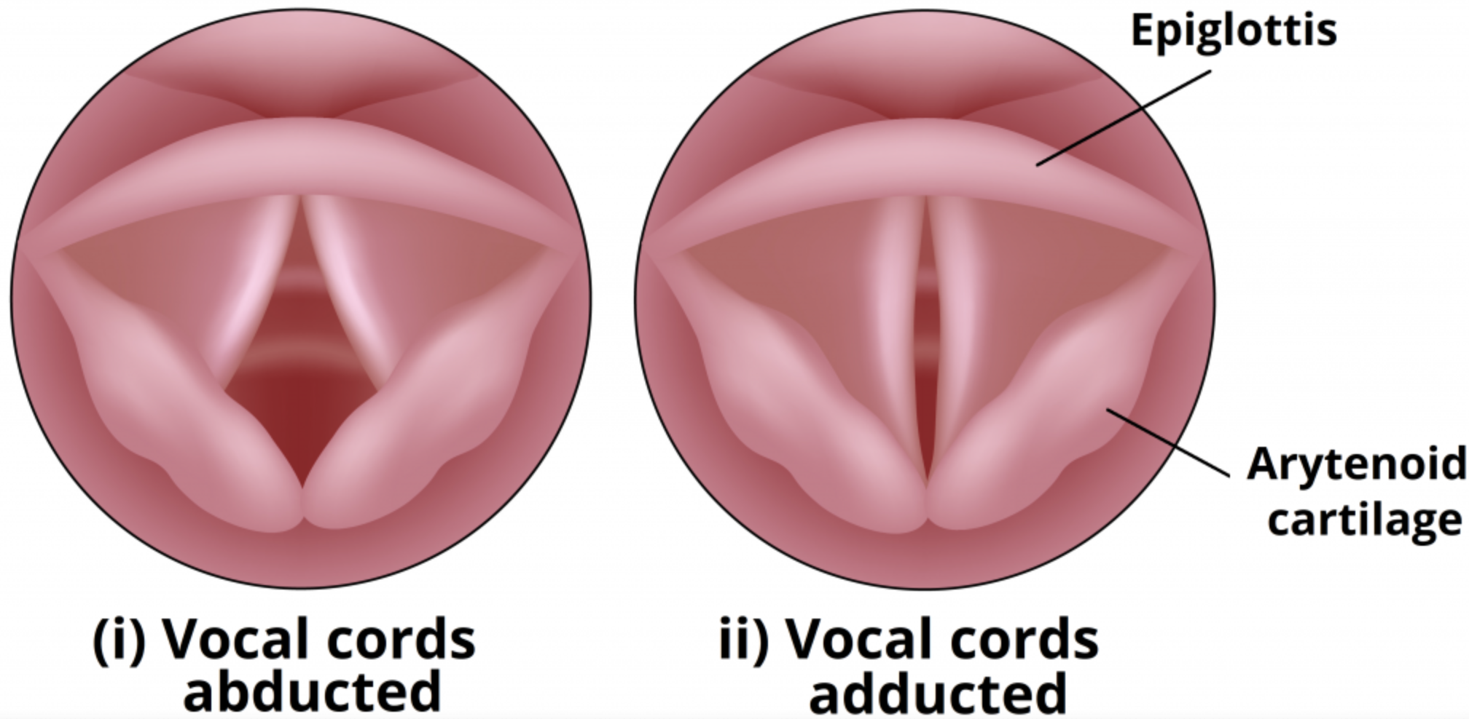

Slide 5
Sounds are produced by air flow from the lungs causing the vocal cord and its covering epithelium to vibrate
the resultant fluctuations in air pressure produce sound waves.
To generate sounds, the vocal cord edges must be brought close enough together to vibrate from the flow of air through the larynx.
The arytenoid cartilages and attached muscles are responsible for movement and tension of the vocal cords.
Resonance of the sound waves is modified by the position and shape of the lips, jaw, tongue, soft palate, and other speech organs.

Slide 6
Causes of Hoarseness
Inflammation
Cancer
Neuromuscular / psychiatric
Other conditions

Slide 7
Inflammation / irritation
Allergies / irritants (alcohol, tobacco)
Direct trauma (intubation)
Environmental irritants (smoke)
Infection (URTI / laryngitis)
Inhaled steroids
Reflux
Vocal abuse / overuse

Slide 8
Cancer
Dysplasia
Papillomatosis
Squamous cell carcinoma

Slide 9
Neuromuscular / Psychiatric
MS
Myasthenia gravis
Nerve injury (vagus, recurrent laryngeal nerve)
Parkinson’s Disease
Psychogenic

Slide 10
Associated Systemic Disease
Acromegaly
Amyloidosis
Hypothyroidism
Inflammatory arthritis (affecting cricoarytenoid joint)
Sarcoidosis

Slide 11
hints
psychological: spoken voice lost, no loss of whisper or cough
worse morning: reflux
worse evening: vocal abuse / overuse, myasthenia
low volume: vocal cord paralysis, Parkinson’s
deep voice, slurred: Acromegaly

Slide 12
Clinical hints
Cough: allergy, inhaled irritants, URTI
Dysphagia: Ca, inflamm arthritis, reflux
Heart burn: reflux, Ca
Coughing blood: Ca
Alcohol abuse: Ca, reflux
Smoking: Ca, laryngitis
Lymph Nodes: Ca, URI
Prof voice use: vocal overuse
Surgery: nerve damage
Intubation: direct trauma

Slide 13
Investigation
History
Clinical exam
Laryngoscopy
Imaging

Slide 14
treatment
Treat the cause
Vocal hygiene
Env changes (humidification, avoidance of smoke and dust etc)
Behavior (avoid excessive coughing / throat clearing
Vocal habit (avoid prolonged talking / shouting)
Diet (hydration, avoidance of spicy food)
Vocal therapy
Vocal and physical exercises
Surgical treatment

