Slide 1
Thigh Pain

Slide 2
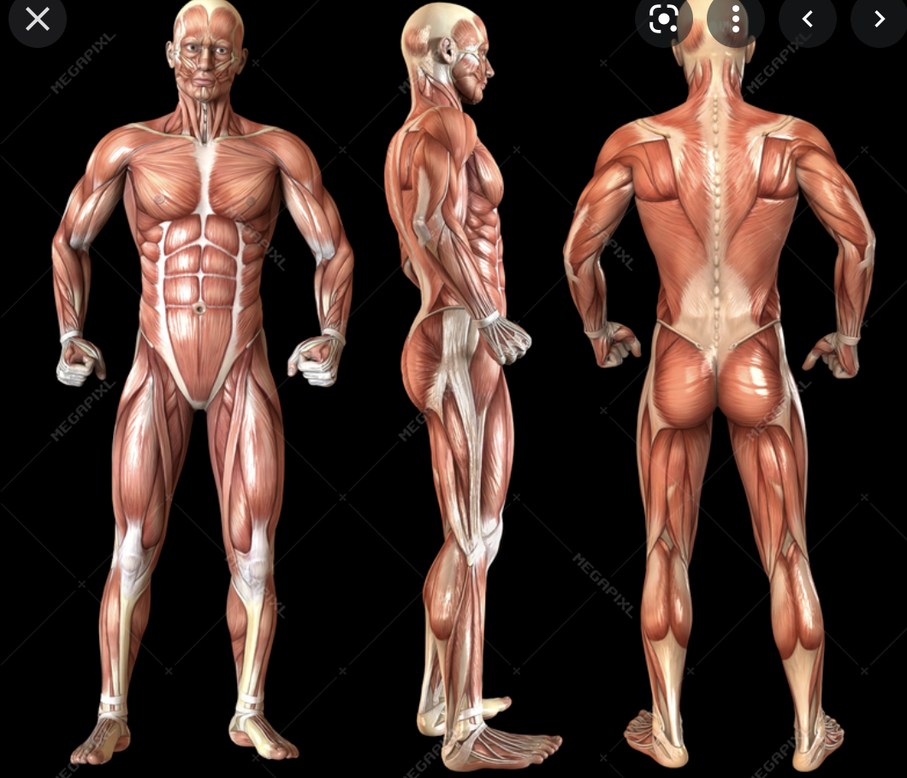

Slide 3
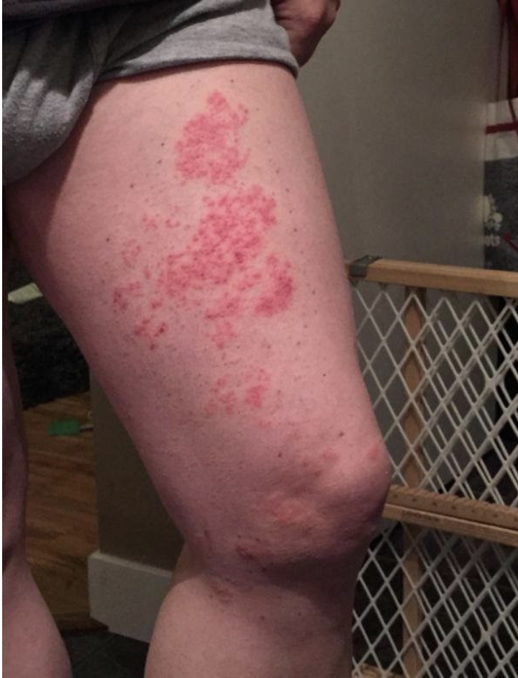
What’s this ?

Slide 4
Causes
local
referred
Bone
Trauma (incl fracture)
tumour
Blood vessels / blood supply
Clots in arteries or veins
Phlebitis
Claudication
Hip joint
Lumbar spine (front or back)
Nerve entrapment
Meralgia paresthetica
Muscle / tendon / ligament
Tear
Myositis
DOMS
Quads tendonitis
Iliotibial band syndrome
Nerves
Neuropathy
neuroma
Skin
Shingles
Dermatitis
Burn injury

Slide 5
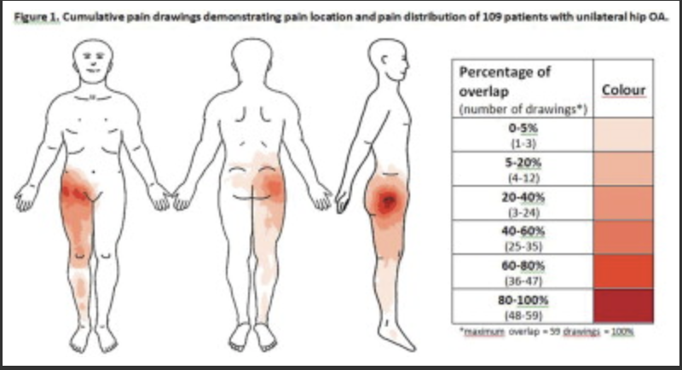
Hip arthritis

Slide 6
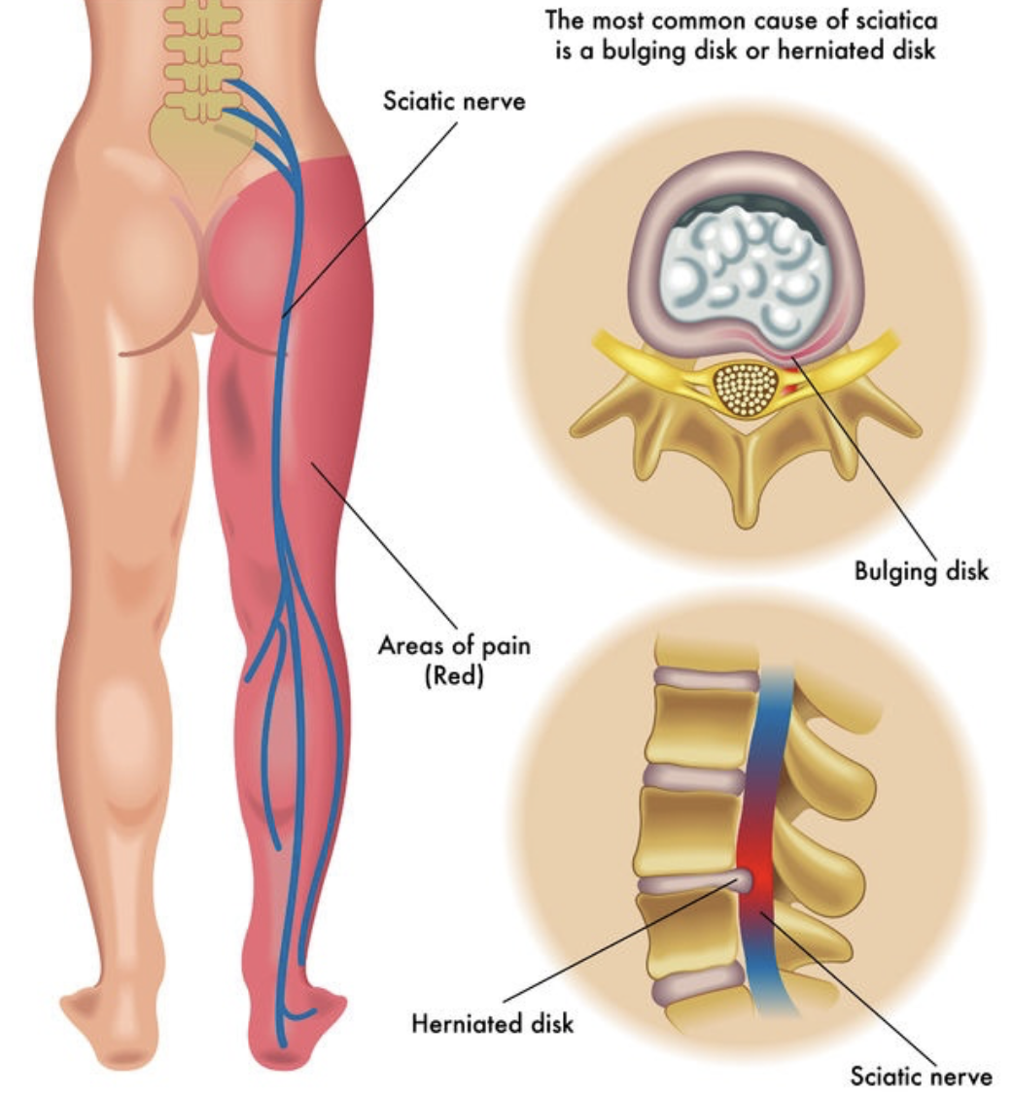
sciatica

Slide 7
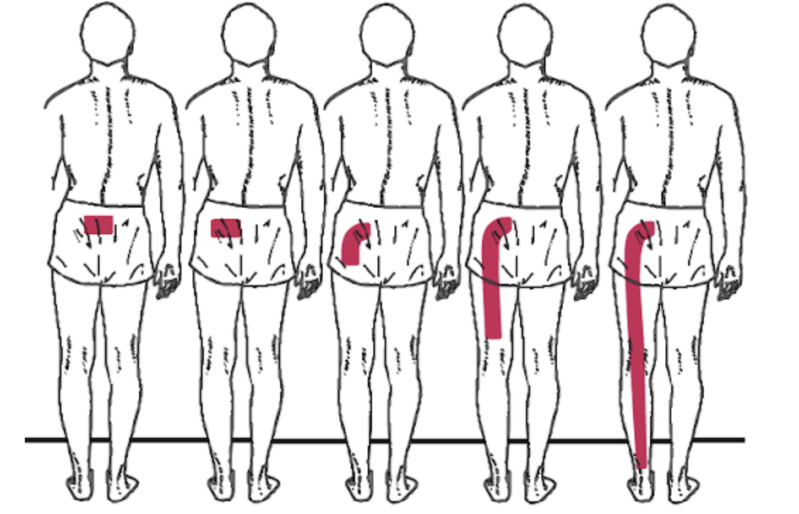

Slide 8
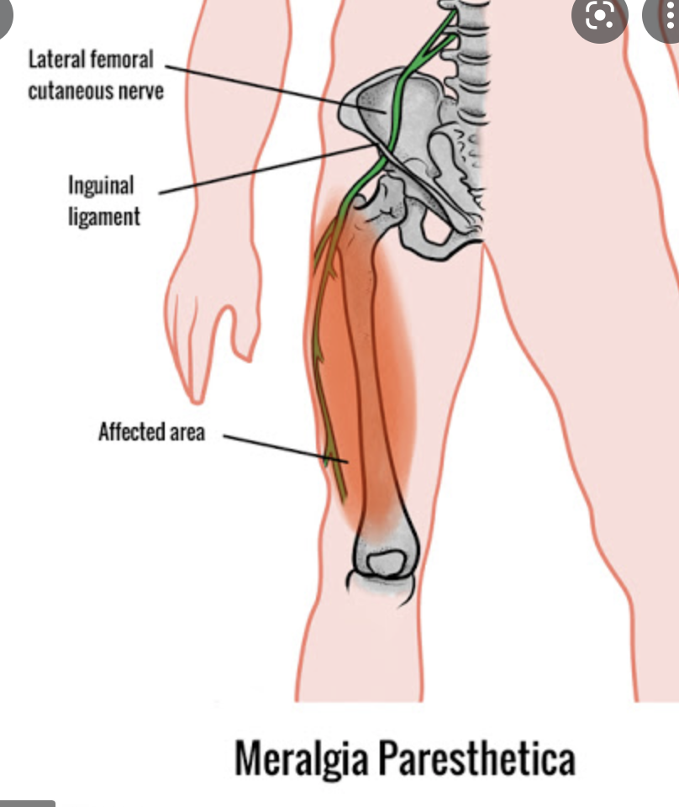

Slide 9
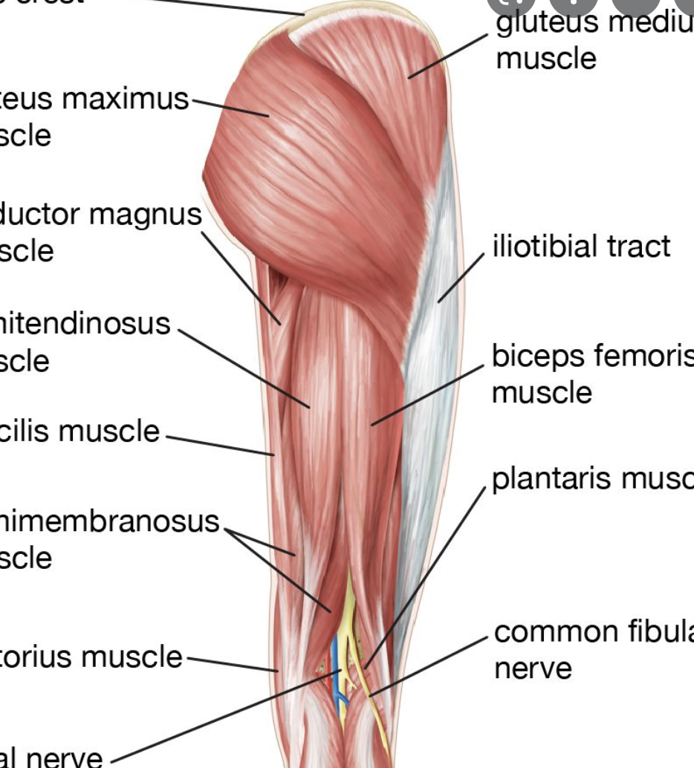
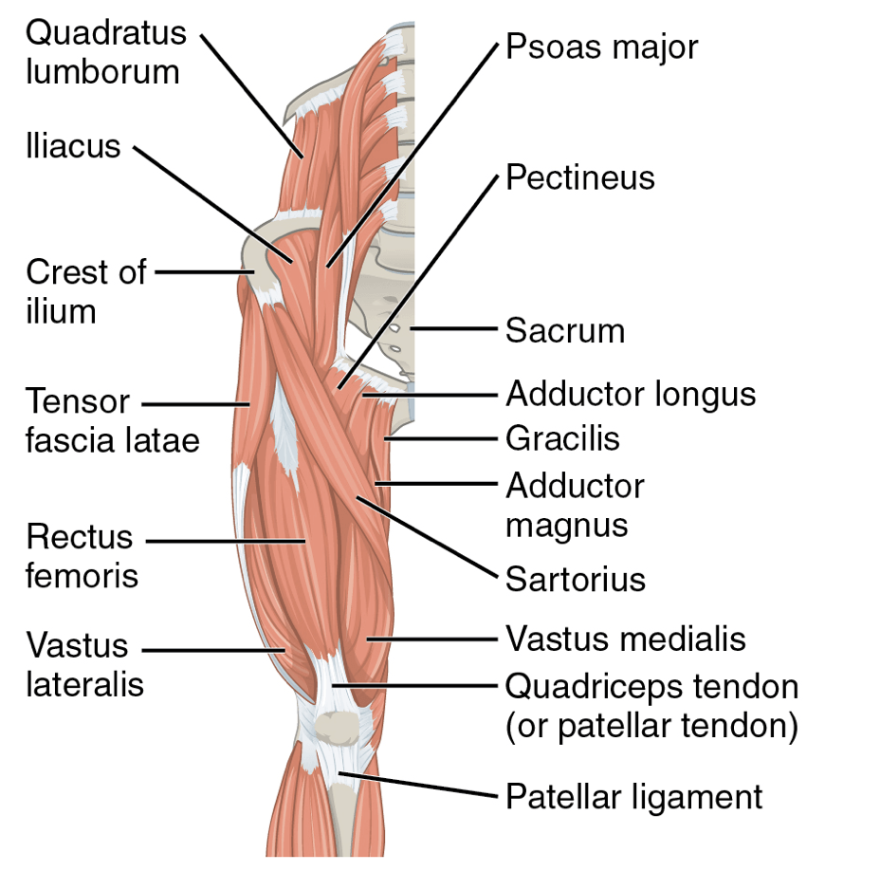

Slide 10
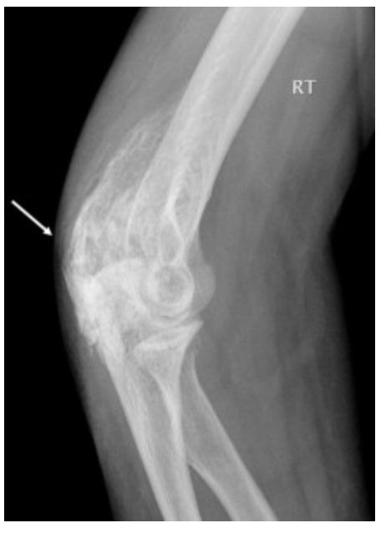
myositis

Slide 11
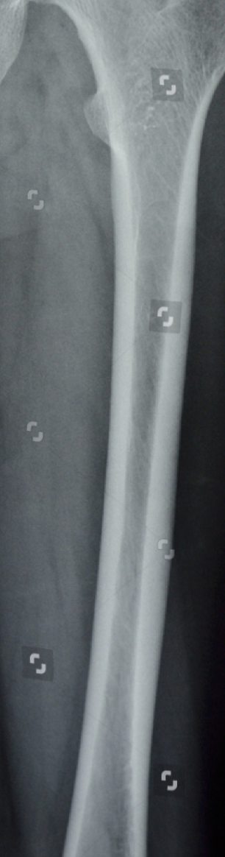
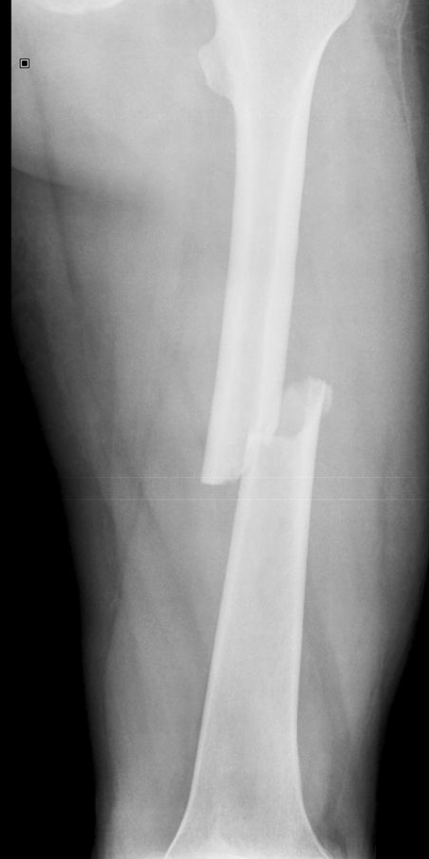
fracture

Slide 12
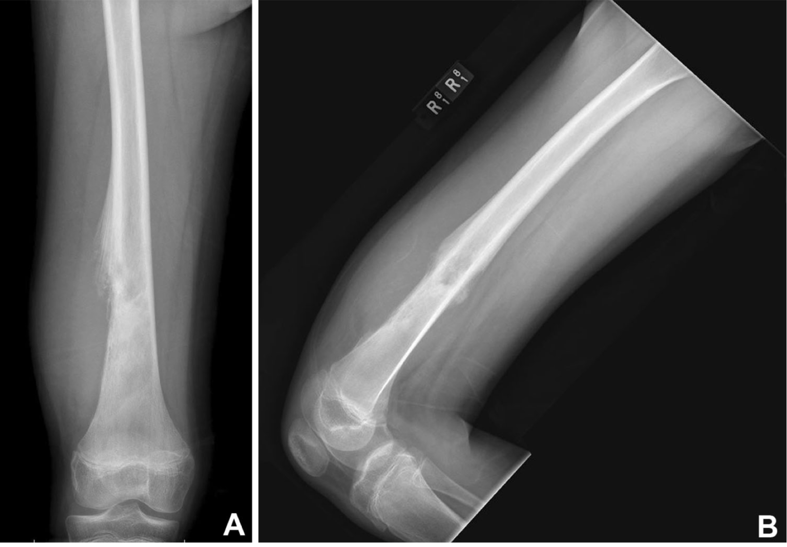
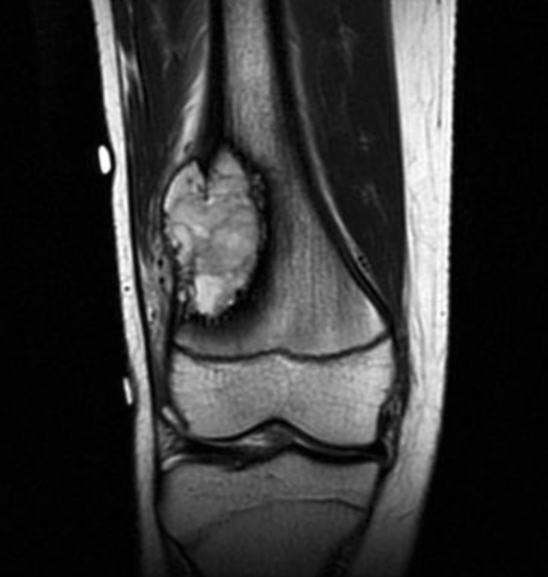
osteosarcoma

Slide 13
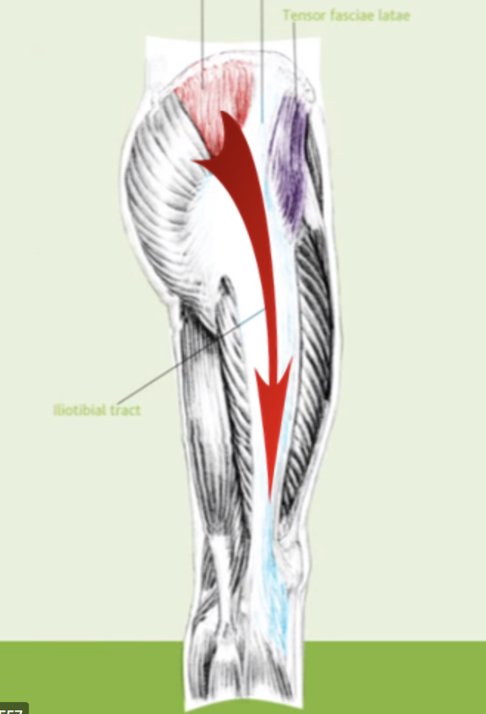
Trochanteric pain syndrome

Slide 14
shingles
Tingling and pain beneath skin
Rash
Blisters

