Slide 1
Heart Failure

Slide 2
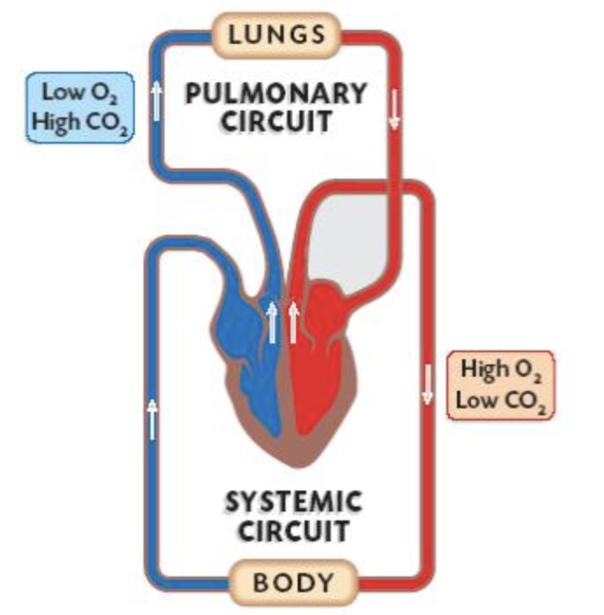

Slide 3
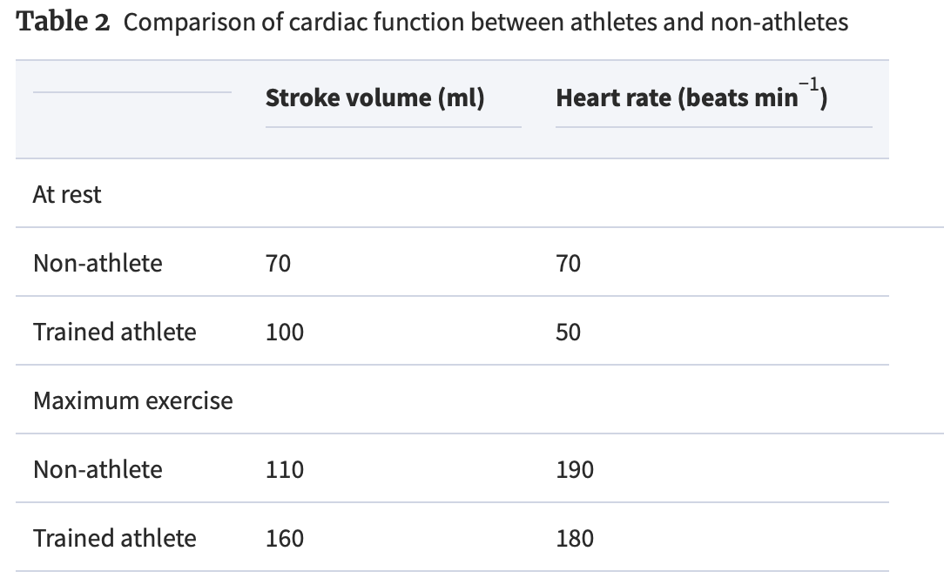
Cardiac
output (l/min)
5
5
+ 57%
+ 170%
21
29
+ 320%
+ 60%
+ 260%
+ 480%

Slide 4
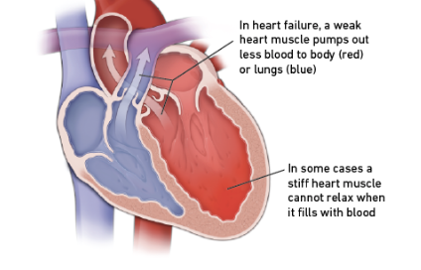

Slide 5
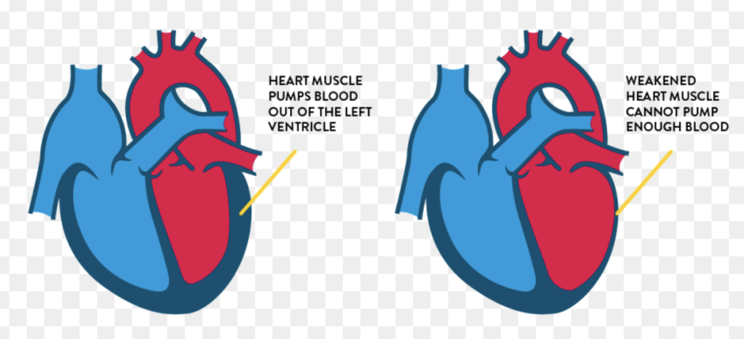

Slide 6
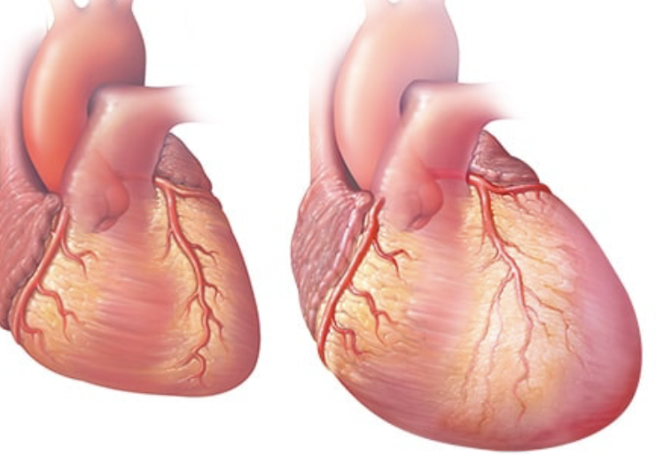

Slide 7
Types of Heart failure 1
Heart failure with preserved left ventricular function (HF-pEF) (i.e., preserved pumping ability). If you have HF-pEF, your EF is in the normal range because your left ventricle is still pumping properly. Also called diastolic heart failure where the heart muscle has bec ome stiff and non-flexible, not allowing the ventricle to fill before pumping
Heart failure with reduced left ventricular function (HF-rEF) (i.e. reduced pumping ability). If you have an EF of less than 35%, you have a greater risk of life-threatening irregular heartbeats that can cause sudden cardiac arrest/death. Also called systolic heart failure

Slide 8
Ejection Fraction
Ejection fraction (EF) refers to how well your left ventricle (or right ventricle) pumps blood with each heart beat. Most times, EF refers to the amount of blood being pumped out of the left ventricle each time It contracts. The left ventricle is the heart's main pumping chamber.
Left ventricular ejection fraction (LVEF) is the measurement of how much blood is being pumped out of the left ventricle of the heart (the main pumping chamber) with each contraction.
Right ventricular ejection fraction (RVEF) is the measurement of how much blood is being pumped out of the right side of the heart to the lungs for oxygen.

Slide 9
EF Figures
Ejection Fraction (EF) %: 55% to 70%
Pumping Ability of the Heart: Normal
Level of Heart Failure/Effect on Pumping: Heart function may be normal or you may have heart failure with preserved EF (HF-pEF).
Ejection Fraction (EF) %: 40% to 54%
Pumping Ability of the Heart: Slightly below normal
Level of Heart Failure/Effect on Pumping: Less blood is available so less blood is ejected from the ventricles. There is a lower-than-normal amount of oxygen-rich blood available to the rest of the body. You may not have symptoms.
Ejection Fraction (EF) %: 35% to 39%
Pumping Ability of the Heart: Moderately below normal
Level of Heart Failure/Effect on Pumping: Mild heart failure with reduced EF (HF-rEF).
Ejection Fraction (EF) %: Less than 35%
Pumping Ability of the Heart: Severely below normal
Level of Heart Failure/Effect on Pumping: Moderate-to-severe HF-rEF. Severe HF-rEF increases the risk of life-threatening heartbeats and cardiac dyssynchrony/desynchronization (right and left ventricles do not pump in unison).

Slide 10
EF and exercise
EF should normally increase with exercise
In heart disease it may not increase or may even decrease

Slide 11
Types of `Heart Failure 2
Left-sided heart failure: The left ventricle no longer pumps enough blood around the body. As a result, blood builds up in the pulmonary veins (the blood vessels that carry blood away from the lungs). This causes shortness of breath, trouble breathing or coughing
–Right-sided heart failure: Here the right ventricle of the heart is too weak to pump enough blood to the lungs. This causes blood to build up in the veins (the blood vessels that carry blood from the organs and tissue back to the heart). The increased pressure inside the veins can push fluid out of the veins into surrounding tissue. This leads to a build-up of fluid in the legs, or less commonly in the genital area, organs or the abdomen (belly).
Biventricular heart failure: In biventricular heart failure, both sides of the heart are affected. This can cause the same symptoms as both left-sided and right-sided heart failure, such as shortness of breath and a build-up of fluid.

Slide 12
Types of Heart Failure 3
Acute Heart Failure: this occurs suddenly, for example following a sudden heart attack, a sudden onset rhythm disturbance, an acute allergic reaction etc
Chronic heart failure: this comes on slowly as the heart gradually becomes weakened (for various reasons)

Slide 13
causes
Coronary artery disease and heart attack.
High blood pressure. If your blood pressure is high, your heart has to work harder than it should to circulate blood throughout your body. Over time, this extra exertion can make your heart muscle too stiff or too weak to properly pump blood.
Faulty heart valves. The valves of the heart keep blood flowing in the proper direction. A damaged valve — due to a heart defect, coronary artery disease or heart infection — forces the heart to work harder, which can weaken it over time.
Damage to the heart muscle from certain diseases, infection, heavy alcohol use, and the toxic effect of drugs, such as cocaine or some drugs used for chemotherapy.
Inflammation of the heart muscle (myocarditis), most commonly caused by a virus, including the COVID-19 virus, and can lead to left-sided heart failure.

Slide 14
A heart problem that you're born with (congenital heart defect). If your heart and its chambers or valves haven't formed correctly, the healthy parts of your heart have to work harder to pump blood, which may lead to heart failure.
Abnormal heart rhythms (arrhythmias). Abnormal heart rhythms may cause your heart to beat too fast, creating extra work for your heart. A slow heartbeat also may lead to heart failure.
Other diseases. Long-term diseases — such as diabetes, HIV, an overactive or underactive thyroid, or a buildup of iron or protein — also may contribute to chronic heart failure.

Slide 15
Causes of acute heart failure
Allergic reactions
Any illness that affects the whole body
Blood clots in the lungs
Severe infections
Use of certain medications
Viruses that attack the heart muscle

Slide 16
symptoms
Shortness of breath with activity or when lying down
Fatigue and weakness
Swelling in the legs, ankles and feet
Rapid or irregular heartbeat
Reduced ability to exercise
Persistent cough or wheezing with white or pink blood-tinged mucus
Swelling of the belly area (abdomen)
Very rapid weight gain from fluid buildup
Nausea and lack of appetite
Difficulty concentrating or decreased alertness
Chest pain if heart failure is caused by a heart attack

Slide 17
Diagniosis : Clinical assessment
careful medical history,
review of symptoms and risk factors
examination
listen to your lungs for signs of fluid build up (lung congestion)
assess the size of the heart (by locating the apex beat)
listen to your heart for murmurs that may suggest heart failure and for rhythm abnormalities.
examine the veins in your neck and check for fluid buildup in your abdomen and legs.

Slide 18
tests
Blood tests.
Chest X-ray. .
Electrocardiogram (ECG). .
Echocardiogram. .
Stress test. .
Cardiac computerized tomography (CT) scan. .
Magnetic resonance imaging (MRI).
Coronary angiogram.
Myocardial biopsy.

Slide 19
Complications of heart failure
Kidney damage or failure. Heart failure can reduce the blood flow to your kidneys, which can eventually cause kidney failure if left untreated. Kidney damage from heart failure can require dialysis for treatment.
Heart valve problems. The valves of the heart, which keep blood flowing in the right direction, may not work properly if your heart is enlarged or if the pressure in your heart is very high due to heart failure.
Heart rhythm problems. Heart rhythm problems may lead to or increase your risk of heart failure.
Liver damage. Heart failure can cause fluid buildup that puts too much pressure on the liver. This fluid backup can lead to scarring, which makes it more difficult for your liver to work properly.

Slide 20
Screening for heart failure
Screening blood tests:
BNP
Lipids
Inflammatory markers (CRP)
Reasons for getting echo
Strong family history of cardiomyopathy
Long-term high blood pressure
Previous heart attack
Use of medicines that are toxic to the heart, such as chemotherapy for cancer

Slide 21
prevention
Not smoking
Controlling certain conditions, such as high blood pressure and diabetes
Staying physically active
Eating healthy foods
Maintaining a healthy weight
Reducing and managing stress

Slide 22
Treatment
Lifestyle. (exercise / nutrition / stress management/ alcohol / rec drugs)
Treat underlying conditions (medication / surgery)
Specific medication for the heart failure
Self- monitoring of symptoms, daily weight with advanced HF
Heart devices (defib / pacemaker / pump assistance devices)
Heart transplant

Slide 23
FACES: the 5 early warning signs (Harvard)
F = Fatigue.
A = Activity limitation. .
C = Congestion. coughing, wheezing, and breathing difficulty.
E = Edema or ankle swelling.
S = Shortness of breath.

Slide 24
Predictors of recovery
younger age
female
some specific causes
hypertension
atrial fibrillation
cancer

