Slide 1
Wrist and Hand

Slide 2
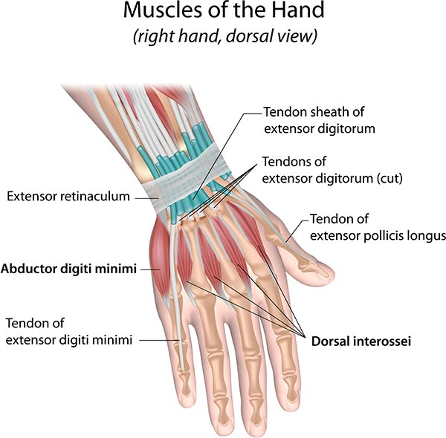
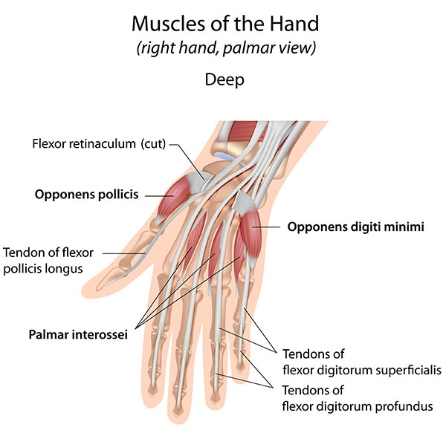
Anatomy

Slide 3
Common Conditions
Osteoarthritis
Rheumatoid Arthritis
Dupuytren’s Contracture
De Quervin’s Tensosynovitis
What is it? What causes it?
Risk factors
Symptoms
Treatment

Slide 4
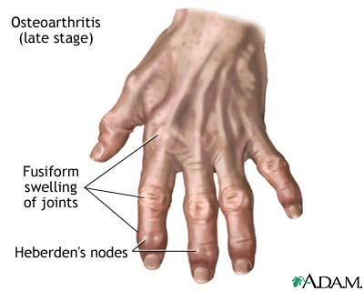
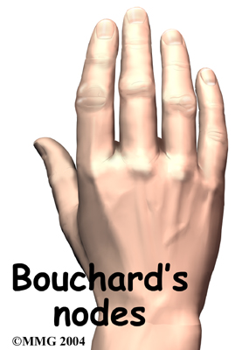
Osteoarthritis
What is it?
- Loss of articular cartilage in joints of hand causing pain, stiffness & loss of function.
- Most likely to affect PIP joints, DIP joints and base of thumb.
Risk Factors: Age/Gender/Ethnicity/Handedness
Symptoms: Pain (worse in morning), stiffness, (some swelling)
- Bouchard’s (proximal IP) nodes / Hebreden’s (distal IP) nodes
- Muscle Weakness / Difficulty gripping and twisting objects
Flare Ups: Cold weather, stress, repetitive movement, infection

Slide 5
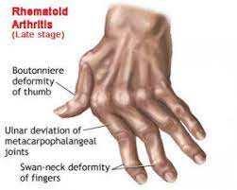
Rheumatoid Arthritis
What is it?
Chronic inflammatory disorder causing painful swelling in the lining of joints. Autoimmune disorder affecting the synovium.
Immune system malfunctions and attacks healthy tissue
Risk Factors: Gender / Age / Family History
Symptoms: Tender, warm, swollen joints
Stiffness in joints, especially in morning and after inactivity
Deformities – Swan neck, Boutannaire’s
Similar symptoms on both sides

Slide 6
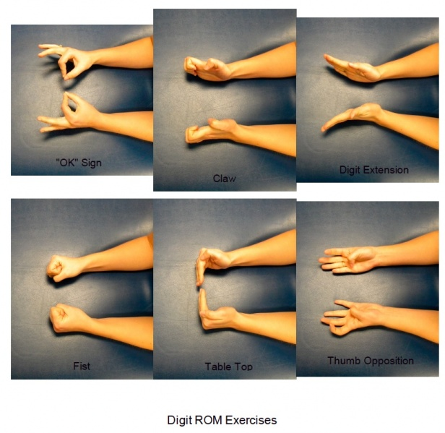
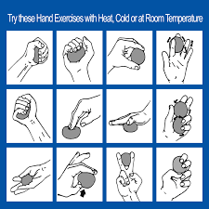
Treatment
Medication: NSAIDs, analgesics (both)
RA – Corticosteroid injections, specialised medication to slow rate of progression of disease.
Hand exercises – joint mobility and muscle strength
Joint protection techniques
Orthotics/splints
OA –Heat application
RA – Surgery:
Synovectomy – remove inflamed lining of joint
Tendon Repair – loose or ruptured tendons repaired
Joint Fusion – Stabilize or realign a joint
Joint Replacement – remove damaged parts, insert prosthesis

Slide 7
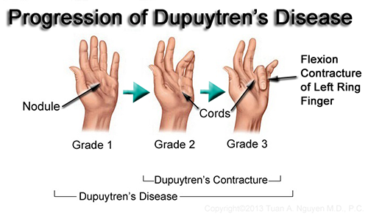
Dupuytren’s Contracture
What is it?
- Abnormal thickening of the skin in the palm of your hand at the base of your fingers. This thickened area may develop into a hard lump or thick band.
Can cause one or more fingers to curl (contract) – usually ring or baby finger
Cause is unnown, most likely hereditary
Risk factors: Age/Gender/Ethnicity/Seizure medication/Diabetes
Symptoms: Small tender nodules on palm, thickening under skin, finger starts to curl, can’t lay palm flat, loss of function.

Slide 8
Treatment
Surgical
Non-surgical
At late stage of condition
If interfering with hand function
Aim: reduce contracture + increase movement in finger
Fasciotomy (release) or Fasciectomy (removal)
Complications: Scarring, wound infection, nerve/blood vessels injust, loss of sensation
Steroid injection – corticosteroids are strong anti-inflammatories
Slow the rate of progression of the contracture
Results vary from person to person
Splinting – to maintain extension of fingers. (Evidence on effectiveness is unclear)

Slide 9
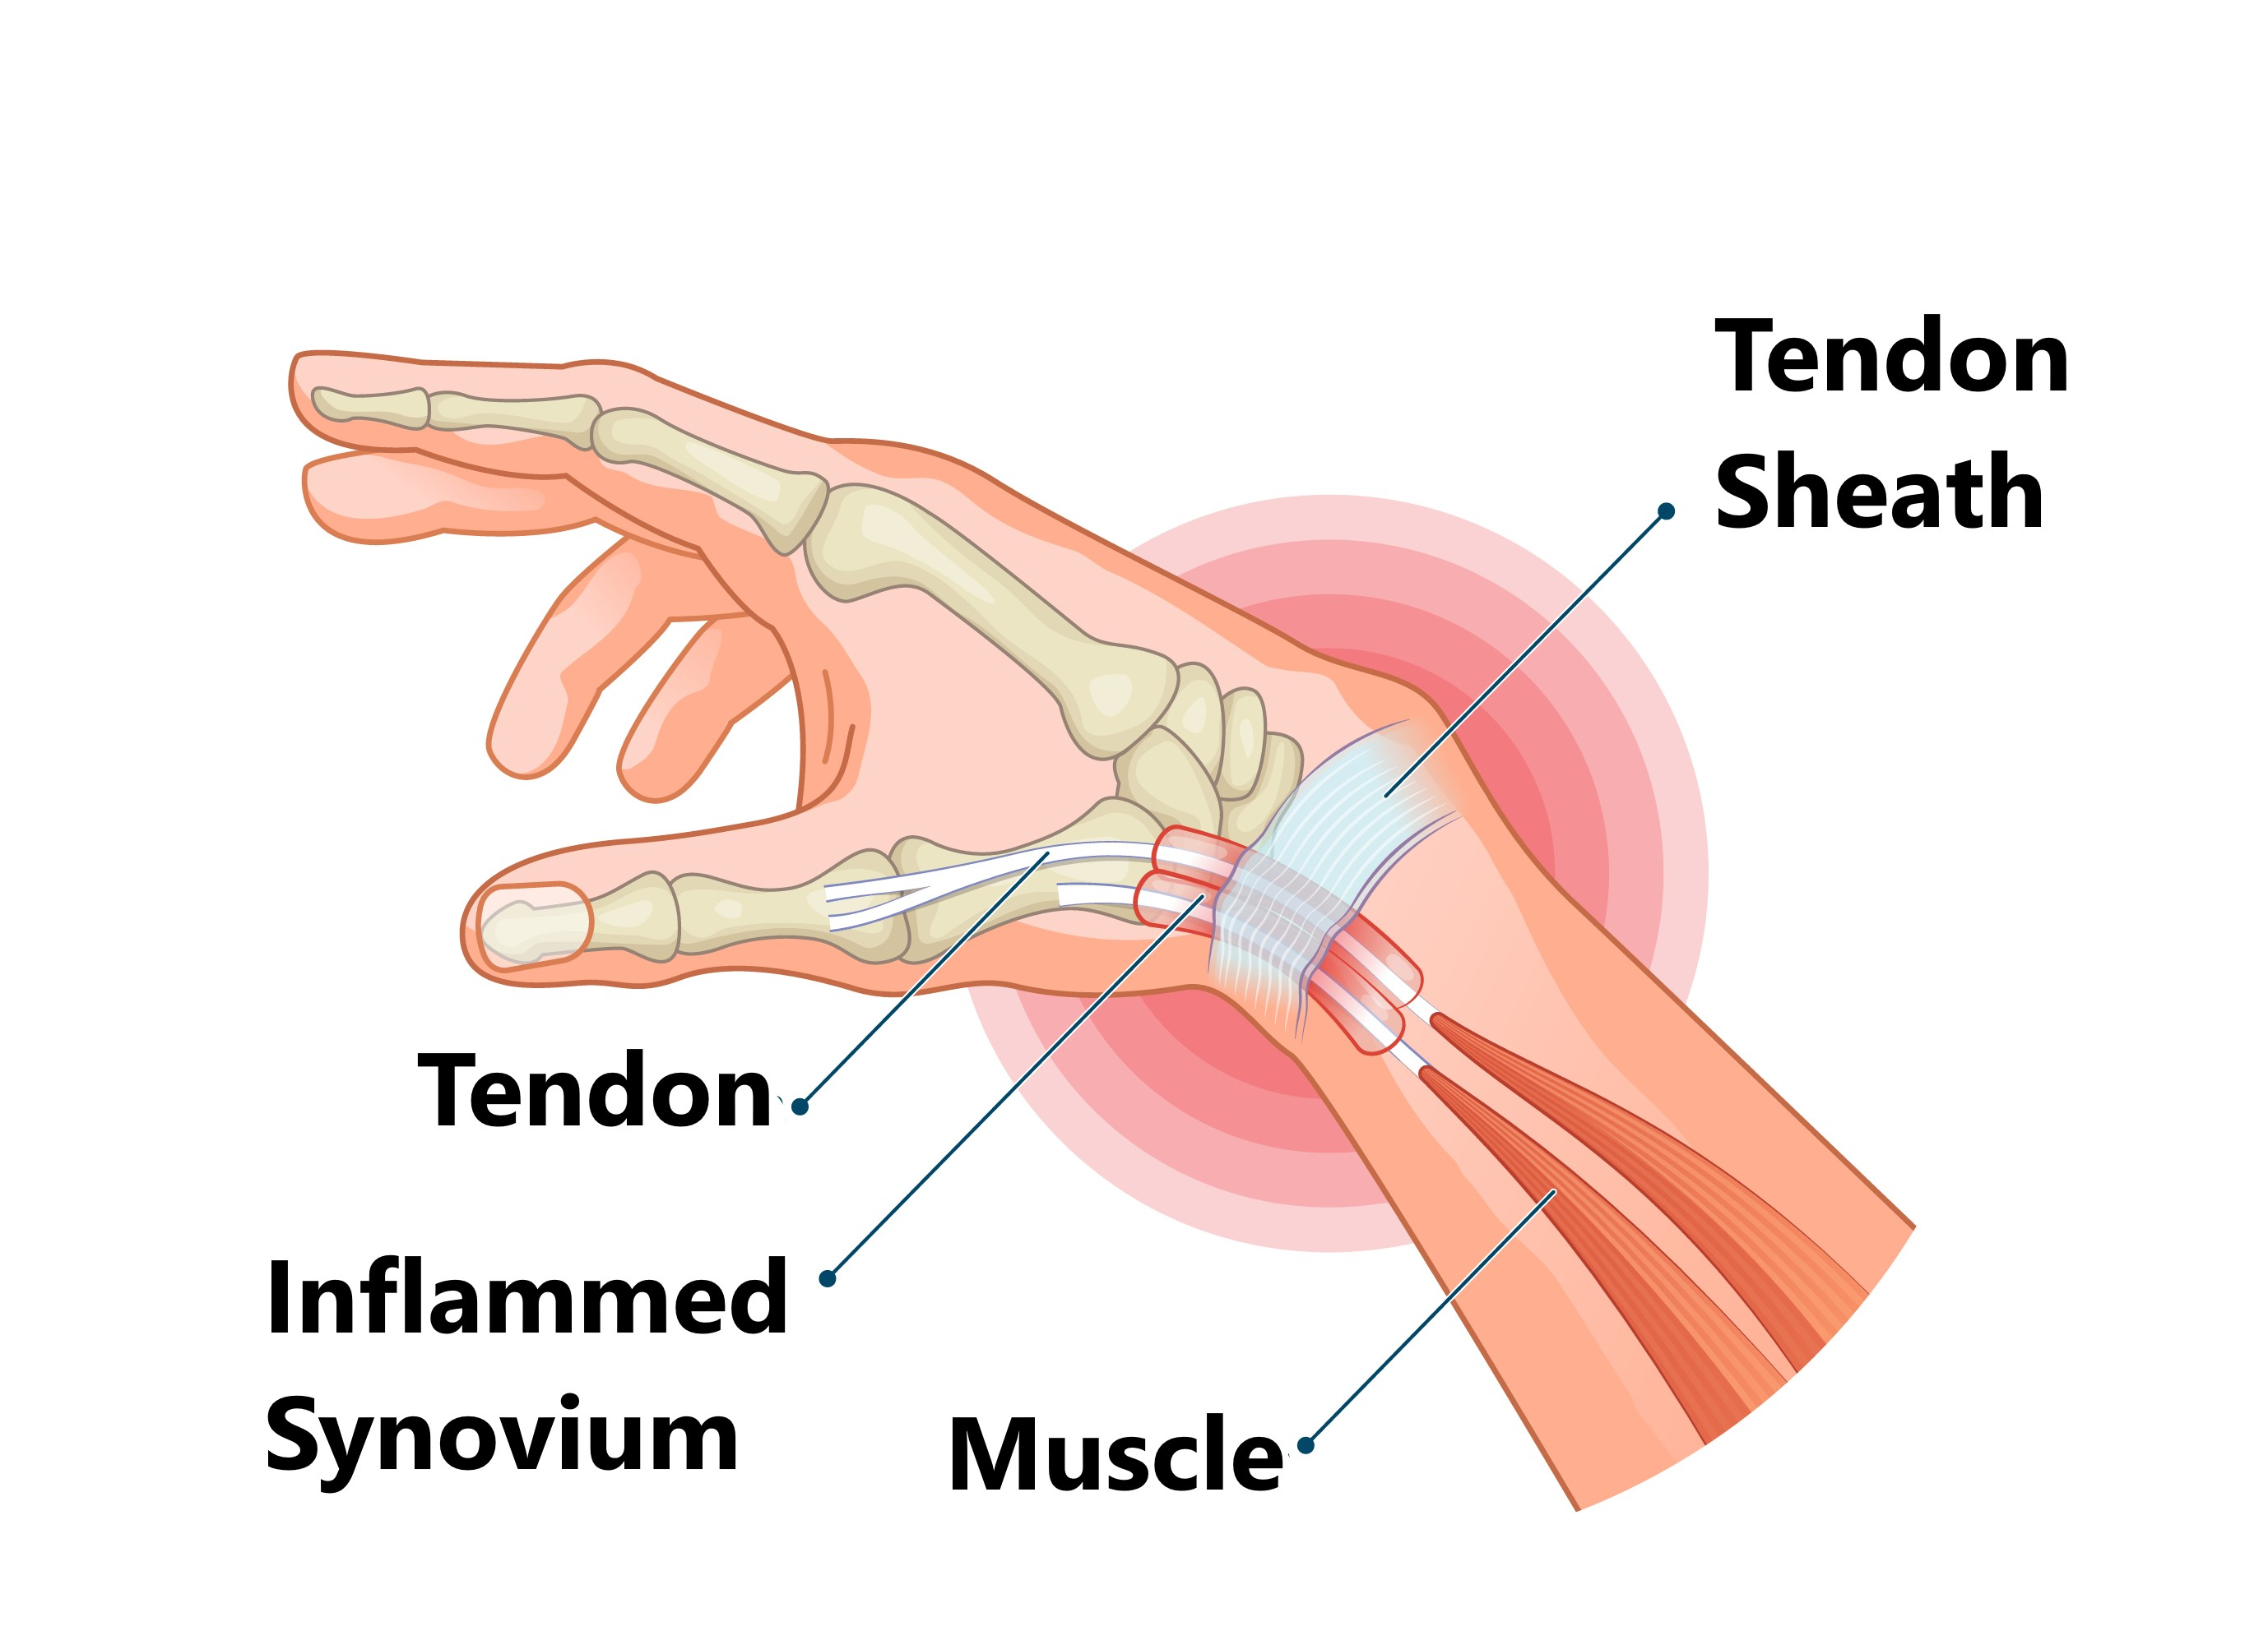
De Quervains Tenosynovitis
Tendons surrounded by synovial sheath. Inflammation and swelling of sheaths of tendons controlling thumb causes pain.
Cause: Repetitive overuse injury – gardening, tennis, lifting a baby
Risk factors: Age / Pregnancy
Symptoms:
Pain and tenderness over thumb side of the wrist. Worse when hand and thumb are in use – grabbing, twisting etc.
Pain can travel up forearm.
Catching or snapping sensation when moving your thumb

Slide 10
Treatment
Non-surgical
Surgical
NSAIDS – anti inflammatory medication
Splints – rest and support thumb
Avoid activities that cause pain and swelling
Corticosteroid injections – into tendon sheath to reduce pain and swelling
If symptoms are severe and don’t improve with conservative management
Involves cutting/opening the tendon sheath.
This relieves the pressure and allows more room for the tendons and for movement

