Slide 1
Knee Pain

Slide 2
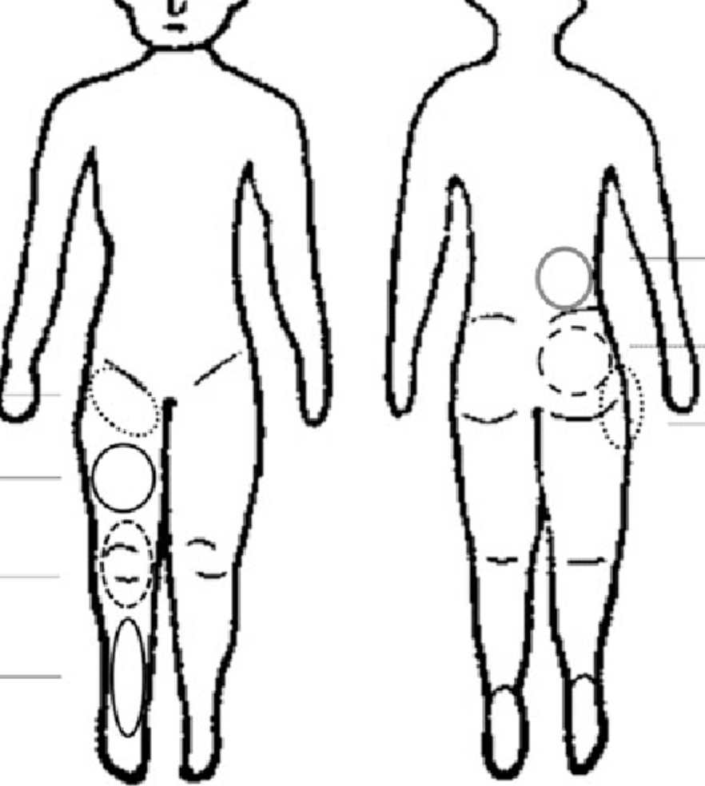
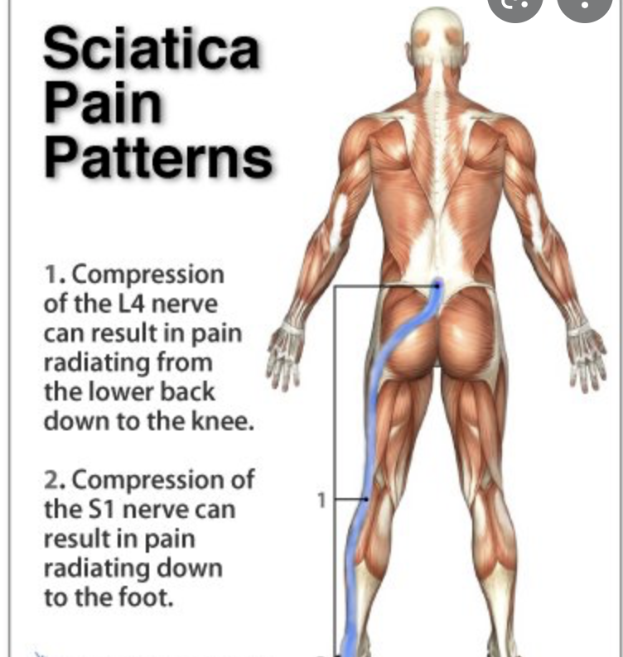
Referred pain to the knee
Lumbar spine (sciatica)
Hip Joint

Slide 3
Local causes
Medial ligament injury
Meniscal kin jury

Slide 4
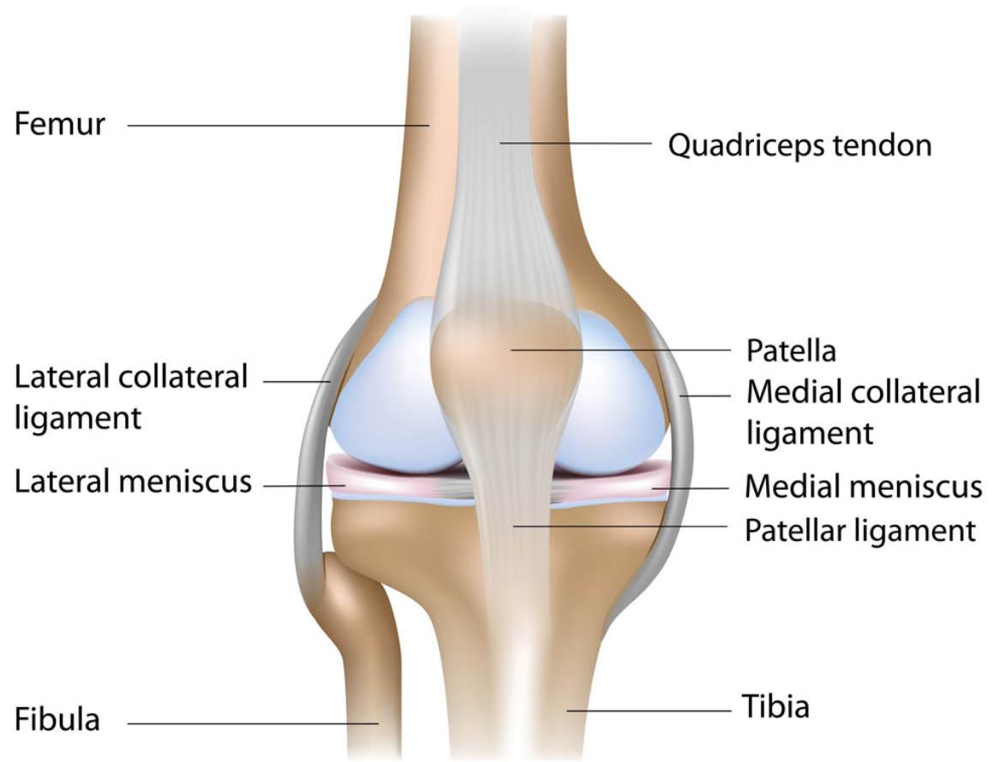

Slide 5
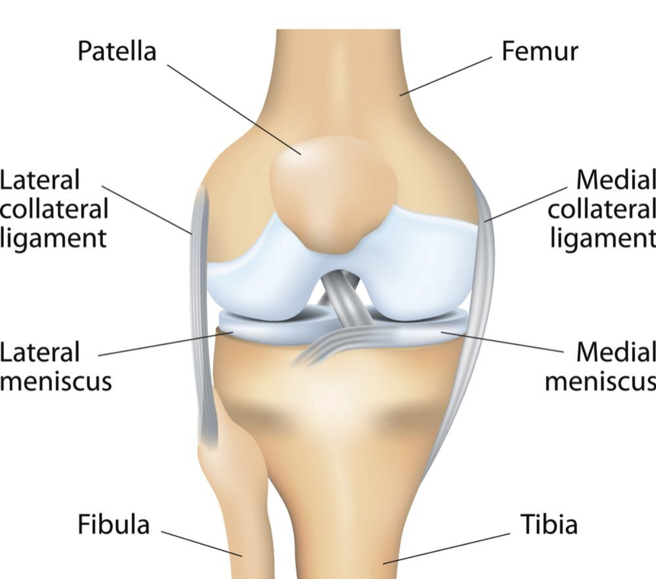

Slide 6
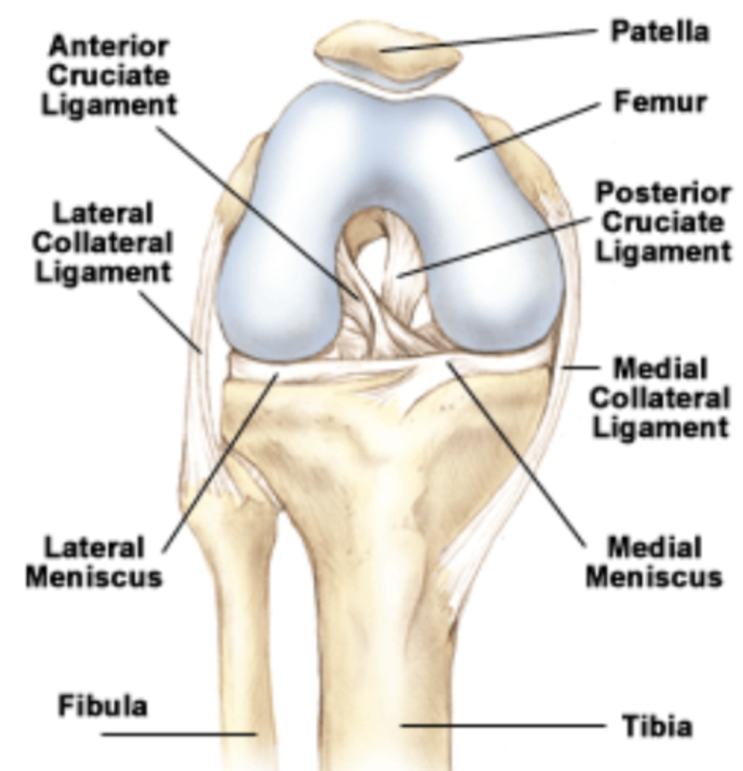

Slide 7
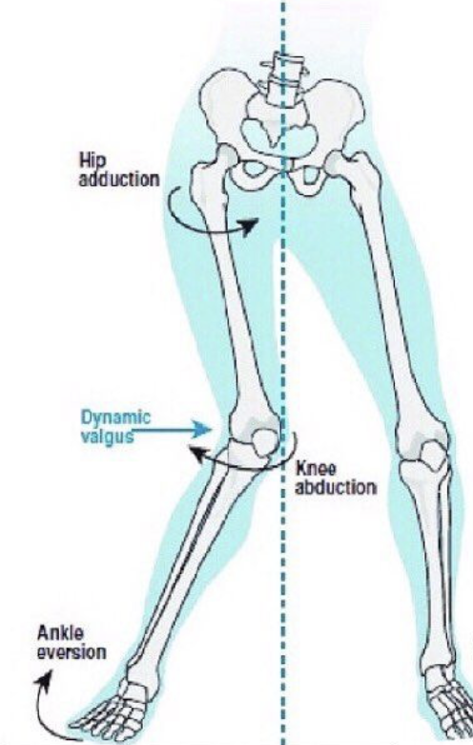
Medial collateral ligament injury
The history
valgus stress described
immediacy medial (inner side of knee) pain
localised (medial) swelling
typically sore ++ / stiff after inactivity
usually does not give way or lock

Slide 9
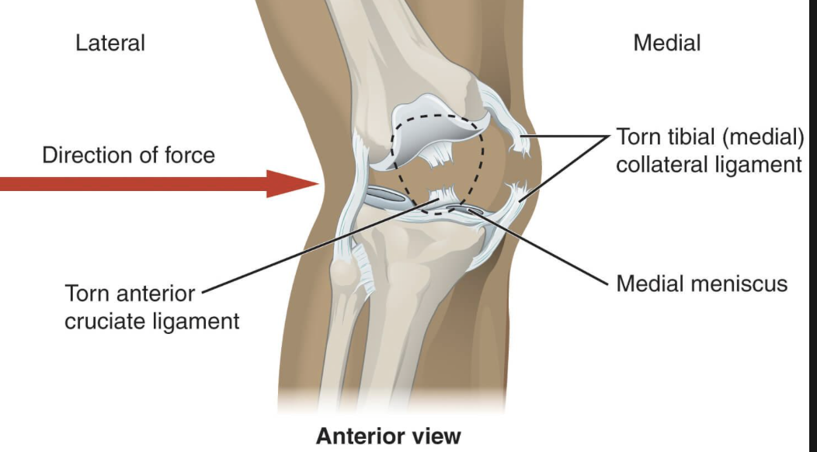
Grades of MCL Injury
On applying valgus stress
Grade 1: painful, not loose
Grade 2: pain and loose
Grade 3: n o pain, but very loose

Slide 10
Treatment of MCL injury
treatment is rest and protection fropm repeat valgus episodes by using a brace
Keep quads strong
usually heals 4-6 weeks
Surgery rarely needed
Note other structures can also be damaged if then stress is very severe or combined with a rotational twist

Slide 11
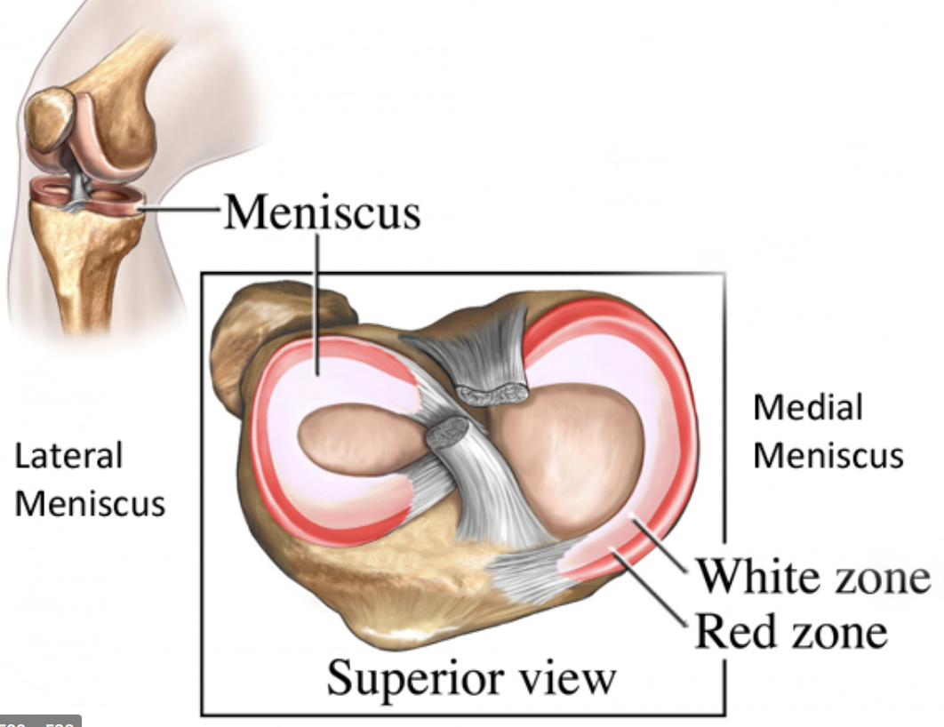

Slide 12
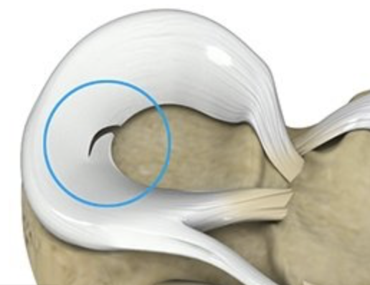

Slide 13
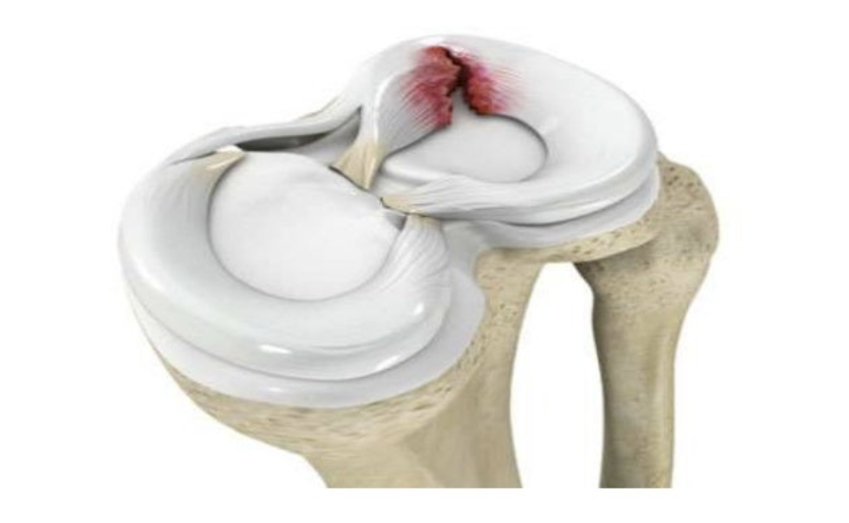
Meniscal tear
The history
twisting injury
immediate pain
pain may be medial / lateral / posterior
+/- locking
swells + all over (not localised)
pain on turns
difficulty squatting / hunkering
gives way
locks

Slide 14
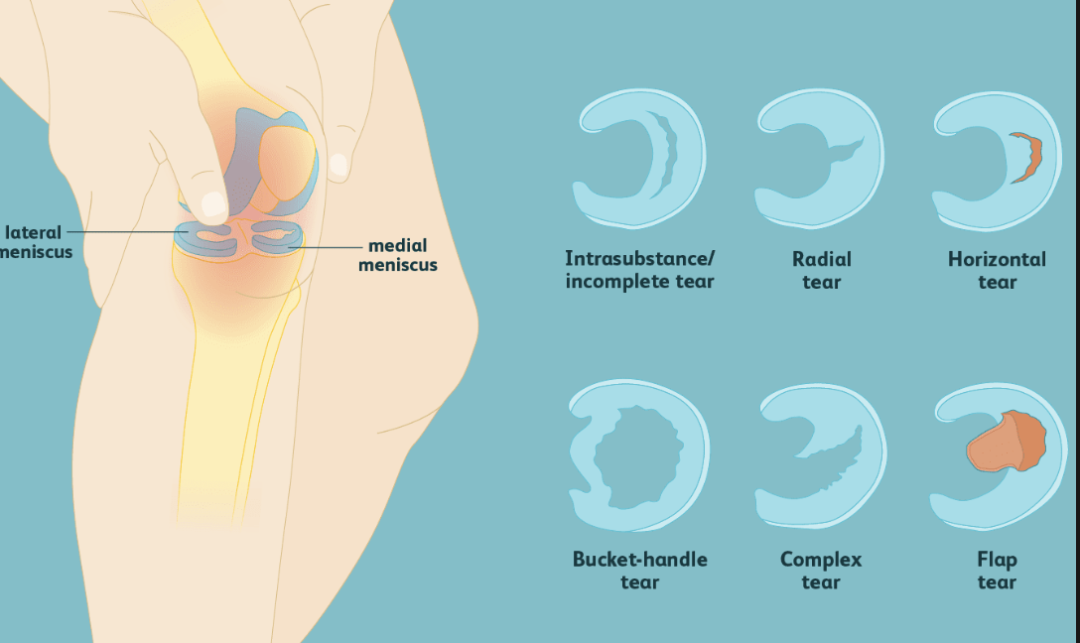

Slide 15
examination
swollen
reduced movement
twisting tests +
tender joint line

Slide 16
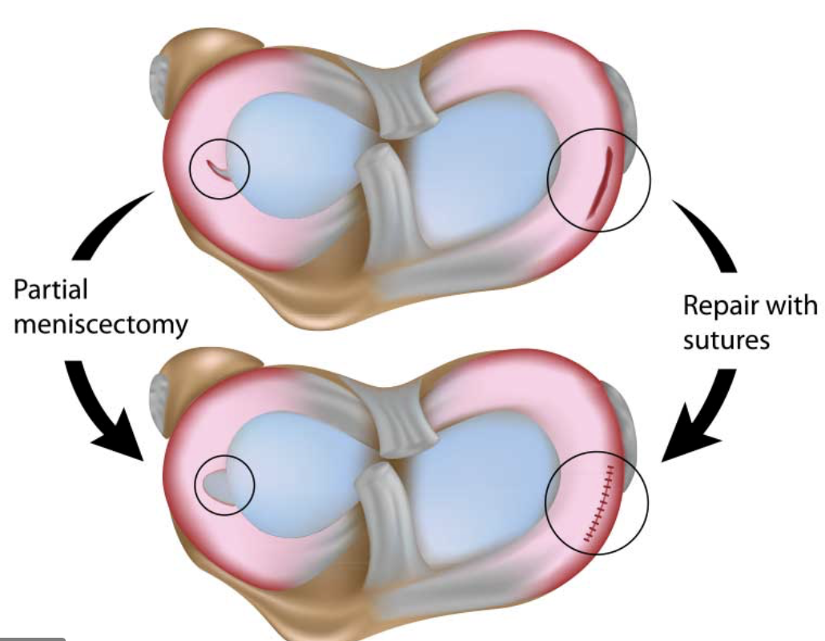
treatment
Poor healing, so often needs surgery

Slide 17
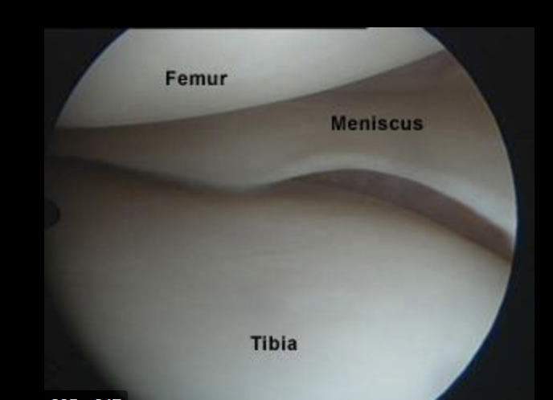

Slide 18
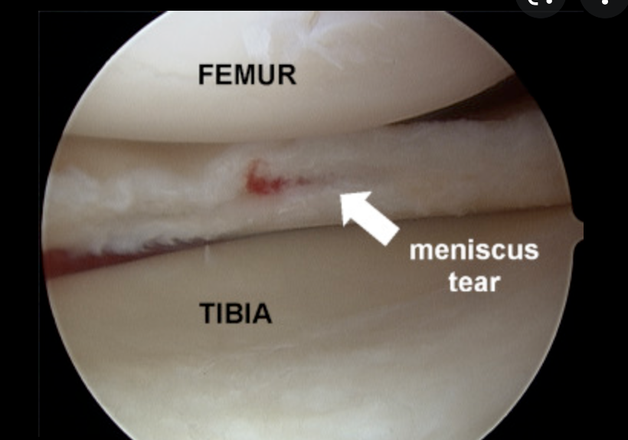

Slide 19
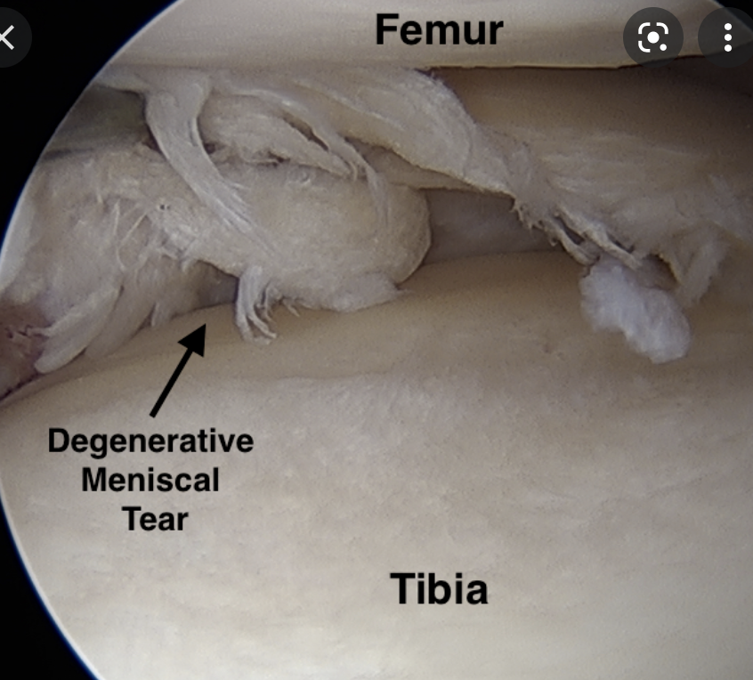
Degenerate Meniscus
gradually breaks down
age related
often occurs with osteoarthritis of the knee
medial compartment OA plus degenerate medial meniscus very common

Slide 20
