Slide 1
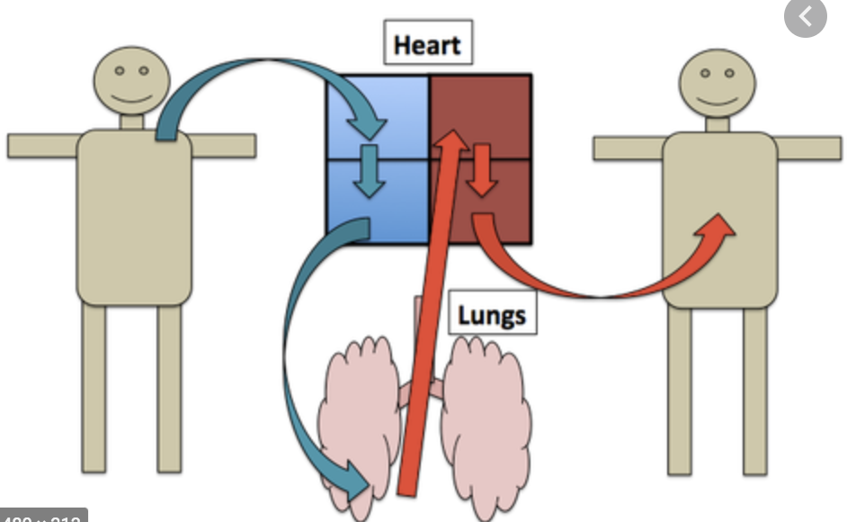

Slide 2
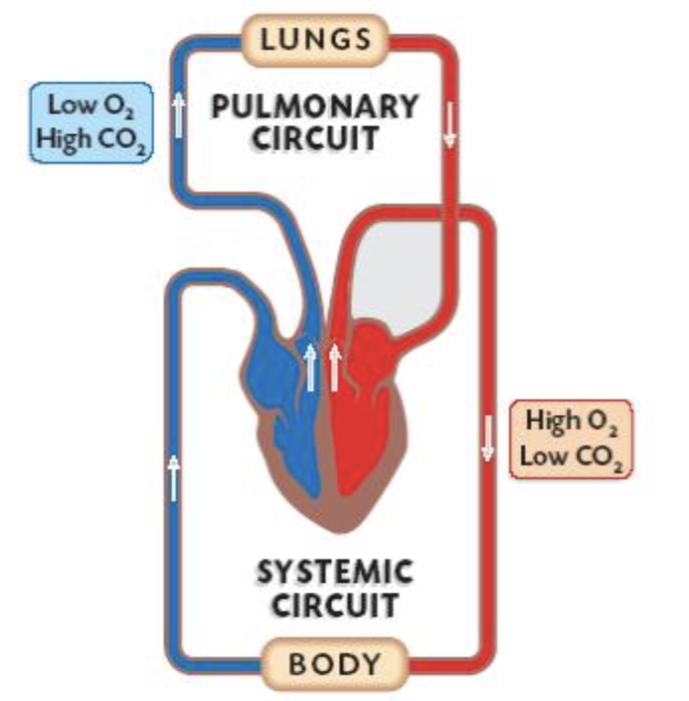

Slide 3
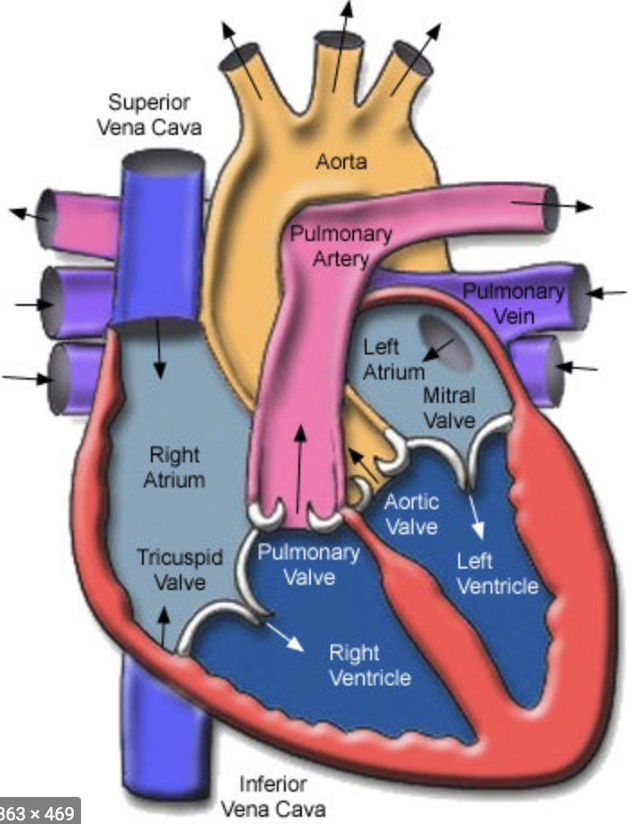

Slide 4
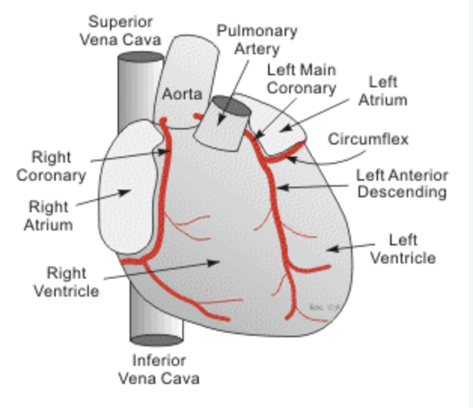

Slide 5
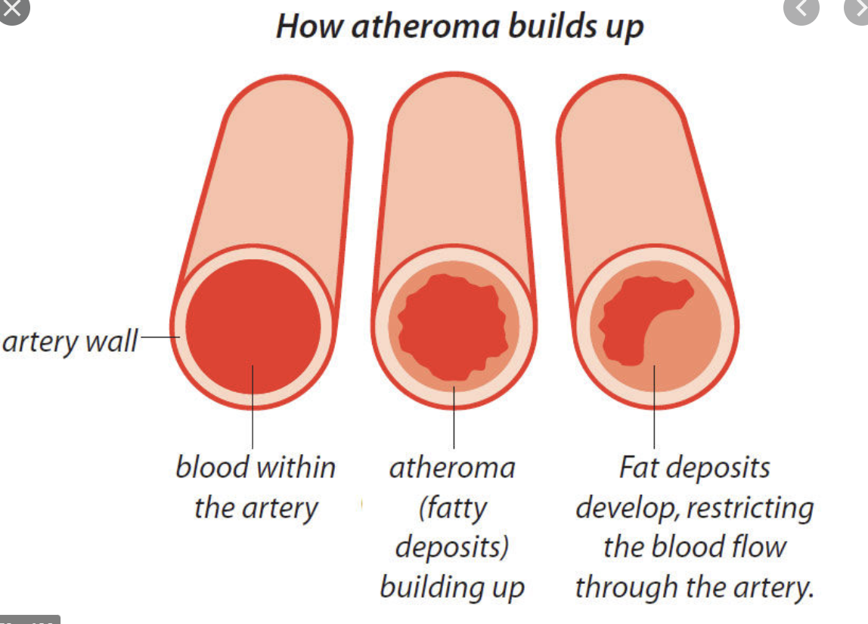

Slide 6
Angina
a type of chest pain caused by reduced blood flow to the heart muscle.
a symptom of coronary artery disease.

Slide 7
Symptoms of angina
chest pain and discomfort, possibly described as pressure, squeezing, burning or fullness.
pain in arms, neck, jaw, shoulder or back.
Others:
Dizziness
Fatigue
Nausea
Shortness of breath
Sweating

Slide 8
Features of anginal pain
Brought on by exertion
Eases with rest
Worse when walking…
in cold weather
up a hill
against the wind

Slide 9
Characteristics of stable angina
Develops when your heart works harder, such as when you exercise or climb stairs
Can usually be predicted and the pain is usually similar to previous types of chest pain you've had
Lasts a short time, perhaps five minutes or less
Disappears sooner if you rest or use your angina medication

Slide 10
Characteristics of unstable angina (a medical emergency)
Occurs even at rest
Is a change in your usual pattern of angina
Is unexpected
Is usually more severe and lasts longer than stable angina, maybe 30 minutes or longer
May not disappear with rest or use of angina medication
Might signal a heart attack

Slide 11
Angina in women
Nausea
Shortness of breath
Abdominal pain
Discomfort in the neck, jaw or back
Stabbing pain instead of chest pressure

Slide 12
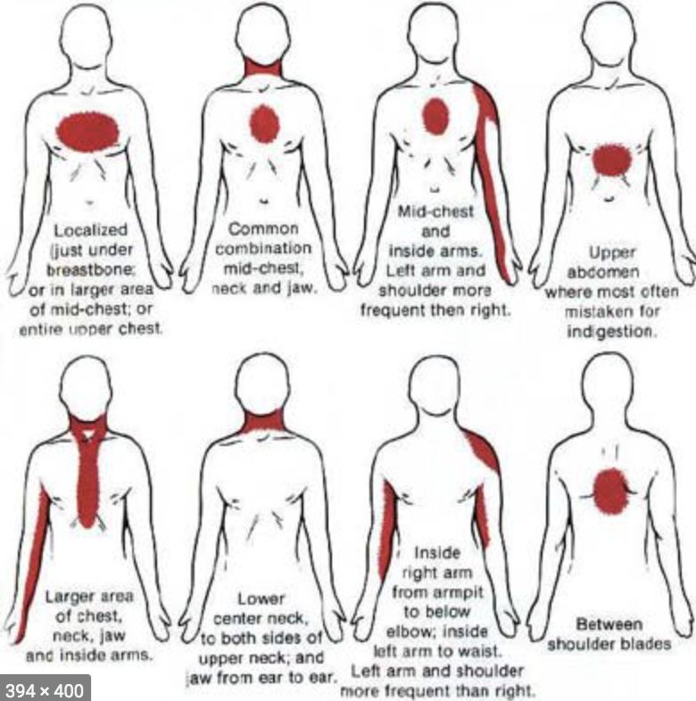

Slide 13
Risk facrtors
Smoking.
Family history of heart disease.
High blood pressure. .
High blood cholesterol or triglyceride levels.
Diabetes.
Older age.
Lack of exercise.
Obesity.
Stress.

Slide 14
Heart attack
Pressure, fullness or a squeezing pain in the centre of your chest that lasts for more than a few minutes
Pain extending beyond your chest to your shoulder, arm, back, or even to your teeth and jaw
Increasing episodes of chest pain
Nausea and vomiting
Prolonged pain in the upper abdomen
Shortness of breath
Sweating
Fainting
Impending sense of doom

Slide 15
mimics
Oesophageal spasm / reflux
Musculoskeletal injury. Neck pain / shoulder pain)
Lung disease (clot)

Slide 16
treatment
Medication
to improve the heart function
to treat high blood pressure
to treat high cholesterol levels
to reduce the risk of clotting (after stenting)
Stress management
Exercise
Quit smoking
Surgery
stenting
bypass surgery

Slide 17
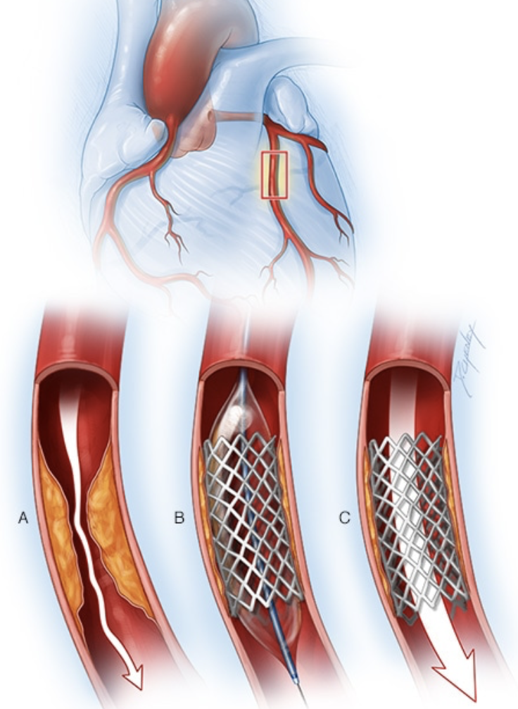

Slide 18
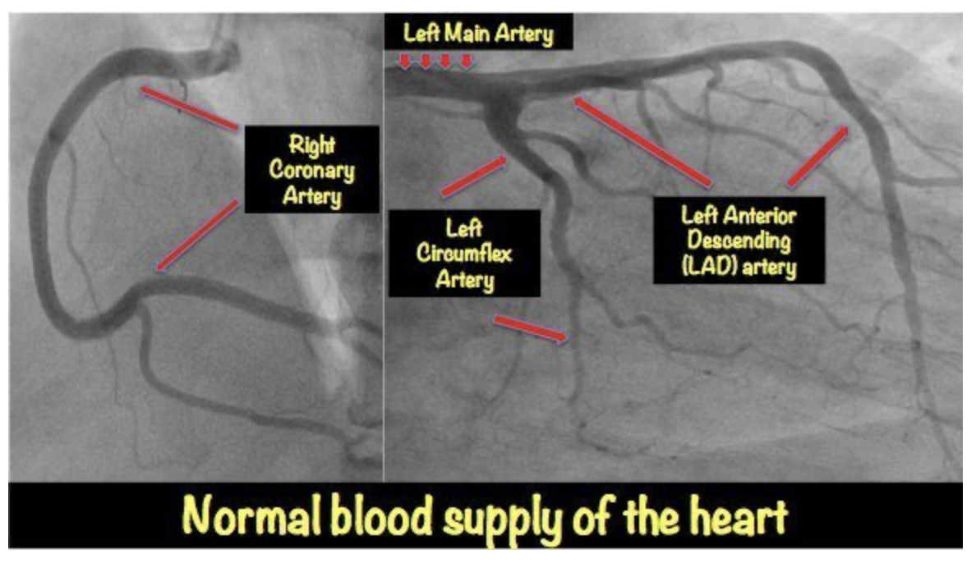

Slide 19
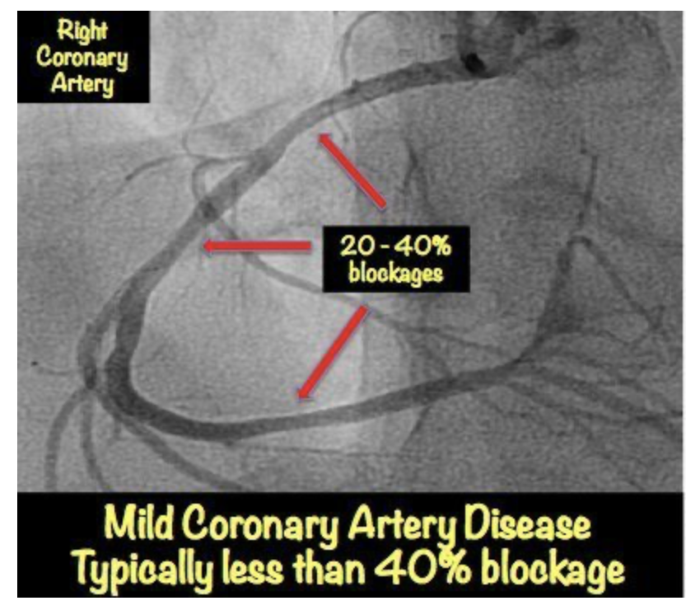

Slide 20
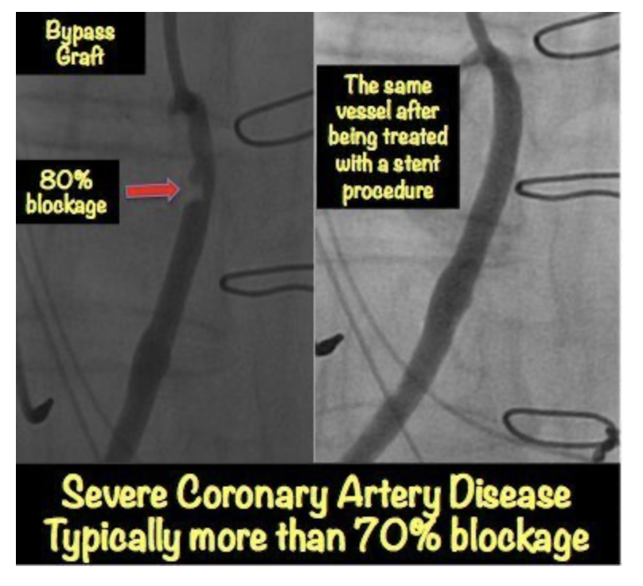

Slide 21
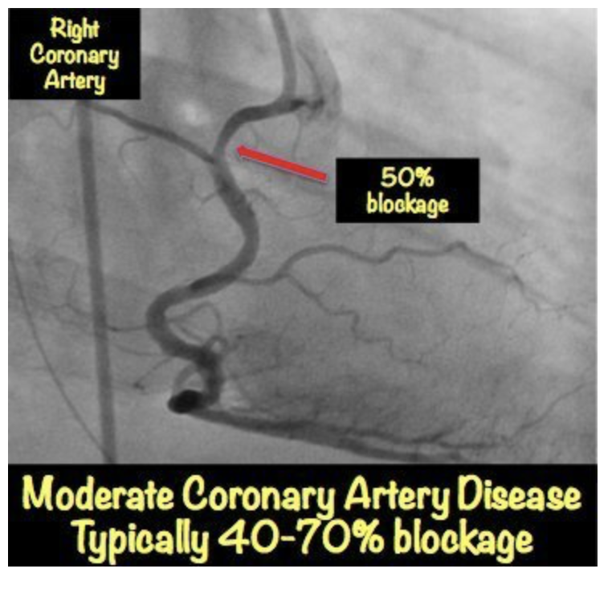

Slide 22
