Slide 1
Wrist and Hand Part 2

Slide 2
Common Conditions
Carpal tunnel syndrome
Guyon canal syndrome
Flexor/Extensor tendon injuries
Colles fracture
What is it? What Causes it?
Risk factors
Symptoms
Treatment

Slide 3
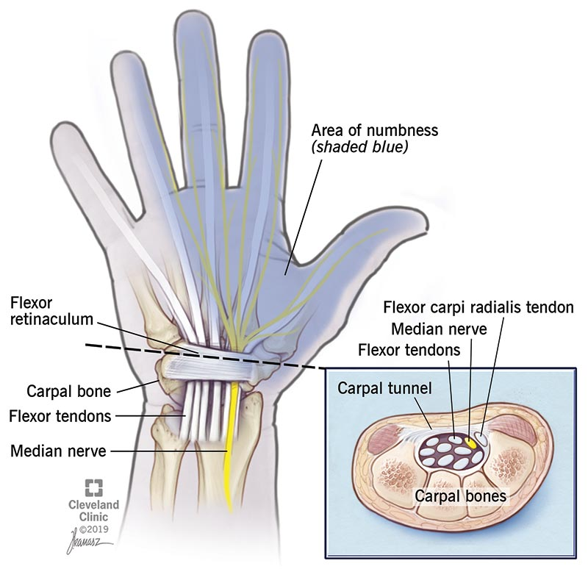
Carpal Tunnel Syndrome
Compression of the median nerve as it passes through the wrist – narrow passageway
Caused by narrowing of tunnel (mechanical, OA) or increase in size of contents (RA, cysts, tumours)
Risk factors: Anatomy/Sex/Inflammatory conditions
Symptoms: Tingling or numbness in some fingers of hand. Weakness in grip, loss of thumb strength. Burning pain, constant pins and needles
Management: Medication – corticosteroid injection, NSAIDs, glucocorticoid
Mild symptoms: activity modification, night splint
Severe symptoms: Surgery decompression – relieve pressure on nerve by cutting through the carpal ligament

Slide 4
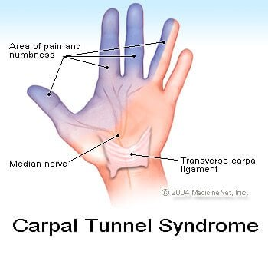
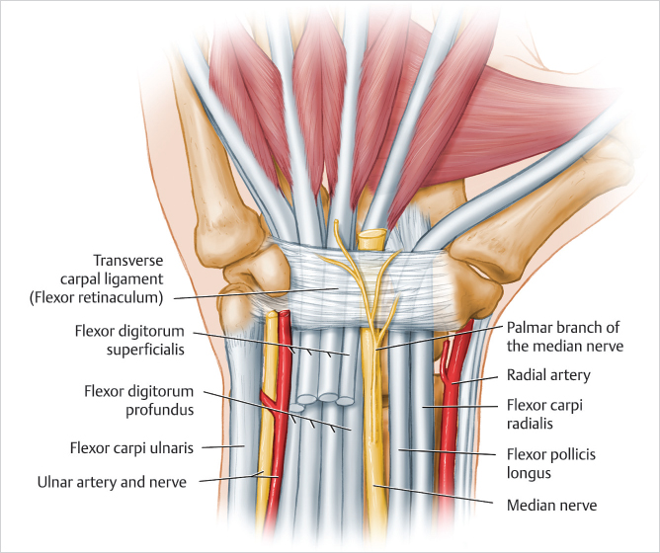

Slide 5
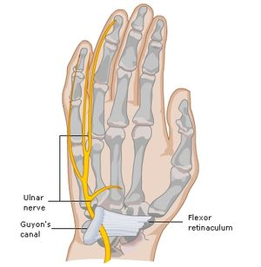
Guyon Canal Syndrome
Very similar to carpal tunnel syndrome although far more rare
Compression on the ulnar nerve
Common in cyclists from pressure on the wrist
Zone 1 – Sensory and motor
Zone 2 – Motor only
Zone 3 – Sensory only
Management – surgical decompression

Slide 6
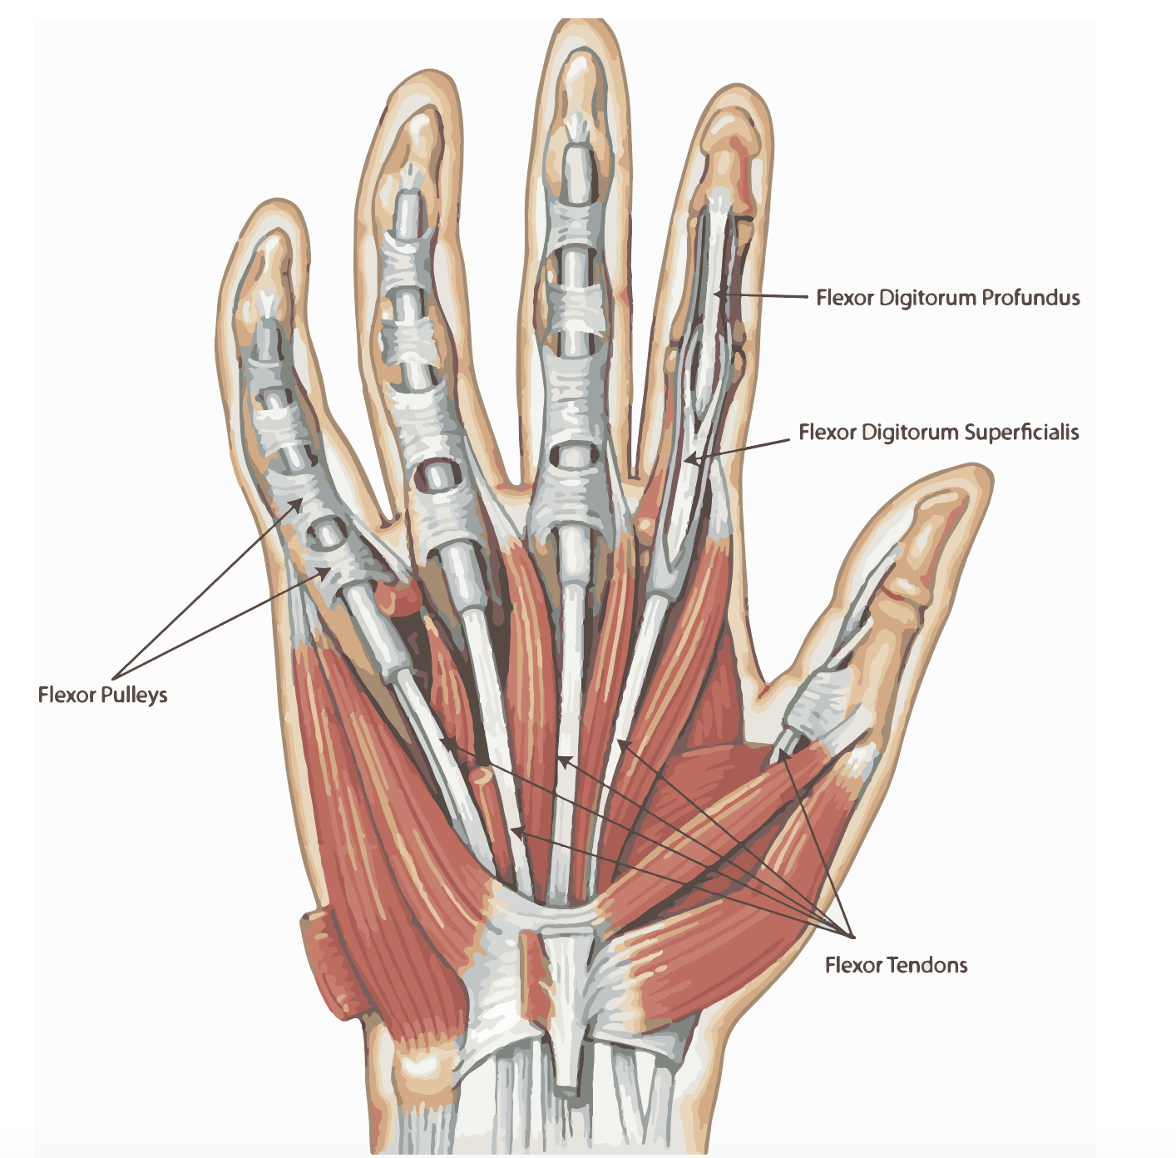
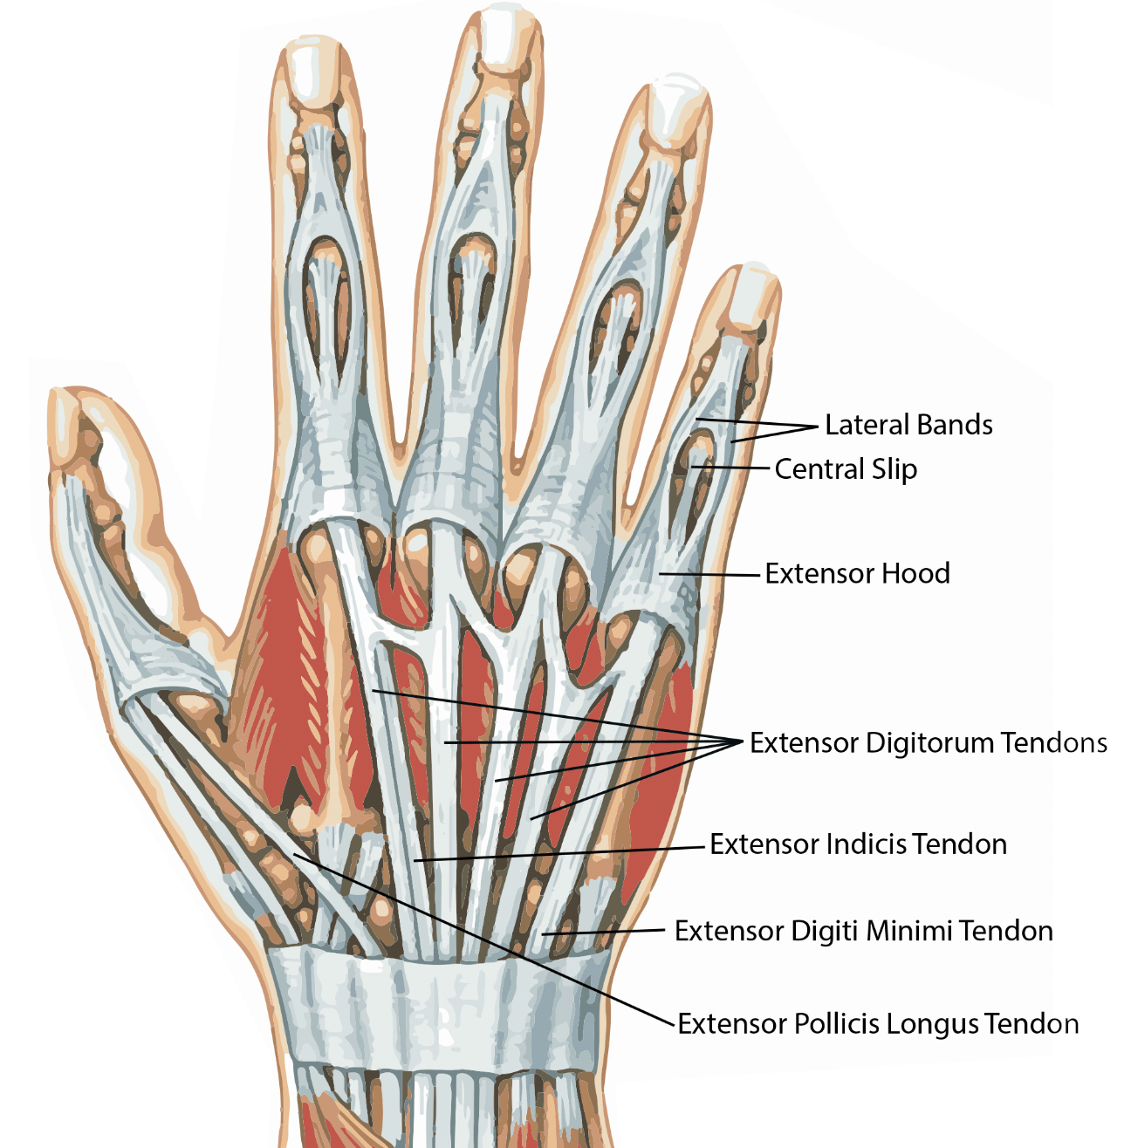
Flexor/Extensor Tendon Injuries
Strong smooth cords that bend and straighten the fingers by connecting the muscles of the forearm and hand to the bones in the fingers and thumb
Usually caused by a cut across the front or back of the wrist, hand or fingers/ Sports injuries / Chronic illness such as RA – muscle more likely to tear
Symptoms: Inability to bend/straighten finger +/- pain / discolouration – blood flow / numbness – nerve damage
Management: Surgical repair – tendon stitched together
Post Op: Splinting, range of movement exercises, strength exercises

Slide 7
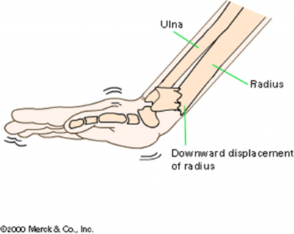
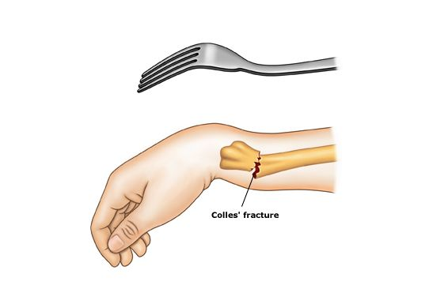
Colle’s Fracture
Fracture of the radius bone in the forearm – ‘broken wrist’
Usually caused by a fall on outstretched arm
Risk factors: Osteoporosis** / Age / Sex / Poor balance
Symptoms: Pain, numbness, tenderness, bruising, deformity of wrist – ‘dinner fork deformity’
Management – depends on severity
Casting / surgical repair
Post op: Scar management, swelling, pain, stifnness, range of movement, strength, function

