Slide 1
Atrila Fibrillation
The signals in the upper chambers of the heart are chaotic. As a result, the upper chambers shake (quiver).
The AV node is then bombarded with signals trying to get through to the lower heart chambers (ventricles).
This causes a fast and irregular heart rhythm.
The heart rate in atrial fibrillation may range from 100 to 175 beats a minute.
The normal range for a heart rate is 60 to 100 beats a minute.

Slide 2
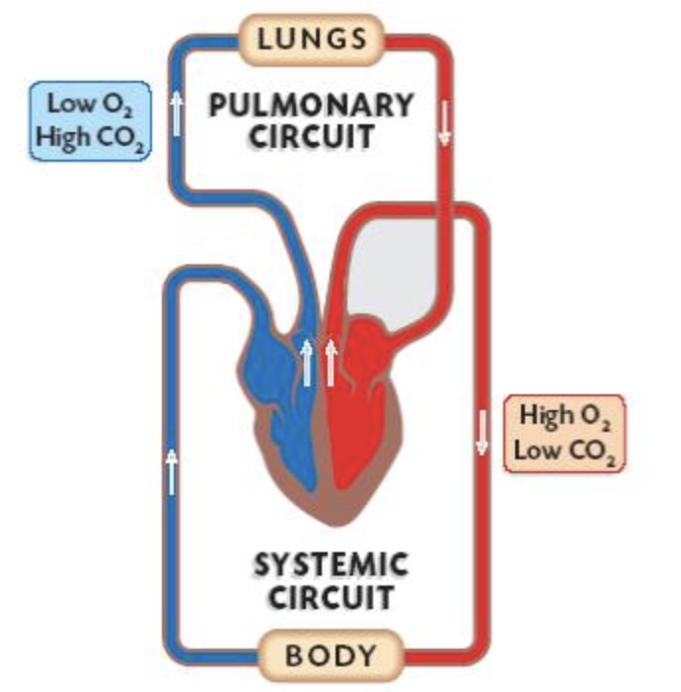

Slide 3
Regular Heart Rhythm
The signal travels from the sinus node through the two upper heart chambers (atria).
The signal passes through a pathway between the upper and lower chambers called the atrioventricular (AV) node.
The movement of the signal causes your heart to squeeze (contract), sending blood to your heart and body.

Slide 4
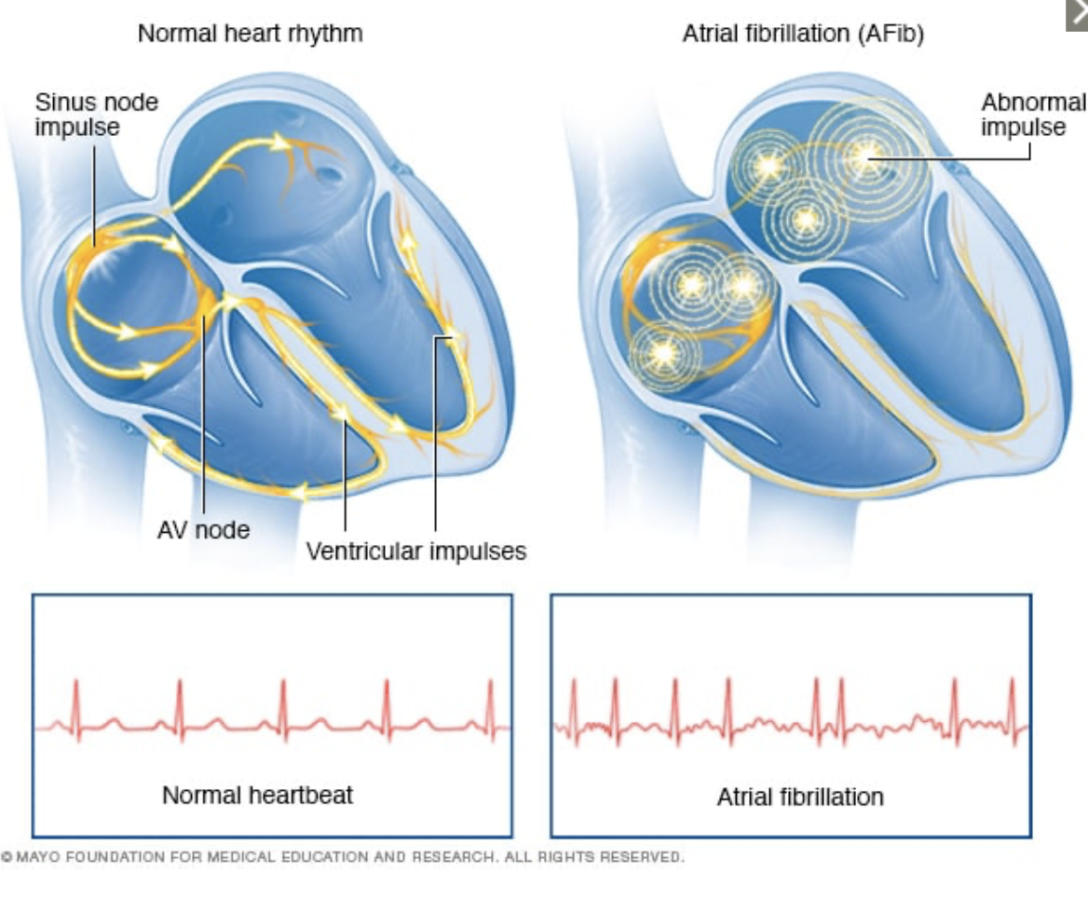

Slide 5
Prevalence
2.3% in people older than 40 years
5.9% in those older than 65 years.
Approximately 70% of individuals with AF are between 65 and 85 years of age.
The absolute number of men and women with AF is about equal.
After age 75 years, about 60% of the people with AF are women.

Slide 6
Symptoms
Sensations of a fast, fluttering or pounding heartbeat (palpitations)
Chest pain
Dizziness
Fatigue
Lightheadedness
Reduced ability to exercise
Shortness of breath
Weakness

Slide 7
Types of A Fib
Occasional (paroxysmal atrial fibrillation). symptoms come and go, usually lasting for a few minutes to hours.. Symptoms might go away on their own. Some people with occasional A-fib need treatment.
Persistent. With this type of atrial fibrillation, the heart rhythm doesn't go back to normal on its own. cardioversion or treatment with medications may necessary.
Long-standing persistent. This type of atrial fibrillation is continuous and lasts longer than 12 months.
Permanent. In this type of atrial fibrillation, the irregular heart rhythm can't be restored. Medications are needed to control the heart rate and to prevent blood clots.

Slide 8
Causes
Coronary artery disease
Heart attack
Heart defect that you're born with (congenital heart defect)
Heart valve problems
High blood pressure
Lung diseases
Physical stress surgery, pneumonia or other illnesses
Previous heart surgery
Problem with the heart's natural pacemaker (sick sinus syndrome)
Sleep apnea
Thyroid disease
Use of stimulants, incl certain medications, caffeine, tobacco and alcohol
Viral infections

Slide 9
Risk factors
Age. The older a person is, the greater the risk of developing atrial fibrillation.
Heart disease. heart valve problems, congenital heart disease, congestive heart failure, coronary artery disease, or a history of heart attack or heart surgery
High blood pressure. Having high blood pressure, especially if it's not well controlled.
Thyroid disease. In some people, thyroid problems may trigger heart rhythm problems (arrhythmias), including atrial fibrillation.
Other chronic health conditions. People with certain chronic conditions such as diabetes, metabolic syndrome, chronic kidney disease, lung disease or sleep apnea have an increased risk of atrial fibrillation.
Drinking alcohol. For some people, drinking alcohol can trigger an episode of atrial fibrillation. Binge drinking further increases the risk.
Obesity. People who have obesity are at higher risk of developing atrial fibrillation.
Family history. An increased risk of atrial fibrillation occurs in some families.
Prolonged intense athletic activity over years

Slide 10
Complications
Blood clots are a dangerous complication of atrial fibrillation that can lead to stroke.
In atrial fibrillation, the chaotic heart rhythm can cause blood to collect in the heart's upper chambers (atria) and form clots. If a blood clot in the left upper chamber (left atrium) breaks free from the heart area, it can travel to the brain and cause a stroke.
The risk of stroke from atrial fibrillation increases as you grow older. Other health conditions also may increase your risk of a stroke due to A-fib, including:
High blood pressure
Diabetes
Heart failure
Some valvular heart disease

Slide 11
Prevention
Eat a nutritious diet
Get regular exercise and maintain a healthy weight
Don't smoke
Avoid or limit alcohol and caffeine
Manage stress, as intense stress and anger can cause heart rhythm problems

Slide 12
Treatment
Treat the underlying condition
Blood thinners
Ablation

